Slide 1
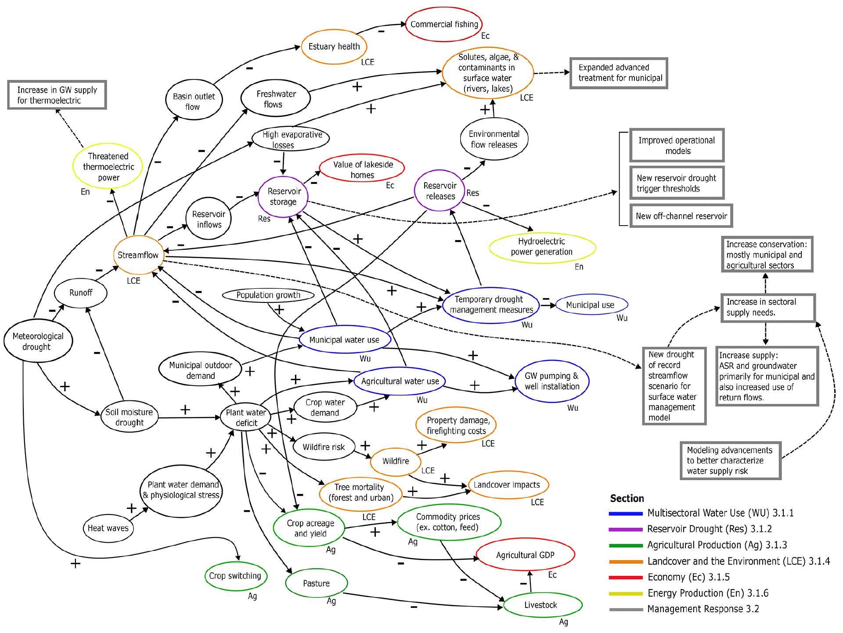
Drought's Impact on Texas' Colorado Basin: A Multisectoral Study
Objective
Examine the multisectoral impacts and adaptive responses to the 2008–2015 drought in the Colorado Basin, Texas, to improve our understanding of future vulnerabilities and strategies for mitigating the effects of extreme drought conditions.
Approach
Analyze high-quality data from nine local, state, and federal sources to characterize regional multisector dynamics, focusing on water security challenges such as groundwater depletion, resource competition, and limited reservoir expansion.
Employ a comprehensive review of grey literature and regional water management plans to assess the breadth of multisectoral impacts and adaptive management responses, including the use of interviews with subject matter experts.
Utilize an influence diagram to summarize and visualize the causal relationships and multisectoral interactions during the drought, highlighting the connections between meteorological drought, reservoir drought, and sectoral impacts.
Impact
Despite severe hydrometeorological conditions, the Colorado Basin's advanced economy and existing water infrastructure effectively mitigate economic and societal impacts during the 2008–2015 drought.
Agricultural production suffers significantly, with a 56% reduction in GDP in 2011, highlighting the vulnerability of the sector to extreme drought conditions.
The drought analyzed prompted substantial changes in water management, including a nearly 300% increase in planned municipal water supply for the lower region and the introduction of new supply strategies such as aquifer storage and recovery.
This influence diagram visually demonstrates how different sectors, such as agriculture, water supply, and the environment, are interlinked and affected by drought conditions. It also highlights the management strategies implemented to mitigate these impacts, providing valuable insights into the broader implications of drought on the Colorado Basin from 2008 to 2015.
Ferencz, Stephen B., Ning Sun, Sean W. D. Turner, Brian A. Smith, and Jennie S. Rice. 2024. Multisectoral Analysis of Drought Impacts and Management Responses to the 2008–2015 Record Drought in the Colorado Basin, Texas. Natural Hazards and Earth System Sciences 24: 1871–1896. https://doi.org/10.5194/nhess-24-1871-2024.
First draft generated using PAIGE, the Pnnl AI assistant for GEnerating publication highlights

