Slide 1
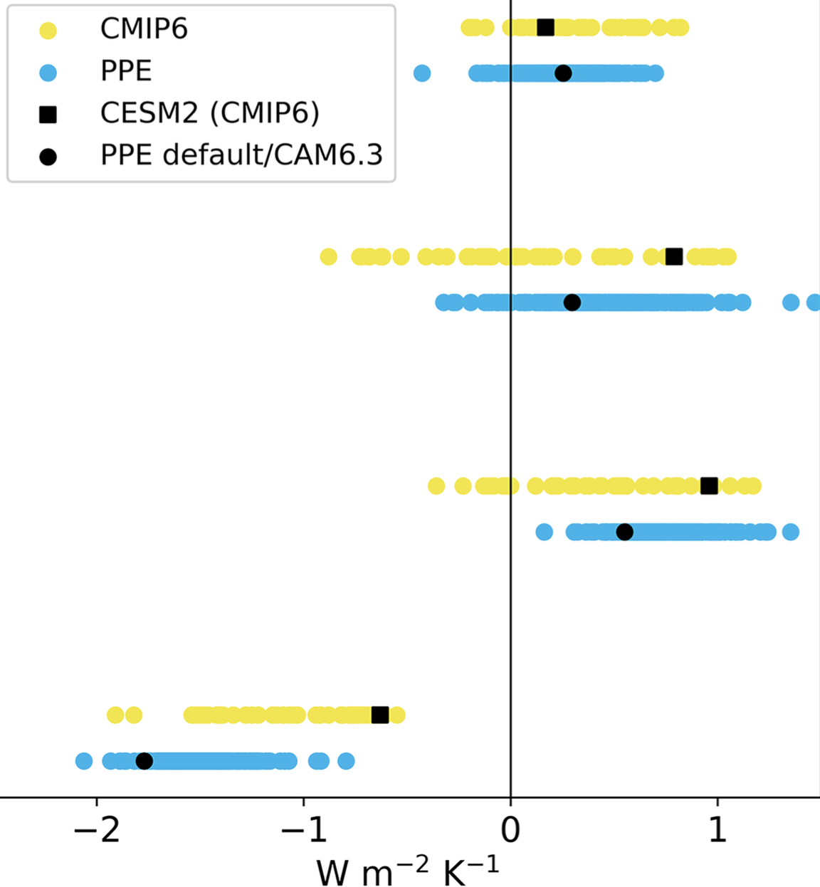
Perturbing Parameters to Understand Cloud Contributions to Climate Change
Margaret L. Duffy, Brian Medeiros, Andrew Gettelman, and Trude Eidhammer:
Journal of Climate (2024) doi: 10.1175/JCLI-D-23-0250.1
Longwave cloud feedback
OBJECTIVE
Quantify the role of parametric uncertainty in setting a climate model’s climate feedbacks and sensitivity.
Shortwave cloud feedback
APPROACH
Use a perturbed parameter ensemble with CAM6. By varying 45 parameters over 262 simulations for present-day and uniform SST warming conditions, calculate feedbacks using cloud radiative kernels. Compare with CMIP results.
Net cloud feedback
IMPACT
Parametric uncertainty can produce spread within one model that is comparable to the multi-model ensemble spread. High-cloud feedbacks, however, appear larger in this model than expected. This work shows how both parametric choices and structural details impact a models climate response.
Total feedback
Spread in global mean feedback across CMIP6 models (yellow) and the CAM6 PPE (blue). Black square shows CESM2 within CMIP6. Black circle shows the default parameter values for CAM6.

