Slide 1
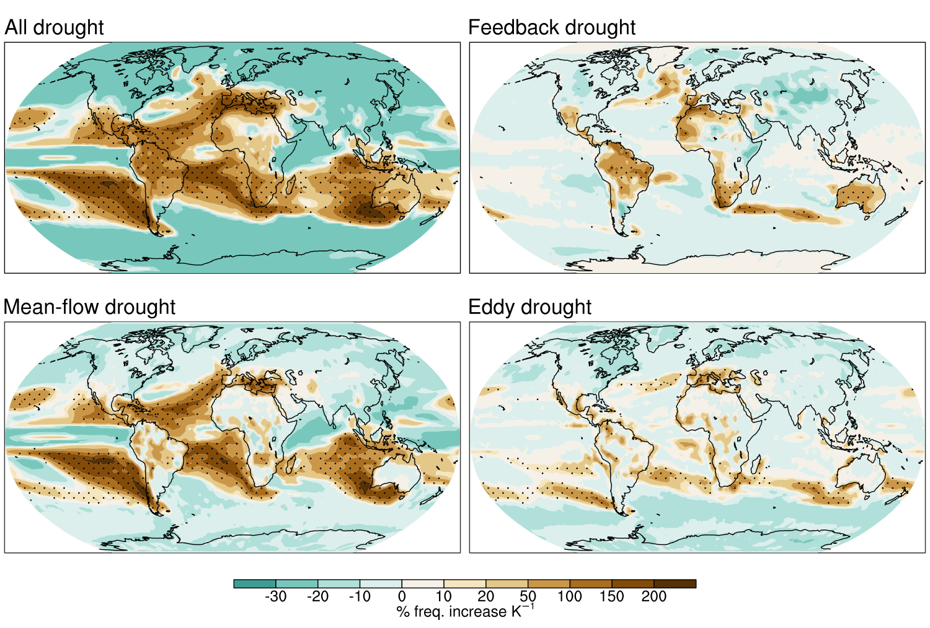
Mechanisms of global drought intensification in the 21st Century
Scientific Challenge
Increases of meteorological drought through the 21st Century are uncertain due to differing projections across global climate models. These differing projections may arise from disagreements in various physical mechanisms which have not yet been elucidated.
Approach and Findings
We use multiple large ensembles of global climate models to project the future increase in frequency of droughts that are rare in the historical climate. Then, we decompose the atmospheric moisture budget to identify the mechanisms by which the increases occur. We find that droughts associated with land–atmosphere feedbacks are those with the greatest increases in the future. However, there is large disagreement between models, particularly over the Amazon and Australia, due to their differing treatment of the land–atmosphere feedbacks.
Figure
Significance and Impact
By analyzing the mechanisms by which drought is delivered, we develop a superior understanding of the reliability of future drought projections across models. This informs us of where drought projections are most uncertain and why.
The multi-model-mean increase of drought frequency by end-of-century. The increases are broken down into increases of “feedback droughts” (those exacerbated by land–atmosphere feedbacks); “mean-flow droughts” (a lack of precipitation from stationary weather patterns); and “eddy droughts” (a lack of precipitation from transient weather systems).
Norris, J., Chen, D., Hall, A., & Thackeray, C. W. (2022). Moisture-budget drivers of global projections of meteorological drought from multiple GCM large ensembles. Journal of Geophysical Research: Atmospheres, 127, e2022JD037745. https://doi.org/10.1029/2022JD037745
Department of Energy • Office of Science • Biological and Environmental Research
Notes:
Word highlight text here.

