Slide 1
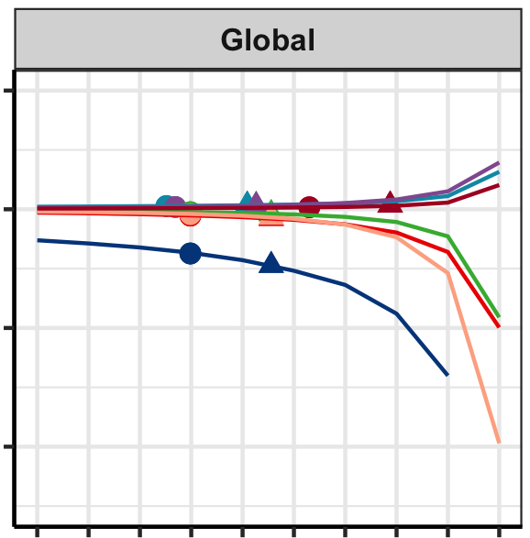
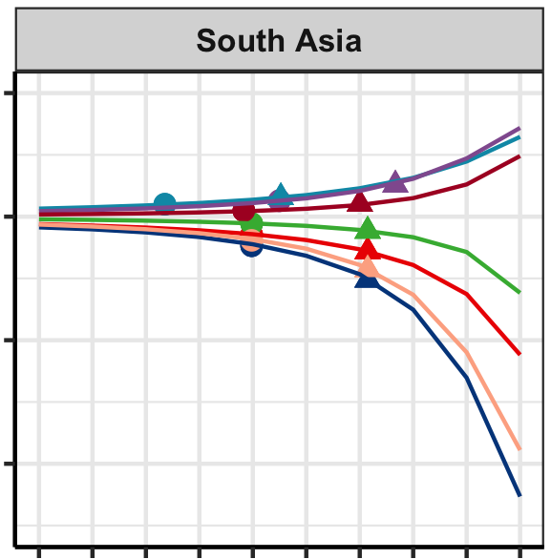

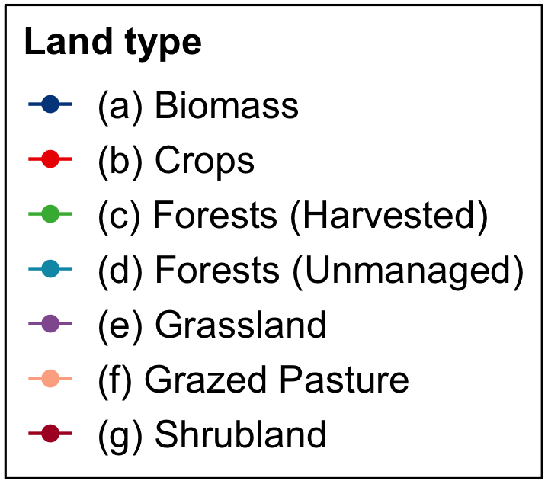
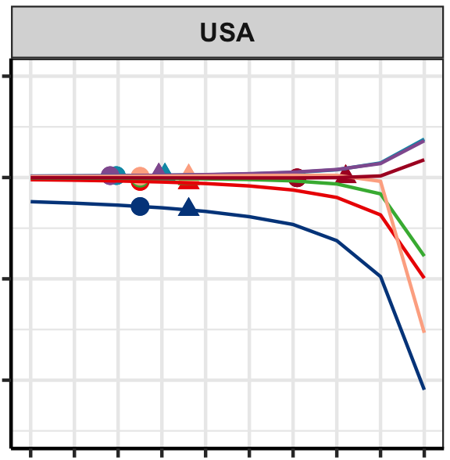
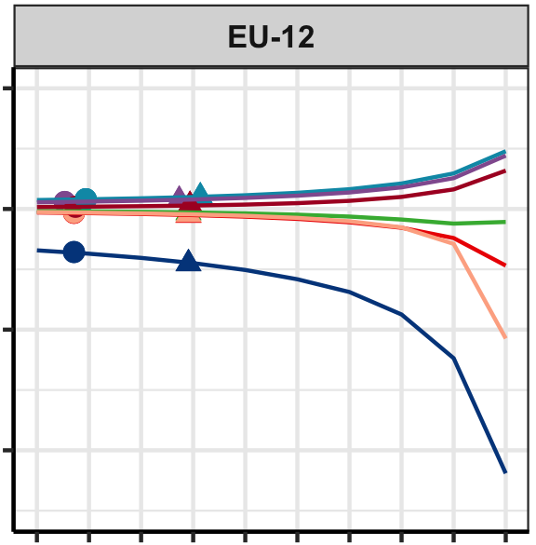

Doubling Protected Land Area Globally Could Cause Substantial Regional Shifts in Land Use
Cropland: -3.2%
Cropland: -16%
Objective
Apply new, spatially explicit land suitability and land protection data to the Global Change Analysis Model (GCAM) to estimate the effects of additional land protection on future land use and land cover.
Approach
Add spatially explicit data of currently protected land and agriculturally suitable land to the Moirai land data system as input to GCAM.
Perform sensitivity analysis with GCAM to determine how land use/cover may change with decreasing land availability.
Assess the potential effects of doubling global protected area from its current assumption by meeting 30% protected area assumptions both regionally and globally.
Impact
This study shows the importance of representing the spatial distribution of land availability on land use and land cover projections and their dynamic inter-regional interactions.
In these scenarios, protecting 30% of all land reduced land conversion to agriculture by 2050 by less than 50% of the newly protected area because large amounts of unprotected land are still available in many regions.
From this study, doubling protected land to 30% reduced the extent of global cropland and global bioenergy feedstock land by just 3.2 % and 10%, respectively, in 2050 compared to the default land availability.
Bioenergy feedstock: -10%
Bioenergy feedstock: -29%
16% reduction in available land
22% reduction in available land
Marginal change in land type area (%)
Cropland: -1.7%
Cropland: -2.0%
Bioenergy feedstock: -2.6%
Bioenergy feedstock: -5.2%
11% reduction in available land
22% reduction in available land
Percent of convertible land available after a 10% decrease
An example of regional variability in the effects of doubling global protected area. Marginal changes in 2050 land area are observed with each 10% decrease in land availability. Moving from the circle (availability: suitable land plus default protection) to the triangle represents the change in respective land type area under 30% land protection. Annotations list the associated changes in land type areas from the current state to the 30% protected area assumption.
A.V. Di Vittorio, K. B. Narayan, P. Patel, K. Calvin, and C. R. Vernon. “Doubling protected land area may be inefficient at preserving the extent of undeveloped land and could cause substantial regional shifts in land use.” Global Change Biology - Bioenergy 00, 1-23 (2023). [DOI: 10.1111/gcbb.13016]
Notes:
http://www.pnnl.gov/science/highlights/highlights.asp?division=749

