Slide 1
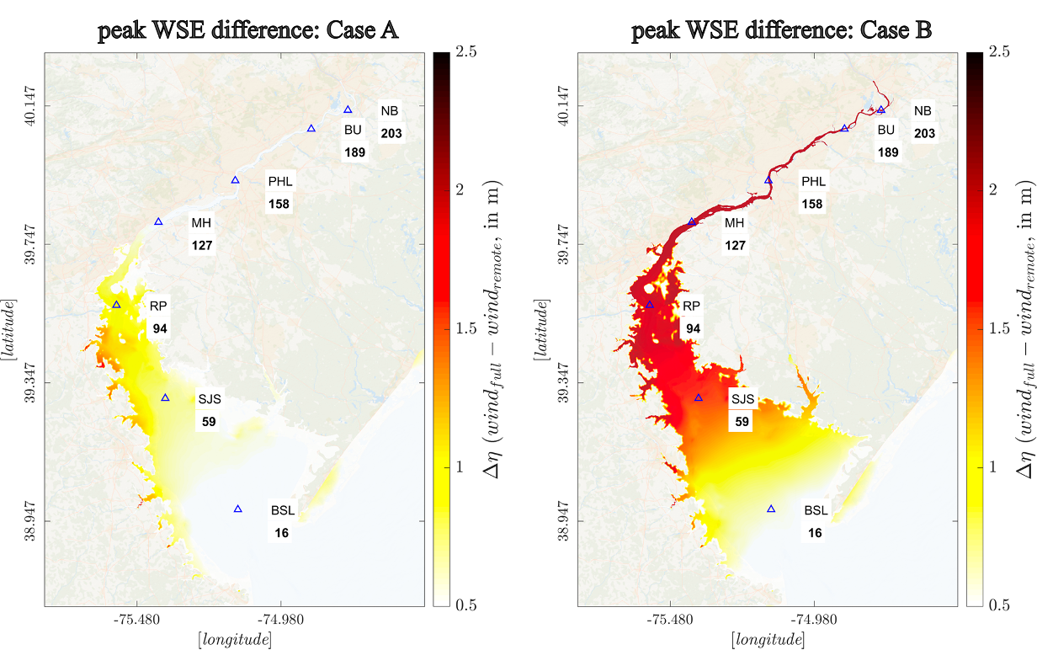
Hurricane Landfalling Winds Can Amplify Flood Hazard in Estuarine Systems
Objective
Examine the impact of estuarine wind fields on amplifying surge-driven flood water levels in converging systems during hurricane landfalls.
Approach
Integrate a regionally refined atmospheric model with high-resolution hydrology and ocean models to simulate ensembles of hurricane events and associated flooding in Delaware Bay and River.
Employ the Energy Exascale Earth System Model (E3SM) to generate Irene-like hurricane tracks, which perturbs model physics parameters to account for uncertainties in model simulated atmospheric conditions during the event.
Couple the Distributed Hydrology Soil Vegetation Model (DHSVM) and Finite Volume Community Ocean Model (FVCOM) to estuary and coastal water levels, incorporating atmospheric, fluvial, and coastal processes.
Impact
Inland-bound hurricane tracks that make landfall before reaching the mid-Atlantic coast produce significantly higher storm surges within Delaware Bay than shore-parallel tracks.
Hurricane landfalling wind direction plays a crucial role in amplifying flood water levels, with up-channel winds causing a 150% increase (2.5 meters) in peak water level in the Delaware River.
Integrated atmospheric-fluvial-coastal modeling reveals that even non-catastrophic offshore surges can lead to record flooding if estuarine winds align with surge direction, emphasizing the need for physics-based high-resolution models in coastal flood risk assessments.
The figure illustrates the increase in peak water surface elevations (WSE; in meters) driven by the hurricane's landfalling wind field for two scenarios. Case A represents a scenario in which the landfalling wind direction (over the bay surface) opposes the storm surge direction, and in Case B, they align in a similar direction.
Deb, Mithun, James J. Benedict, Ning Sun, Zhaoqing Yang, Robert D. Hetland, David Judi, and Taiping Wang. 2024. Estuarine Hurricane Wind Can Intensify Surge-Dominated Extreme Water Level in Shallow and Converging Coastal Systems. Natural Hazards and Earth System Sciences 24: 2461–2479. https://doi.org/10.5194/nhess-24-2461-2024.
First draft generated using PAIGE, the Pnnl AI assistant for GEnerating publication highlights

