Slide 1
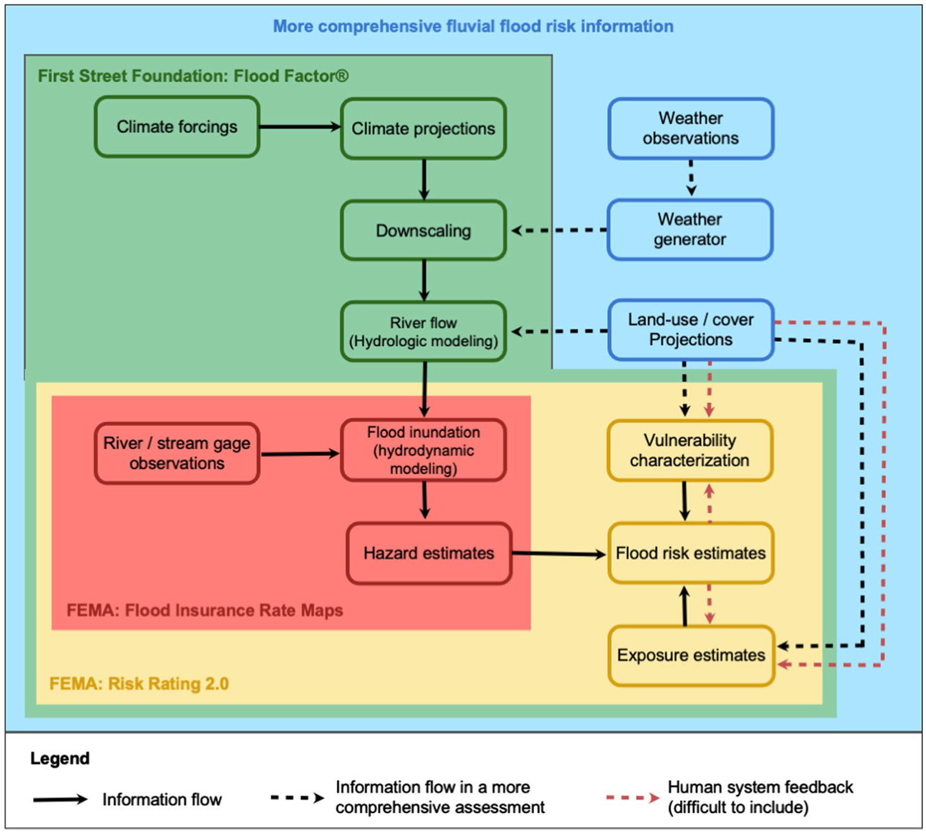
Navigating the Complexities of Flood-Risk Information Design
Objective
Assess design features and risk communication approaches to create more actionable flood-risk information.
Approach
Analyze current methods to produce household-scale fluvial flood-risk information in the United States.
Identify design features and communication approaches that can improve decision-making.
Impact
Designing flood-risk information for property-scale adaptation poses nontrivial conceptual and operational challenges due to deep uncertainties and complex dynamics.
Improved uncertainty characterization and model diagnostics can inform simpler designs that enhance the usability of flood-risk information.
Our findings underscore the need for integrated, transparent, and regionally tailored flood-risk information to better guide adaptation decisions and policy-making.
Summary of key components that influence quantitative estimates of flood risks and how these components are considered in a subset of current approaches (from Cooper et al, 2022, open access)
Cooper, C. M., Sharma, S., Nicholas, R. E., and Keller, K. 2022. Toward More Actionable Flood-Risk Information. Earth's Future 10: e2022EF003093. https://doi.org/10.1029/2022EF003093.
Edited text of a draft generated using PAIGE, the PNNL AI assistant for GEnerating publication highlights

