Slide 1
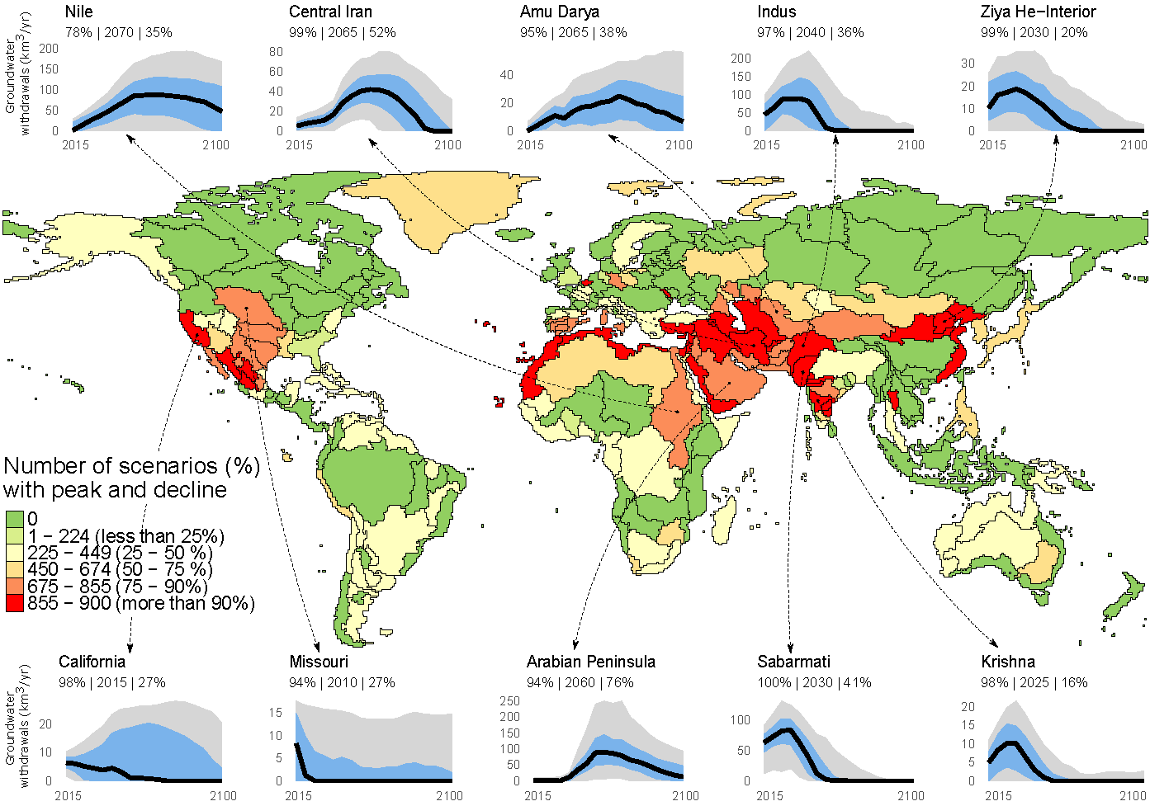
Groundwater Withdrawals Peak Globally over the 21st Century
Objective
To understand how groundwater extraction might evolve over the remainder of the 21st century across a range of global change scenarios.
Approach
We used the Global Change Analysis Model (GCAM) to simulate groundwater withdrawals over the 21st century across 235 water basins. We ran GCAM for 900 scenarios covering a wide range of uncertain future human and Earth system drivers and interactions, including both supply side (e.g., climate impacts on surface water) and demand side (e.g., socioeconomic change) factors.
Impact
We find that global non-renewable groundwater withdrawals exhibit a distinct peak-and-decline signature, comparable to historical observations of other depletable resources (e.g., minerals), in nearly all (98%) scenarios, peaking around mid-century, followed by a decline through 2100.
The peak and decline occur in about one-third (82) of global river basins, including 21 that may have already peaked, exposing about half (44%) of the global population to groundwater stress.
Basins that peak and decline will probably face increasing costs of groundwater and food production, suggesting important implications for global agricultural trade. Overall, our results suggest a diminished role for groundwater in meeting global water demands during the 21st century.
Over the 900 GCAM scenarios exploring uncertain future drivers, groundwater withdrawals in about one-third of the water basins show a high probability of peaking and declining over the 21st century. These basins will see higher water prices, decreased crop production, and increased reliance on trade.
Niazi, H., Wild, T.B., Turner, S.W.D., Graham, N.T., Hejazi, M., Msangi, S., Kim, S., Lamontagne, J.R., & Zhao, M. (2024). Global peak water limit of future groundwater withdrawals. Nature Sustainability, 7(4), 413–422. https://doi.org/10.1038/s41893-024-01306-w
Notes:
http://www.pnnl.gov/science/highlights/highlights.asp?division=749

