Slide 1
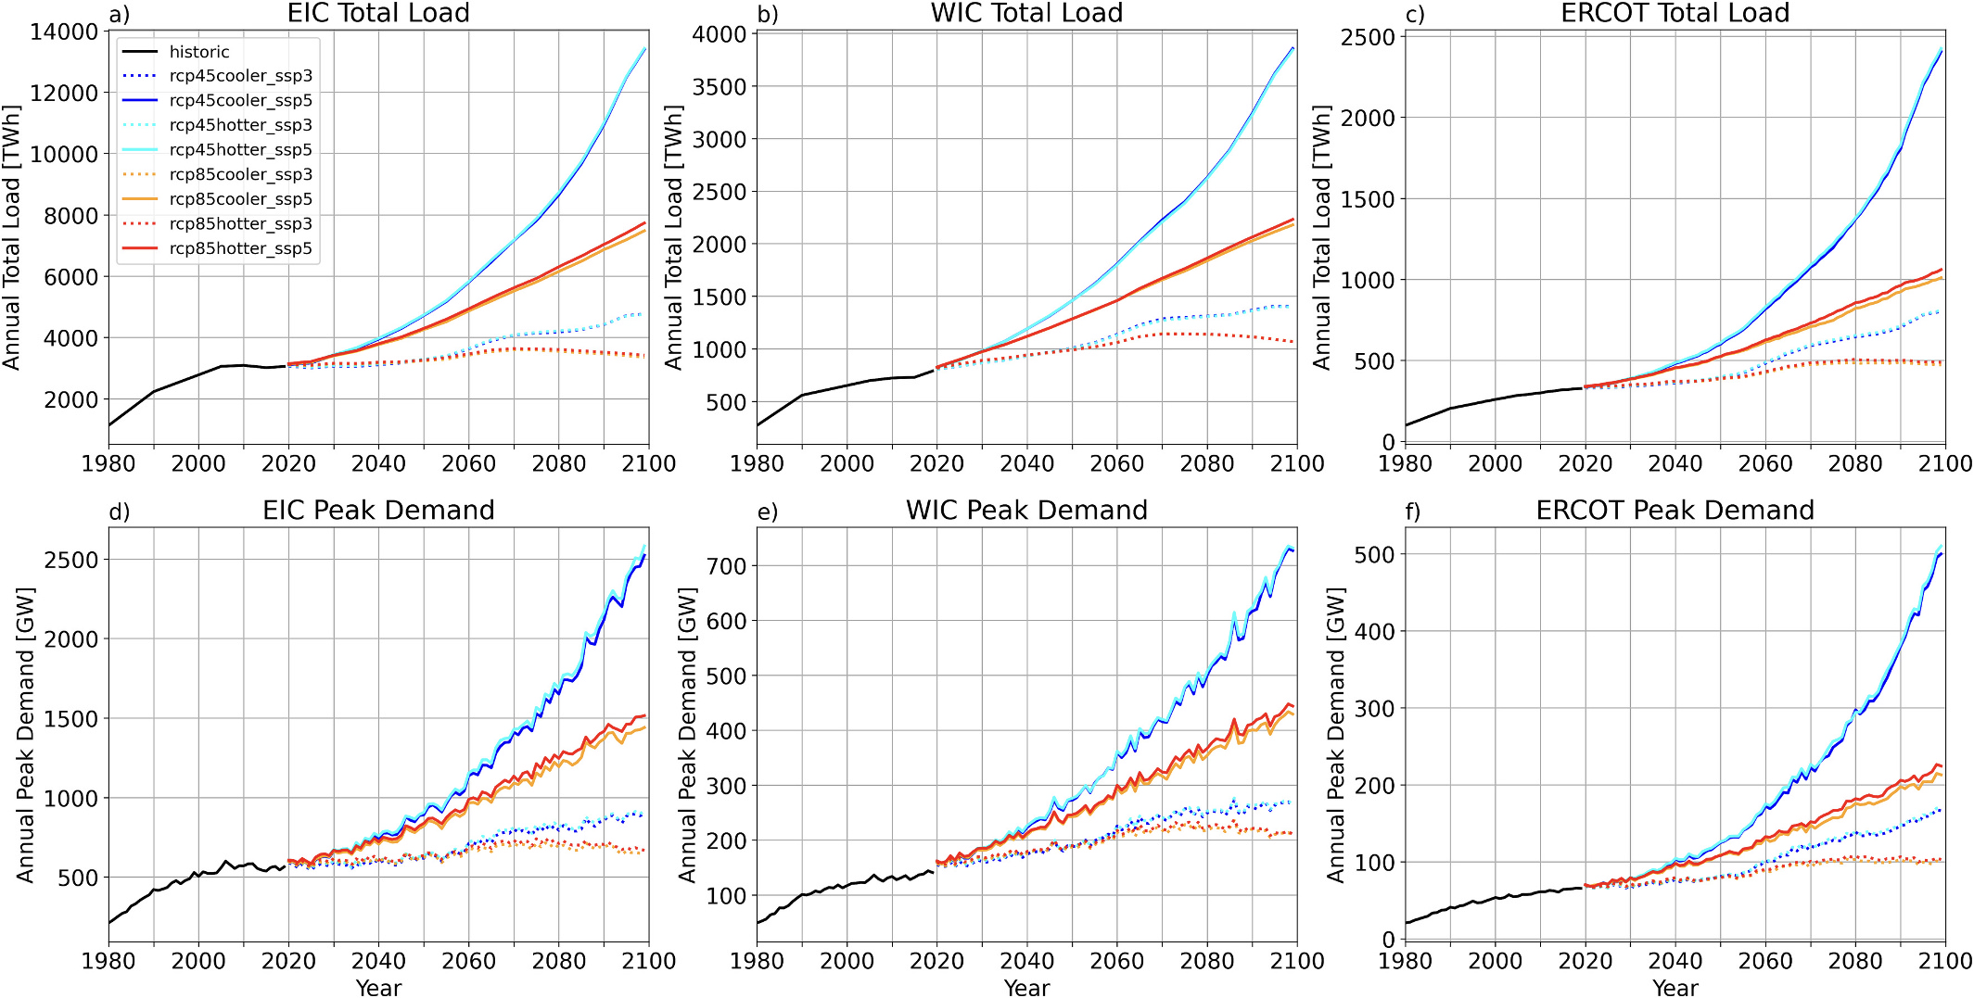
Diverging Electricity Demand Scenarios Highlight Socioeconomic Impact Timing
Objective
Quantify if and when projected U.S. electricity demands within each of the three major electricity interconnections diverge significantly due to socioeconomic versus future climate uncertainties.
Approach
Implement a multi-model framework using GCAM-USA (multisector dynamics integrated analysis model) and TELL (ML-based electricity load model) to generate high-resolution, hourly electricity demand projections across eight scenarios that capture a wide range of socioeconomic, climate, and climate model uncertainties.
Socioeconomic scenarios are based on the Shared Socioeconomic Pathways (SSP) 3 and 5, representing low versus high population and economic growth in the U.S. Future climate spans Representative Concentration Pathway (RCP) 4.5 to RCP 8.5, and uncertainty in the climate projections is based on structural uncertainty in the Climate Model Intercomparison Project 6 (CMIP6) archive.
Conduct pairwise scenario comparisons to isolate the effects of socioeconomic, climate, and climate model uncertainties on electricity demand projections, enabling a detailed analysis of divergence timing.
This figure demonstrates the divergence in electricity demand projections over time across eight scenarios in each of the three major U.S. electricity interconnections: the Eastern Interconnection (EIC), the Western Interconnection (WIC) and the Electric Reliability Council of Texas (ERCOT). Historical and projected trends in annual total load and peak demand are shown.
Impact
Socioeconomic scenario uncertainty leads to significant divergence in electricity demand projections within the first 10 years, with SSP5 scenarios showing 5–15% higher loads by 2030 compared to SSP3.
Climate scenario impacts on electricity demand, driven by decarbonization and electrification in RCP 4.5, become relevant after mid-century, with average load differences not exceeding 5% until then.
Climate model uncertainty impacts are minimal, with mean differences barely exceeding 4% by 2090, indicating that the choice of hotter or cooler models matters only after 50+ years.
Burleyson, Casey D., Zarrar Khan, Misha Kulshresta, Nathalie Voisin, Mengqi Zhao, and Jennie S. Rice. 2025. When Do Different Scenarios of Projected Electricity Demand Start to Meaningfully Diverge? Applied Energy 380: 124948. https://doi.org/10.1016/j.apenergy.2024.124948.
First draft generated using PAIGE, the Pnnl AI assistant for GEnerating publication highlights

