Slide 1
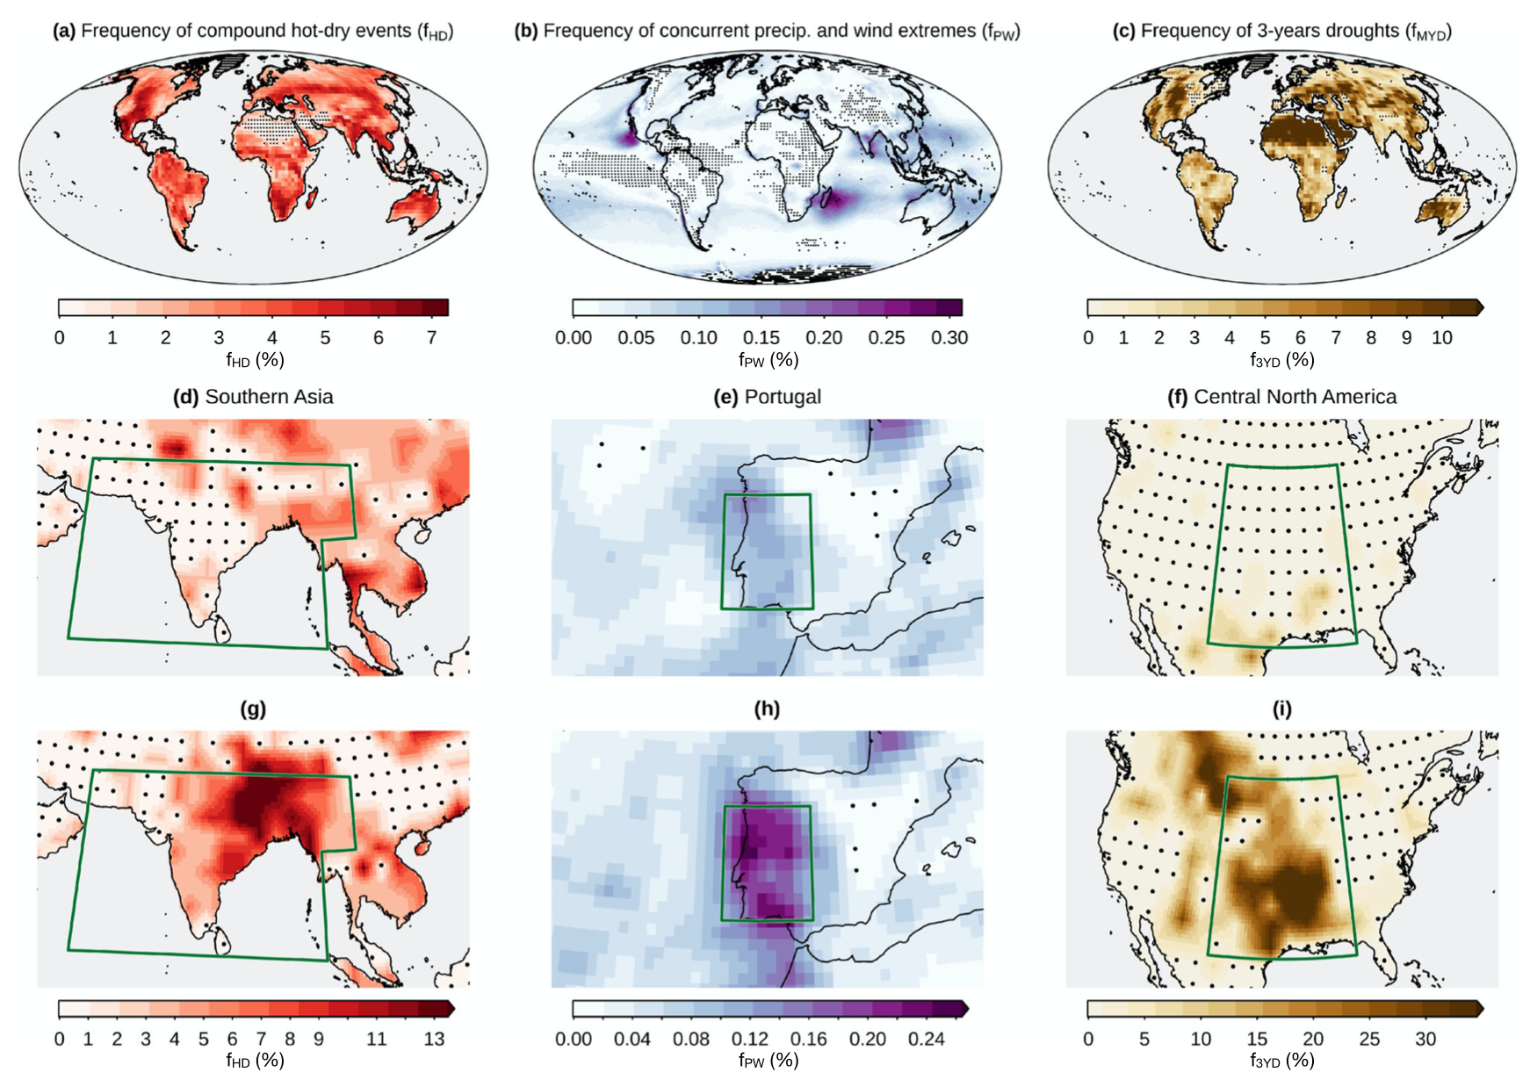
Advancing research on compound weather and climate events via large ensemble model simulations
Bevacqua, E., L. Suarez-Gutierrez, A. Jézéquel, F. Lehner, M. Vrac, P. Yiou, J. Zscheischler:
Nature Communications (2023) doi:10.1038/s41467-023-37847-5
OBJECTIVE
Review outstanding issues in compound event research and how climate model large ensembles can help address them.
APPROACH
We use a collection of large ensembles to present six different compound event case studies that illustrate the benefit and limitations of large ensembles, from precipitation-wind extremes to temporally compounding crop failures in bread basket regions.
IMPACT
Compound events are increasingly recognized as particularly damaging extreme events. Studying their change under warming is thus urgent, yet complicated by limited sample size in observations. Large ensembles can help reduce projection uncertainties or serve as test beds to better quantify uncertainties and develop statistical methods. We expect this paper to be an important reference for the compound event community moving forward.

