Slide 1
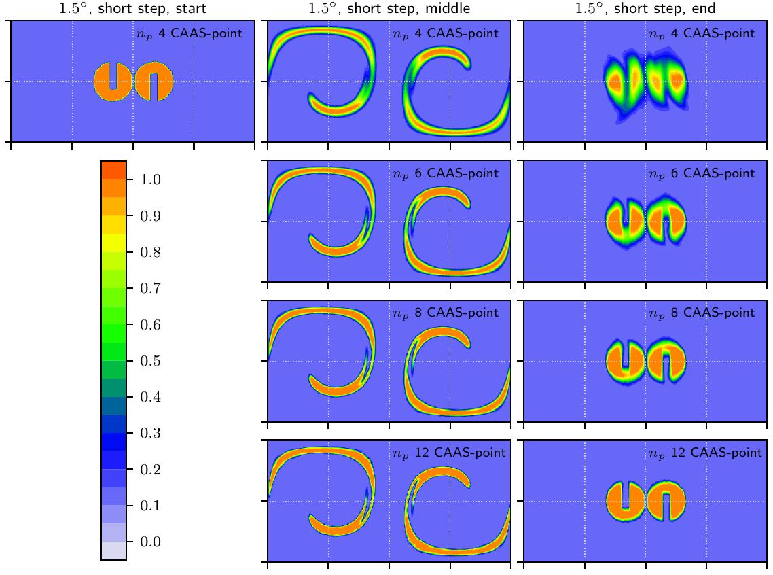
Islet: Interpolation Semi-Lagrangian Element-Based Transport
Objective
Maximize computational efficiency of models like the E3SM Atmosphere Model.
Enable optionally ultra-high-resolution tracer transport coupled to standard-resolution dynamics.
Approach
Use three grids, one each for physics, dynamics, and tracer transport.
Develop efficient, property-preserving remap algorithms to remap data among the grids.
Use the new Islet bases to create an ultra-high-resolution tracer transport method.
Impact
The lowest-resolution Islet transport method is used in E3SM version 2. It speeds up tracer transport by 6 to 8 times. It provides slightly higher resolution than the transport method in version 1.
Example of tracer transport at multiple resolutions. The velocity data (representing the dynamics) and time steps are the same in each case. Time proceeds left to right. Resolution increases top to bottom. The exact solution at the final time (right column) is the same as the initial condition (left column).
A. M. Bradley, P. A. Bosler, O. Guba, “Islet: interpolation semi-Lagrangian element-based transport.” Geosci. Model Dev. 15 (2022). [DOI: 10.5194/gmd-15-6285-2022]
Notes:
http://www.pnnl.gov/science/highlights/highlights.asp?division=749

