Slide 1
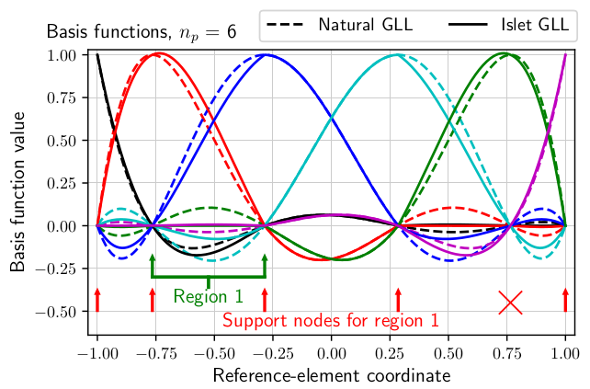
Stabilized bases for high-order, interpolation semi-Lagrangian, element-based tracer transport
Objective
Maximize efficiency of models like the E3SM Atmosphere Model.
Construct an element-based interpolation semi-Lagrangian (ISL) transport method.
Approach
Classical ISL methods do not work on unstructured element grids.
Natural element-based basis sets produce an unstable ISL method.
Develop a search procedure to find stabilized basis sets that are modifications of the natural basis sets, producing a stabilized, efficient, element-based ISL method for unstructured element grids.
Impact
The lowest-order Islet basis set is used in E3SM versions 2 and 3. The transport method speeds up tracer transport by 6 to 8 times over version 1. It provides slightly higher resolution than the transport method in version 1.
Example of modifications to a natural basis set (dashed curves) to produce an Islet stabilized basis set (solid curves). Each color corresponds to a basis function in the set; in this example, there are six.
A. M. Bradley, “Stabilized bases for high-order, interpolation semi-Lagrangian, element-based tracer transport.” J. Comput. Phys. 508 (2024). [DOI: 10.1016/j.jcp.2024.113034]
Notes:
http://www.pnnl.gov/science/highlights/highlights.asp?division=749

