Slide 1
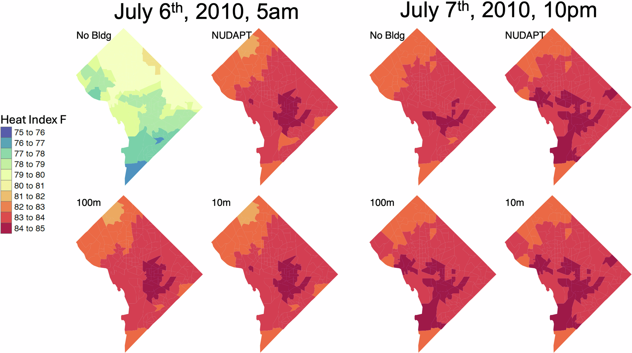
Modeling Urban Heat: The Importance of Building Details
Objective
Examine how variations in the resolution of urban morphological inputs affect the accuracy of mesoscale weather modeling in characterizing urban heat exposure and its implications for urban sustainability and equity, particularly during extreme heat events.
Approach
Implement mesoscale weather simulations using the Weather Research and Forecasting (WRF) model at 270 m resolution, integrating urban morphological inputs at varying resolutions (10 m, 100 m, 1 km) and comparing them to simulations without morphological data.
Develop Python scripts to compute and incorporate NUDAPT-defined urban parameters from high-resolution building footprint data, allowing for detailed representation of urban morphology in the simulations.
Conduct Mann-Whitney U tests to statistically assess differences in meteorological outputs across simulations with different morphological inputs, focusing on variables such as temperature, humidity, and wind speed to understand their spatial heterogeneity.
Impact
Simulations with 3D urban morphological inputs show significant differences in meteorological outputs compared to those without, highlighting the importance of urban morphology in weather modeling.
The study finds that the resolution of urban morphological inputs has a minor impact on spatial variability, but the absence of such inputs leads to larger discrepancies, particularly affecting vulnerable neighborhoods.
Regression analyses reveal that socioeconomic vulnerability is positively correlated with heat index during heat waves, emphasizing the need for high-resolution urban data to assess heat exposure impacts on at-risk populations.
This figure illustrates the simulated hour averaged heat index in °F for DC Census tracts by building input resolution at different times of day. The No Bldg panels show heat index calculated using output from the simulation with no 3D building input. The NUDAPT panels show heat index calculated using output from the simulation containing the 3D NUDAPT 1km input. 100 m and 10 m panels show heat index calculated from the output of simulations using 100 m and 10 m 3D morphological input, respectively.
Allen-Dumas, Melissa R., Levi T. Sweet-Breu, Christa M. Brelsford, Linying Wang, Joshua R. New, and Brett C. Bass. 2024. Sensitivity of Mesoscale Modeling to Urban Morphological Feature Inputs and Implications for Characterizing Urban Sustainability. npj Urban Sustainability 4: 49. https://doi.org/10.1038/s42949-024-00185-6.
First draft generated using PAIGE, the Pnnl AI assistant for GEnerating publication highlights

