Slide 1
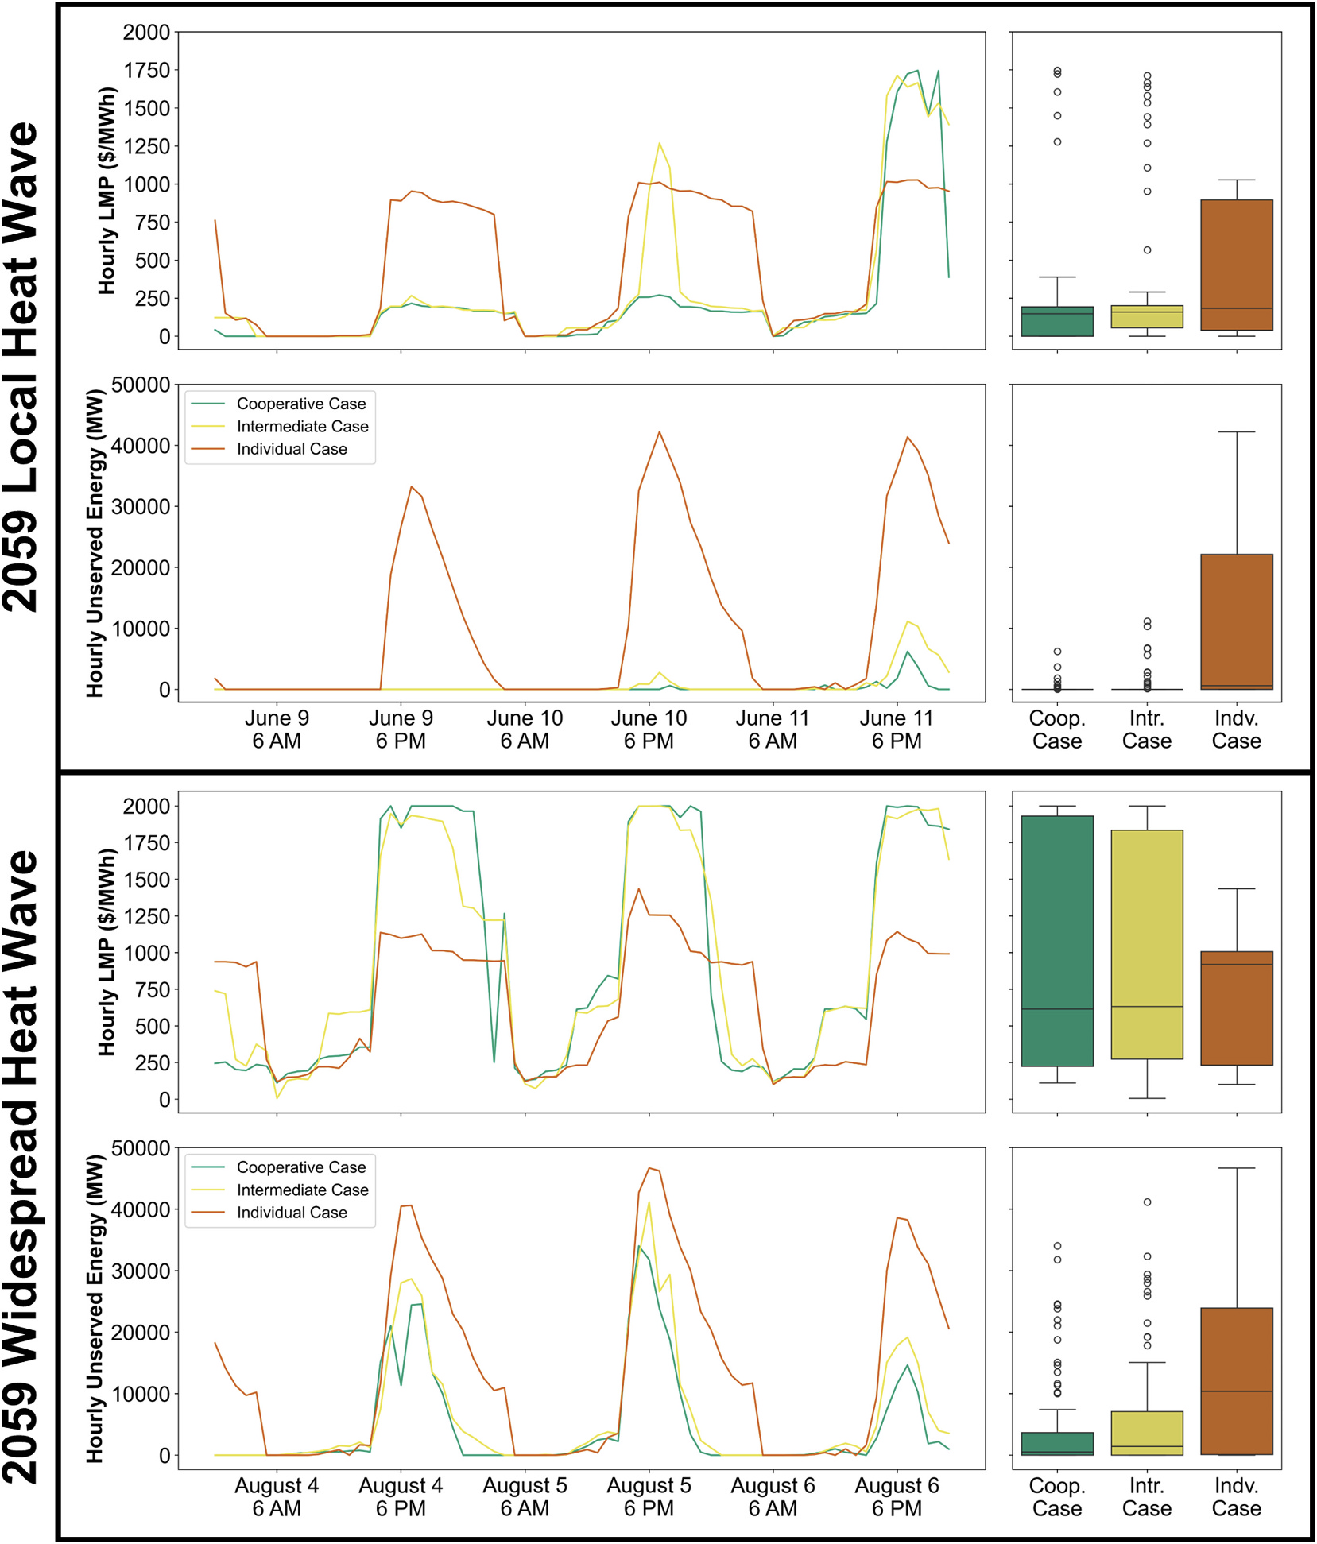
Cooperative Transmission Planning Reduces System-Wide Costs and Enhances Grid Performance During Heat Waves
Objective
Investigate the impacts of cooperative transmission expansion planning on grid performance and reliability during heat waves with varying spatial scales, highlighting the economic, reliability and environmental benefits of interregional transmission cooperation.
Approach
Employ an advanced modeling chain to simulate power grid operations of the U.S. Western Interconnection in 2019 and 2059, incorporating different levels of collaboration between transmission planning regions.
Utilize a novel climate perturbation technique to replay historical heat waves under future climate scenarios, assessing the economic and reliability impacts of cooperative versus individual transmission expansion planning.
Integrate a fully open-source grid operations modeling framework with a production cost model component to evaluate the effects of transmission planning on grid performance during extreme weather events.
Impact
Cooperative transmission planning reduces yearly average wholesale electricity prices by 64.3% and annual transmission and generation costs by 34.6% in 2059 compared to individual planning.
Despite diminished benefits during widespread heat waves, cooperative planning significantly decreases costs and greenhouse gas emissions by enhancing renewable energy utilization.
California Independent System Operator benefits most from cooperative planning due to its substantial reliance on solar generation which creates a need for imports during the early morning and late evening, highlighting the importance of strategic investments in transmission infrastructure.
Time series and distribution of hourly average LMPs and total unserved energy in the Western Interconnection (WI) during 2059 local and widespread heat waves. Results highlight the grid’s increased volatility under variable renewable energy dominance, with the cooperative TEP scenario consistently showing lower unserved energy compared to intermediate and individual TEP.
Akdemir, Kerem Ziya, Kendall Mongird, Jordan D. Kern, Konstantinos Oikonomou, Nathalie Voisin, Casey D. Burleyson, Jennie S. Rice, Mengqi Zhao, Cameron Bracken, and Chris Vernon. 2025. Investigating the Effects of Cooperative Transmission Expansion Planning on Grid Performance during Heat Waves with Varying Spatial Scales. Applied Energy 378: 124825. https://doi.org/10.1016/j.apenergy.2024.124825.
First draft generated using PAIGE, the Pnnl AI assistant for GEnerating publication highlights

