Slide 1
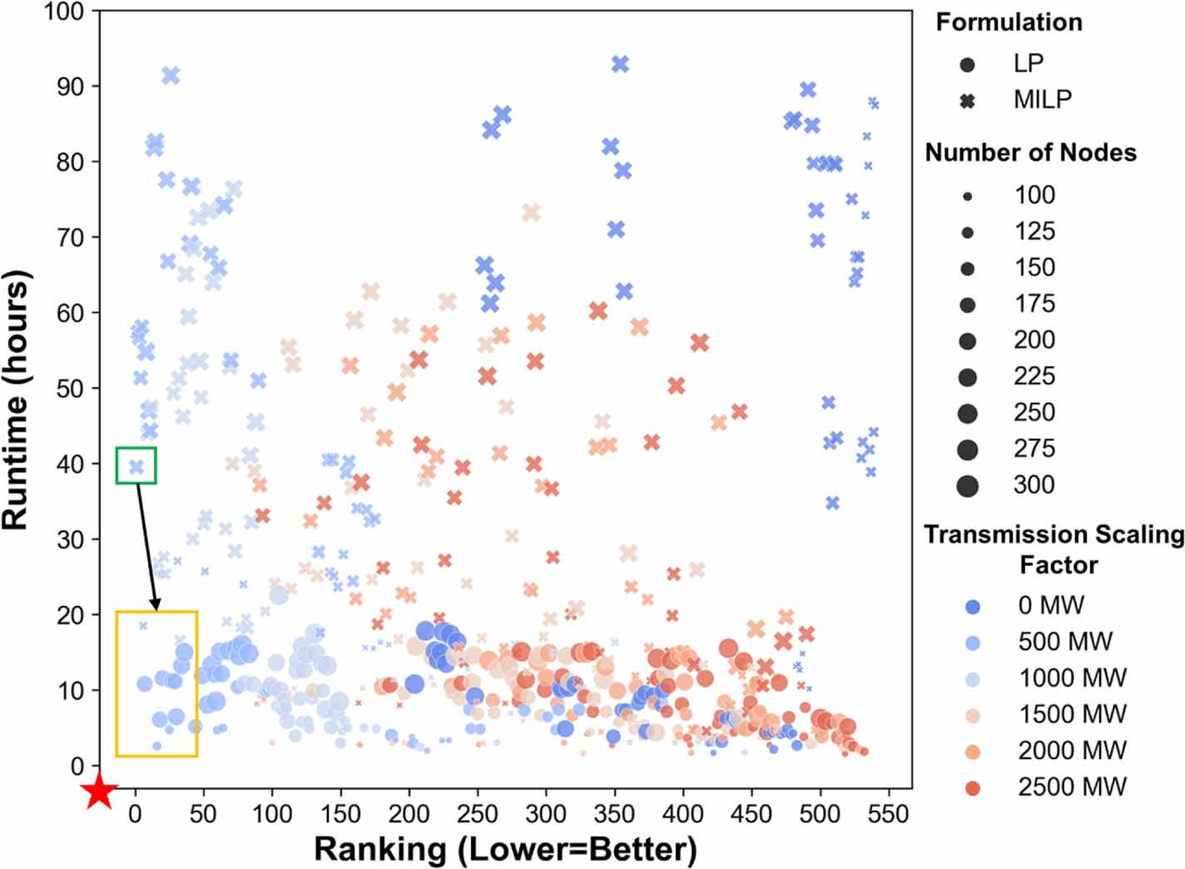
Balancing Speed and Accuracy in Power Systems Operations Modeling
Objective
Develop an open-source model, Grid Operations (GO), to balance computational speed and model fidelity in production cost models for power system operations, enabling large-scale simulations of grid dynamics under climate and weather extremes.
Approach
Implement a Python-based open-source framework, Grid Operations (GO), that utilizes synthetic grid databases to create scale-adaptive production cost models (PCMs) with user-defined parameters such as the number of nodes, mathematical formulation, transmission line capacity scaling, and hurdle rate scaling.
Conduct a calibration process by comparing simulated locational marginal prices (LMPs) and generation mixes with historical data across various model versions, enabling the identification of PCMs that optimally balance fidelity and computational speed for large-scale power system simulations.
Impact
Simplified open-source production cost models (PCMs) with fewer nodes and linear programming formulations can accurately capture electricity market operations, locational marginal prices (LMPs), and generation mix.
The GO framework enables researchers to balance computational speed and model accuracy, facilitating large-scale stochastic simulations for analyzing power system vulnerabilities to climate and weather extremes.
Tradeoff between model fidelity (ranking) and runtime for 540 simulations of operations in the Western U.S. electricity grid in 2021. Each point represents one model version out of 540. The green box shows the best model version while the orange box identifies other possible options with similar rankings but much lower runtimes. Red star shows the optimal point on this figure.
Akdemir, Kerem Ziya, K. Oikonomou, J.D. Kern, N. Voisin, H. Ssembatya, and J. Qian. "An open-source framework for balancing computational speed and fidelity in production cost models." Environmental Research: Energy 1, no. 1 (2024): 015003.. DOI:10.1088/2753-3751/ad1751

