Slide 1
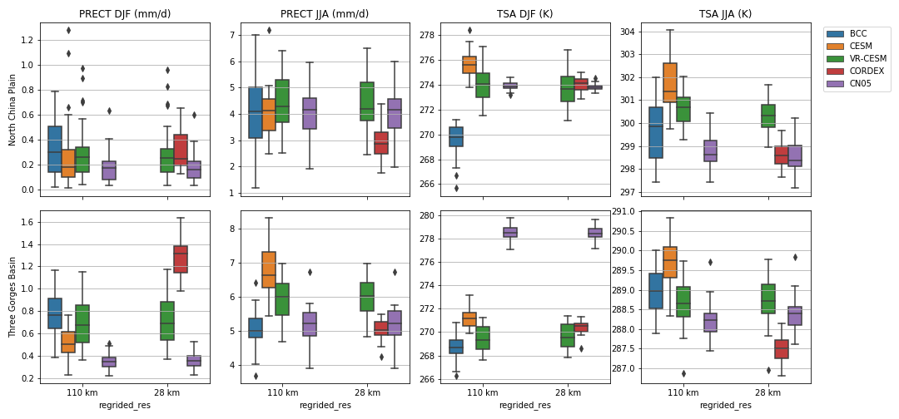
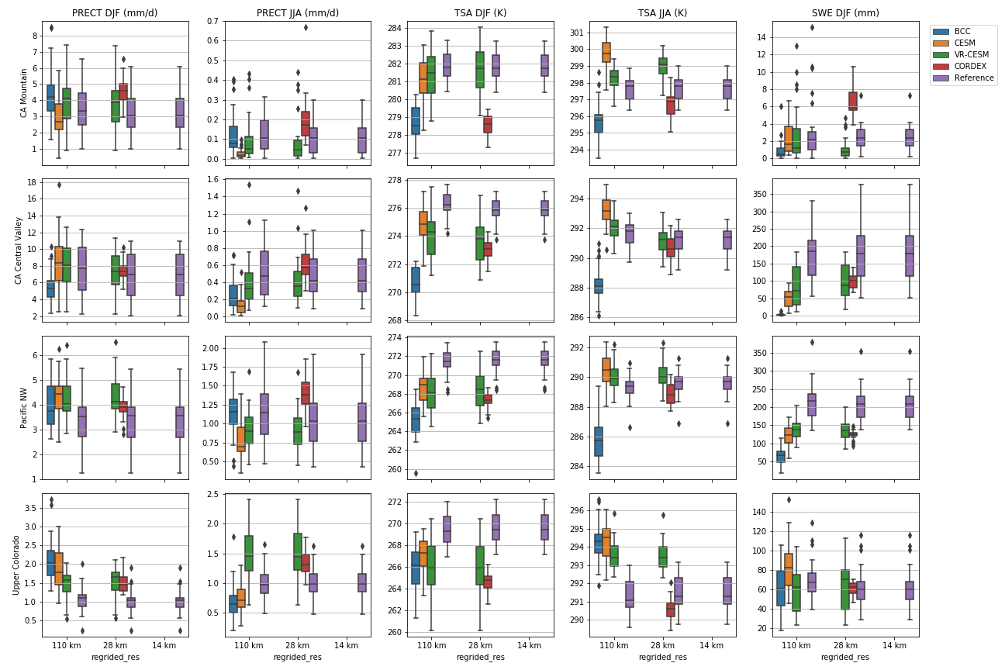
Evaluating Variable-Resolution CESM over China and Western U.S. For Use in Water-Energy Nexus and Impacts Modeling
Scientific Challenges
The refined-resolution global climate model VR-CESM’s performance has not been evaluated in China region due to lack of data availability. The assessment of model performance is critical for providing high-resolution climate projections for water-energy nexus and impact modeling, including wind, solar energy and groundwater resources.
Upper: North China Plain and Three Gorges Dam
Lower: Pacific Northwest and Upper Colorado Basin
Approach and Results
The historical climate outputs of VR-CESM simulations are assessed by comparing against a group of coarser-resolution models, downscaled models and reference datasets, in both China and the western U.S. The assessment indicates that precipitation is better simulated by VR-CESM, while temperature results are more variable and comparable across models and locations.
Significance
Through the CERC-WET partnership we were able to evaluate VR-CESM for eastern China against detailed data.
Simulated precipitation skill is dependent upon the reference datasets used. Precipitation bias in VR-CESM is the smallest due to the added value provided by resolution refinement.
Temperature biases exhibit a more complicated temporal and spatial pattern, due to interactions among processes.
We conclude that VR-CESM outperforms other models evaluated and provides the best estimation of downscaled climate data for water-energy studies.
DJF and JJA precipitation, temperature and snow water equivalent biases of VR-CESM, CESM, CORDEX-NA and reference datasets (U.S: PRISM for all except Livneh for snow, China: CN05) at four regions in China and western U.S.
Xu Z., Di Vittorio A., et al. (2021), Evaluating Variable-Resolution CESM over China and western U.S. for use in water-energy nexus and impacts modeling. Journal of Geophysical Research: Atmospheres, DOI: 10.1029/2020JD034361

