Slide 1

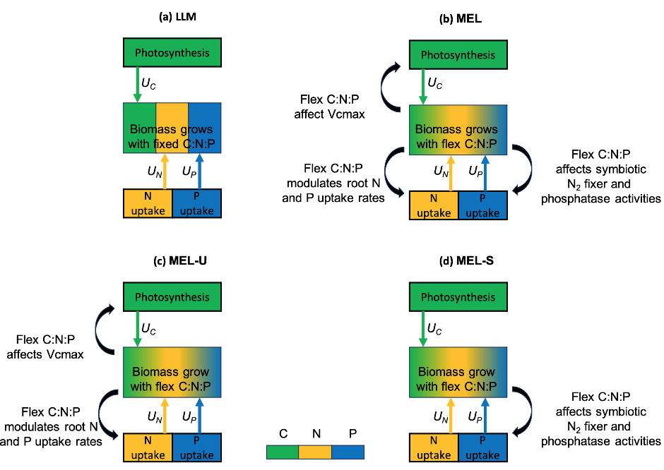
Nitrogen & Phosphorus co-limitation drives ecosystem carbon accumulation
Scientific Achievement
We found that the MEL approach better represents observed plant nutrient limitation strength across tropical, temperate, and boreal forest ecosystems, compared with LLM.
Under RCP8.5, the MEL approach projected much stronger 21st century CO₂ fertilization effects (2-fold) on plant Net Primary Productivity (NPP) than LLM because of the effective resource coordination mechanisms within MEL.
Significance and Impact
Terrestrial ecosystem processes, including plant biomass growth and microbial decomposition of soil organic matter, are limited by nutrient availability.
Projected ecosystem carbon accumulation under elevated atmospheric CO₂ concentrations remains highly uncertain because of the diverse model representation of N and P co-limitations.
Competing hypothesis of (a) Liebig’s Law of the Minimum (LLM); (b) Multiple Element Limitation (MEL); (c) MEL allowing the plant to only mediate photosynthesis and nutrient uptake rates towards optimal C:N:P ratios; and (d) MEL allowing the plant to only mediate external resource supply through adjusting symbiotic N₂ fixation and phosphatase activity.
Research Details
  Two prevailing hypotheses of N and P limitation that have been widely employed by current generation land models are Liebig’s Law of the Minimum (LLM) [Liebig and Playfair, 1847] and the Multiple Elemental Limitation (MEL).
  We implemented these approaches in the E3SM land model to analyze implications for 21st century global carbon cycling.
  We compiled N & P fertilization experiment data to evaluate models.
Zhu, Qing, et al. "Plant responses to elevated CO2 under competing hypotheses of nitrogen and phosphorus limitations." Ecological Applications (2024), DOI: 10.1002/eap.2967, e2967.
Work is performed at LBNL, supported by Reducing Uncertainties in Biogeochemical Interactions through Synthesis and Computation (RUBISCO) Scientific Focus Area Project.

