Slide 1
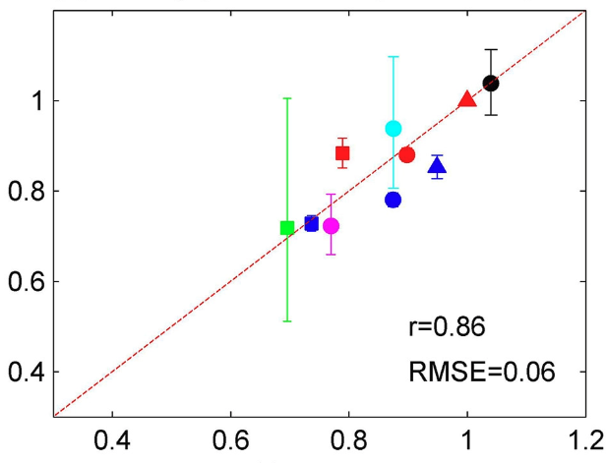
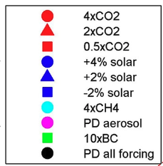
Explaining Forcing Efficacy With Pattern Effect and State Dependence
ACTUAL
Scientific Achievement LLNL scientists and colleagues have conducted a series of climate model experiments to illuminate the processes determining variations in “forcing efficacy” whereby global warming per unit forcing depends on forcing agent. The team demonstrated that forcing efficacy is simply another manifestation of the pattern effect: Each forcing agent causes a unique warming pattern and induced radiative feedback, leading to diversity in how much warming results from a given forcing agent.
Significance & Impact
The work removes the ambiguity that surrounds efficacies and the connection between forcing agent and global temperature response. Carefully accounting for pattern effects and state dependence on radiative feedbacks captures the relevant physics and obviates the need for forcing efficacies, which are poorly defined and likely impossible to estimate from observations.
RECONSTRUCTED
Forcing efficacies for a variety of forcing agents and magnitudes can be accurately reconstructed by accounting for the impact of warming pattern and state dependence on feedbacks
Research Details The team performed a set of fully-coupled simulations using CESM1 to calculate the efficacy of 10 different forcing agents, then used a Green's function approach to show that forcing efficacy can be largely understood in terms of the radiative feedback pattern effect. They also used atmosphere-only perturbed SST experiments to quantify the role of feedback dependence on global mean surface temperature anomalies for forcing efficacies.
Zhou, C., Wang, M., Zelinka, M. D., Liu, Y., Dong, Y., & Armour, K. C. (2023). Explaining forcing efficacy with pattern effect and state dependence. Geophs. Res. Lett., doi:10.1029/2022GL101700.
Notes:
The Science
Lawrence Livermore National Laboratory scientists along with their colleagues have conducted a series of climate model experiments to illuminate the processes that determine why certain forcing agents (like carbon dioxide and methane) cause greater global mean surface temperature changes than other forcing agents (like black carbon or sulfate aerosols) – even for the same globally averaged radiative forcing. This concept is referred to as “forcing efficacy” but the physical reasons for it have not been well established. In this work the team demonstrated that forcing efficacy is simply another manifestation of the pattern effect that is well-studied in the climate feedback community. Briefly, this refers to the fact that the planet’s ability to shed heat to space depends not only on how much it warms, but also on the spatial structure of the warming. The team extended this concept to demonstrate that each forcing agent causes a unique warming pattern and induced radiative feedback. This leads to diversity in how much warming results from a given forcing agent. They also find that temperature-dependence in the feedbacks – that is, variation in feedback strength with global temperature – plays a secondary role in driving variations in efficacy among forcing agents.
The Impact The paper demonstrates that the concept of forcing efficacy – which implies that each forcing agent is somehow more or less effective at causing temperature change, even for the same global mean radiative forcing – is actually just a manifestation of the pattern effect, in which diverse warming patterns lead to diverse radiative damping rates. This removes the ambiguity that surrounds efficacies and the connection between forcing agent and global temperature response by illuminating the physical mechanism that actually lies between them: radiative feedbacks and their dependence on warming pattern. In other words, carefully accounting for pattern effects and state dependence on radiative feedbacks captures the relevant physics and obviates the need for forcing efficacies, which are poorly defined and likely impossible to estimate from observations.
Summary The magnitude of global surface temperature change in response to unit radiative forcing depends on the type and magnitude of forcing agent—a concept known as a “forcing efficacy.” However, the mechanisms behind the forcing efficacy are still unclear. In this study, we perform a set of simulations using CESM1 to calculate the efficacy of 10 different forcing agents defined in terms of fixed-SST effective radiative forcing, and then use a Green's function approach to show that each forcing efficacy can be largely understood in terms of the radiative feedbacks associated with the different surface temperature patterns induced by the forcing agents (a pattern effect). We also quantify how the state dependence of feedbacks on global mean surface temperature anomalies impacts forcing efficacies. The results show that the forcing efficacy can be well reconstructed with a combination of pattern effect and state dependence.

