Slide 1
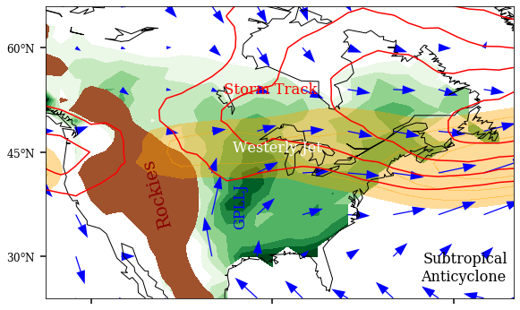
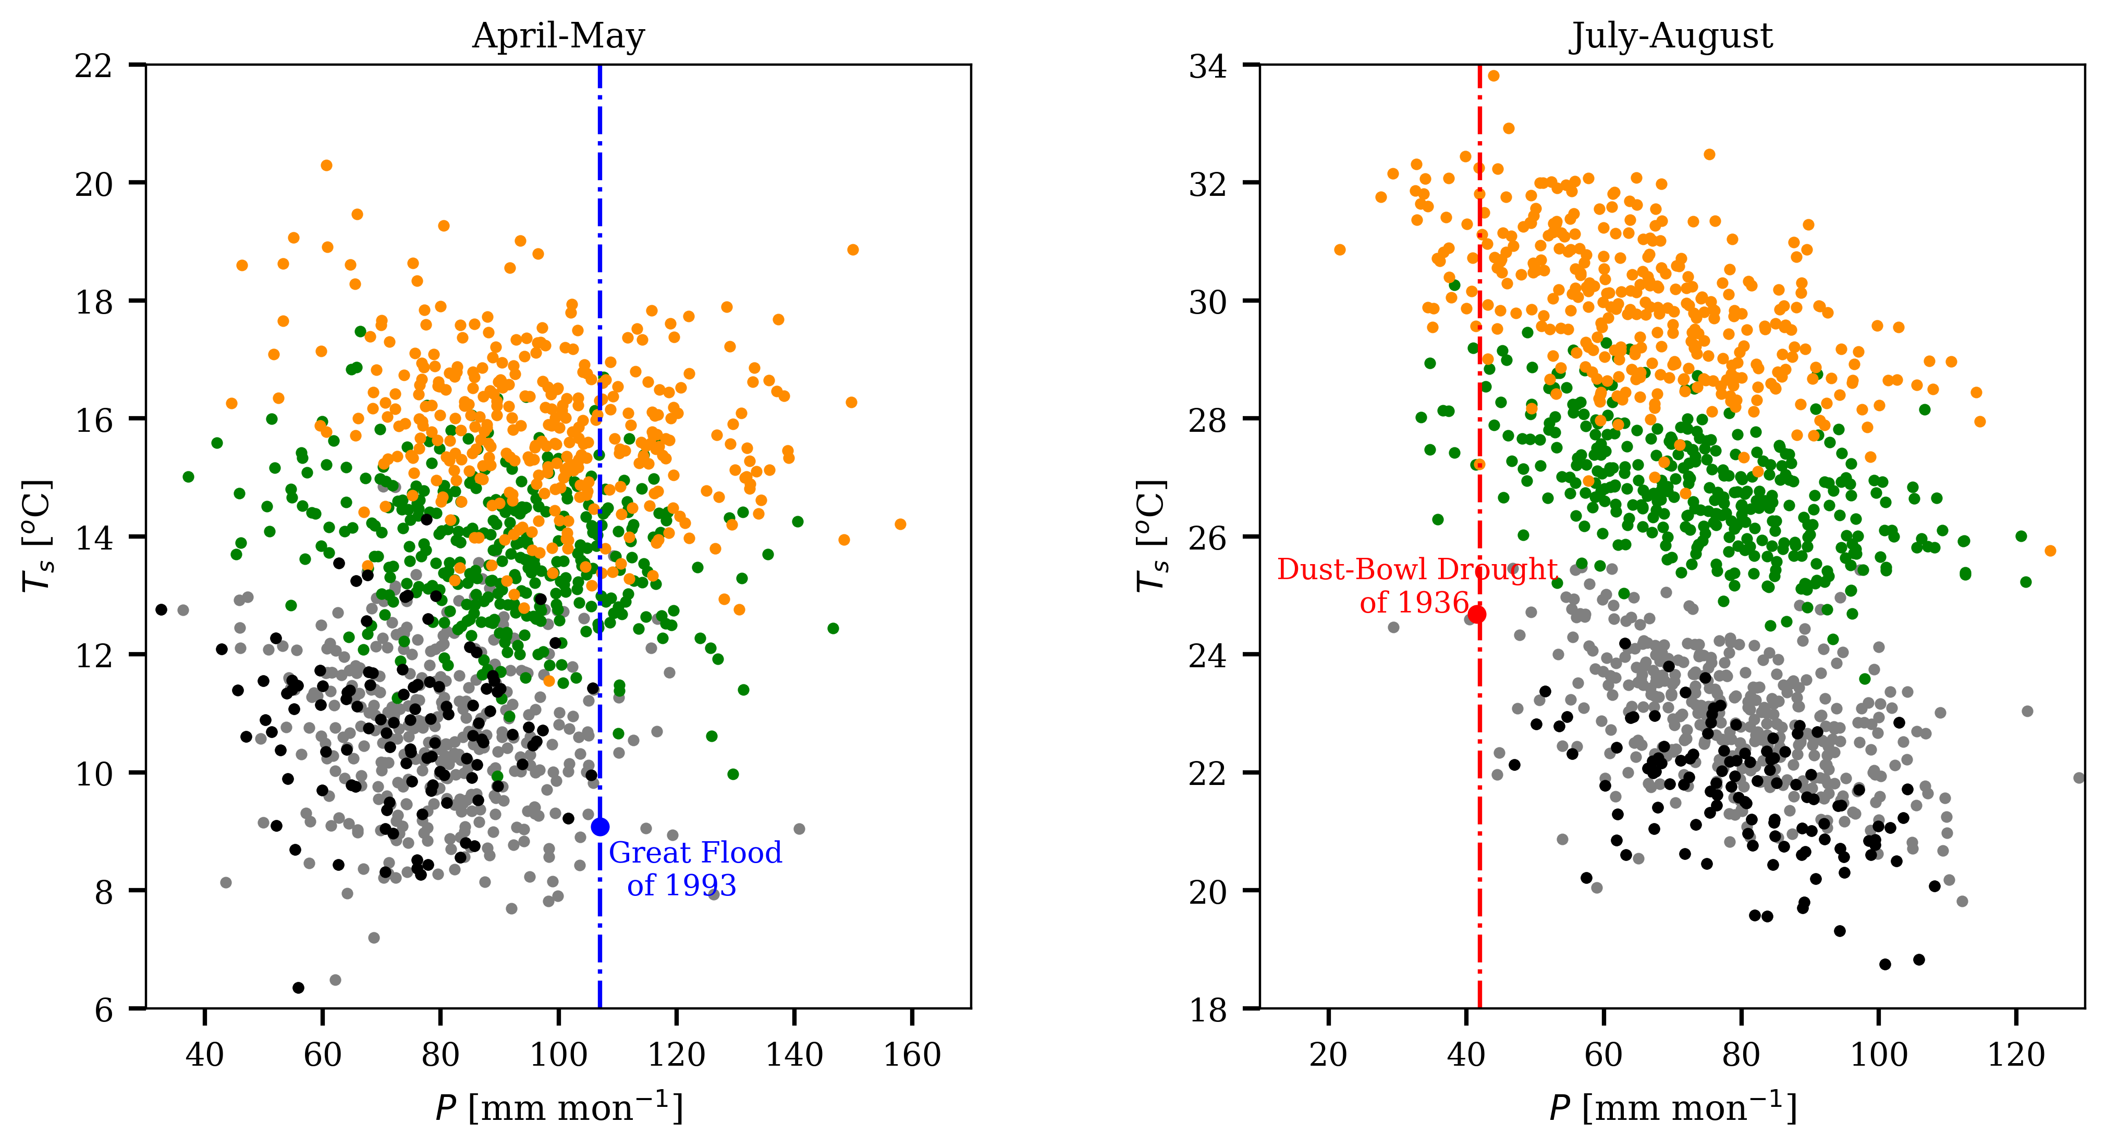
Jet Shift Causes Seasonally Dependent Future Changes in Midwest Hydroclimate
Objective
Investigate changes in the Midwest’s future hydroclimate as a function of the month.
Elucidate the dynamic mechanisms that underpin the seasonally dependent hydroclimate changes.
Approach
Analyze future changes in the U.S. Midwest circulation, precipitation, and climate extremes under global warming using ensemble projections of the Coupled Model Intercomparison Project Phase 6 and the Multi-model Initial-condition Large-ensemble Simulations.
Illustrate the seasonally dependent impacts of the poleward jet shift on the Midwest hydroclimate.
Impact
The warm-season North-American westerly jet is projected to shift northward under global warming, making it closer to (farther away from) the Midwest before (after) June, leading to more (less) mean precipitation.
The seasonally-dependent mean precipitation changes correspond to 10-fold (5-fold) increases in the frequency of late-spring deluges and late-summer droughts under a high (intermediate) emission scenario.
a) Drivers of
the Central U.S. hydroclimate
b) Future changes in
jet latitude and mean precipitation
Future
Jet Lat.
Current
Jet Lat.
Current
Precip
Future
Precip
c) April-May climate extremes
d) July-August climate extremes
RCP8.5
RCP4.5
HIST
OBS
a) The warm-season central U.S. hydroclimate is regulated by two major systems—the midlatitude storm track (red contours) and the subtropical southerly winds (blue arrows). Both are coupled to the westerly jet (yellow shading). b) Midwest rainfall peaks in June upon the arrival of the westerly jet. Under global warming, the westerly jet is projected to shift northward, making it closer to (further from) the Midwest before (after) June, leading to more (less) precipitation; c,d) Scatterplots of Midwest temperature and precipitation for individual years under current and future warmer climates for April-May and July-August.
W. Zhou, L. R. Leung, and J. Lu. “Seasonally dependent future changes in the US Midwest hydroclimate and extremes” Journal of Climate, 35, 17-27 (2021). [DOI: 10.1175/JCLI-D-21-0012.1].

