Slide 1
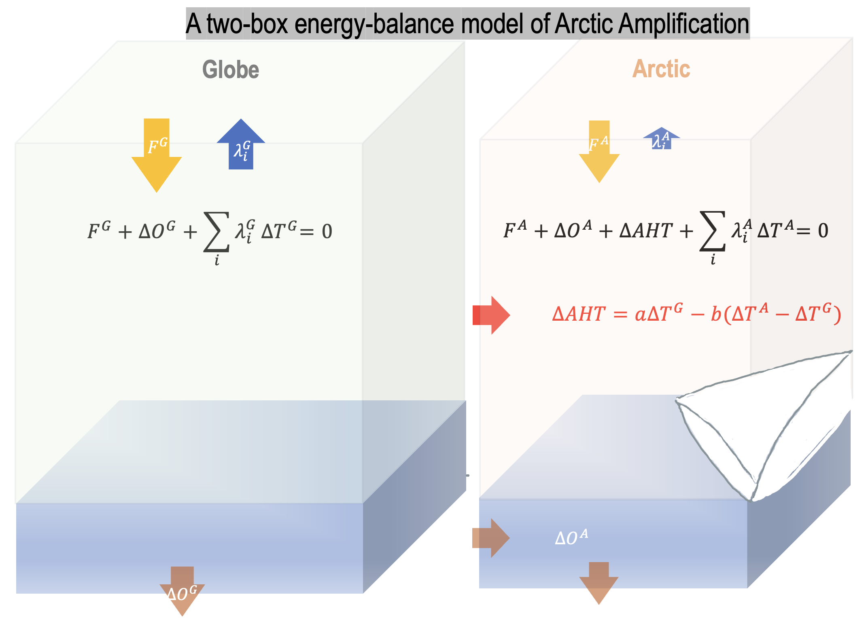
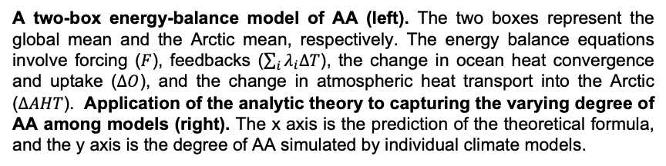
The Complexity of Amplified Arctic Warming can be Understood Analytically
Objective
Build an analytic theory for the degree of AA which works beyond the existing diagnostic frameworks
Approach
Build a two-box energy-balance model of AA by deciphering the intricate physics of atmospheric meridional heat transport
Derive the functional relation between the degree of AA and key physical parameters
Impact
The degree of AA is a simple, nonlinear function of five key physical parameters. The formula captures the varying AA among climate models and attributes the variation to specific physical factors
The formula illustrates how essential physics mutually determine the degree of AA. It allows us to predictively understand how AA changes if certain physical factors change.
Our results articulate that atmospheric heat transport (AHT) as both forcing and feedback to AA and underscore its partial sensitivities instead of total change as key parameters of AA.
The lapse-rate feedback has been widely recognized as a major contributor to AA, but its effect is fully offset by the water-vapor feedback.
A two-box energy-balance model of AA (left). The two boxes represent the global mean and the Arctic mean, respectively. The energy balance equations involve forcing ($F$), feedbacks ($\sum_{i}{λ_{i}∆T}$), the change in ocean heat convergence and uptake ($∆O$), and the change in atmospheric heat transport into the Arctic ($∆AHT$). Application of the analytic theory to capturing the varying degree of AA among models (right). The x axis is the prediction of the theoretical formula, and the y axis is the degree of AA simulated by individual climate models.
W. Zhou, L. R. Leung, S-P Xie, and J. Lu. An analytic theory for the degree of Arctic Amplification. Nature Communications. 15:5060 (2024). DOI:10.1038/s41467-024-48469-w.

