Slide 1
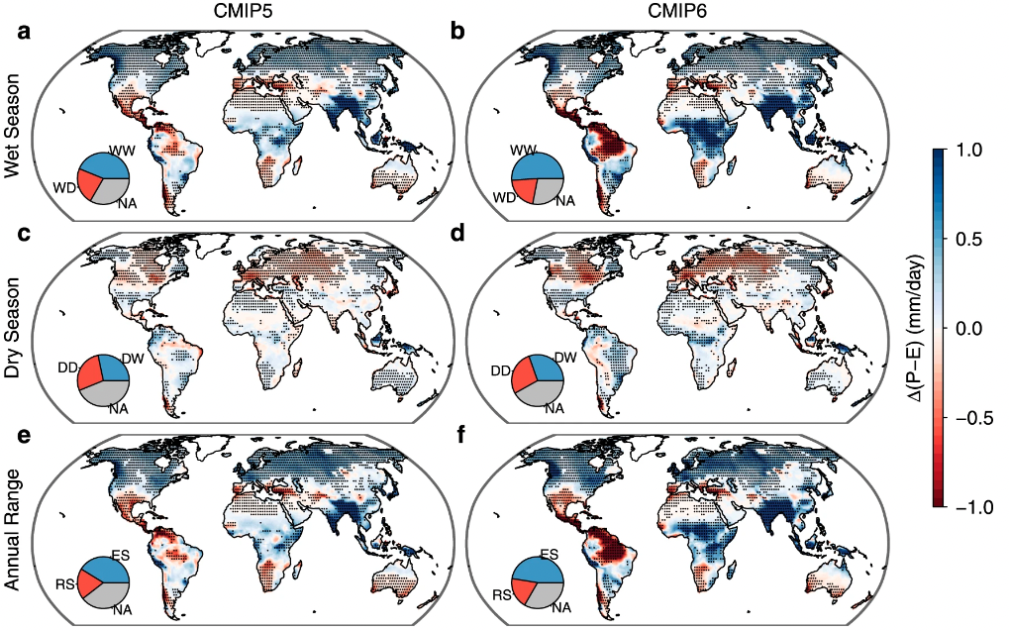

Diminishing seasonality of subtropical water availability in a warmer world dominated by soil moisture-atmosphere feedbacks
Scientific Achievement
We show that ~20% of land experiences a diminished seasonal cycle of water availability, mostly over subtropical regions and the Amazon, using projections from the Coupled Model Intercomparison Project.
We show that we demonstrate that 63% of the seasonality reduction is driven by seasonally varying soil moisture (SM) feedbacks on P–E.
Significance and Impact
Global warming is expected to cause wet seasons to get wetter and dry seasons to get drier, which would have broad social and ecological implications.
Our results underscore the importance of soil moisture–atmosphere feedbacks for seasonal water availability changes in a warmer climate.
Figure. CMIP6 seasonality changes in surface water availability (precipitation minus evaportranspriation, P-E) for the wet and dry seasons, and the associated annual range.
Research Details
Zhou S, Williams AP, Lintner BR, Findell KL, Keenan TF, Zhang Y, Gentine P (2022) Diminishing seasonality of subtropical water availability in a warmer world dominated by soil moisture-atmosphere feedbacks. Nature Communications, 13, 5756
This analysis leverages both CMIP5 and CMIP6 simulation experiments to examine seasonal changes in surface water availability (precipitation minus evaporation, P–E).

