Slide 1
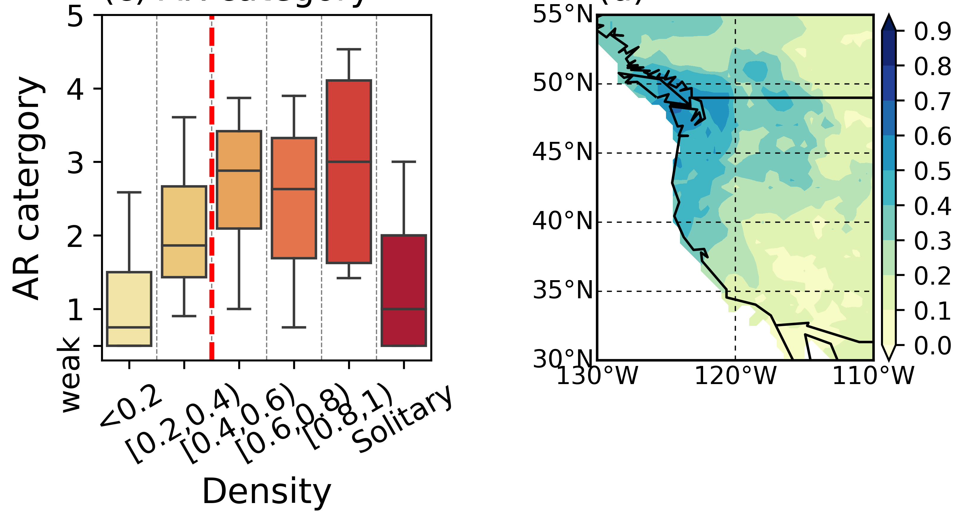
Back-to-back high category atmospheric river landfalls occur more often on the west coast of the United States
(a)
(b)
Scientific Challenges
Understanding the dynamics and impacts of atmospheric river (AR) clusters is crucial due to their role in causing extreme weather events, as highlighted by the catastrophic ARs in California during December 2022-January 2023.
Approach and Results
The study utilized a machine learning clustering tool to analyze atmospheric river clusters, revealing that clusters with higher density are associated with more frequent high-category ARs and increased likelihood of extreme precipitation and severe land responses.
Significance
Figure (a) Distribution of atmospheric river (AR) category based on cluster density. (b) Percentage of AR-associated extreme precipitation in dense AR clusters
Improved Risk Management: Insights from the study can help in better forecasting and managing the risks associated with atmospheric river.
Climate Adaptation Strategies: The findings support the development of targeted climate adaptation and resilience strategies to mitigate the impacts of these high-risk weather events.
Future Projections: The research can help to improve the prediction and project of such back-to-back AR activity.
Zhou, Y., Wehner, M. & Collins, W. Back-to-back high category atmospheric river landfalls occur more often on the west coast of the United States. Commun Earth Environ 5, 187 (2024). https://doi.org/10.1038/s43247-024-01368-w

