Slide 1
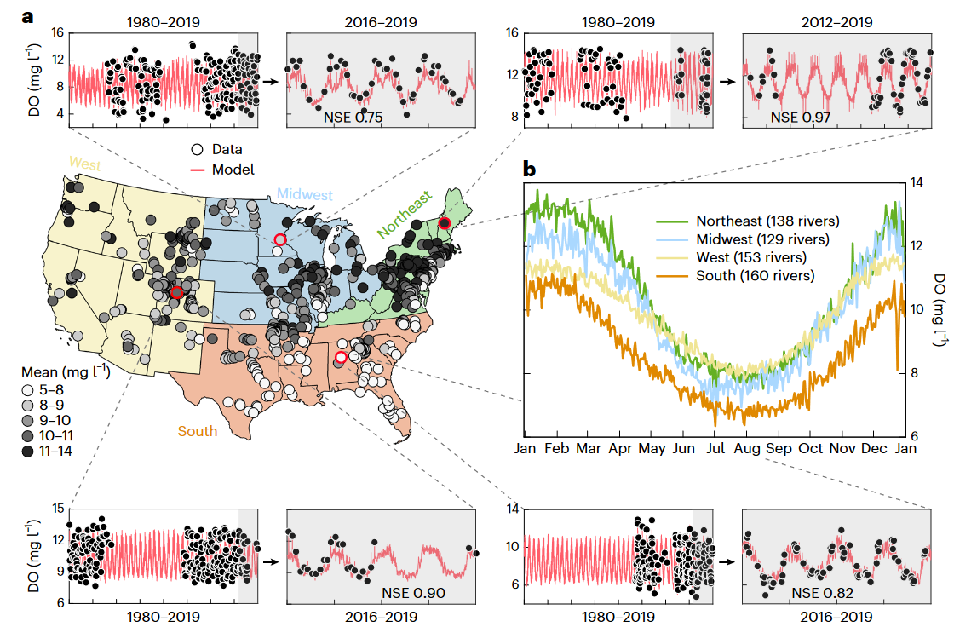
Temperature outweighs light and flow as the predominant driver of dissolved oxygen in US rivers
Objective
Determine the most influential drivers of riverine daily dissolved oxygen (DO) dynamics at the continental scale
Approach
Differentiable models couple physics-based formulations to neural networks (NNs) that learn parameterizations (and potentially processes) from observations, here photosynthesis rates.
Impact
DO concentration is an important measure of water quality, aquatic metabolism, and redox conditions, and regulates the emission of riverine greenhouse gases and the mobilization of toxic metals and nutrients.
Dissolved oxygen (DO) concentration in rivers was able to be fairly accurately modeled by training a deep learning model on temperature data alone. Light was a close second in terms of modeling importance, while flow imparted minimal influence on DO modeling.
The model developed in this work showed declining DO in warming rivers, which has important implications for water security and ecosystem health in the future climate.
Figure 1. Spatio-temporal DO dynamics. a, A map of long-term, baseline mean concentrations (1980–2019) in 580 rivers from four regions; the Northeast has the highest mean concentrations of 10.4 ± 1.06 mg l−1 (mean ± s.d.), followed by the Midwest (9.72 ± 0.91 mg l−1), West (9.67 ± 0.80 mg l−1) and South (8.46 ± 1.24 mg l−1). b, Annual trends in each region, plotted using concentration data averaged (arithmetic) across all regional rivers. Top and bottom rows show time series of data (black dots) and model output (red lines) in four representative rivers, one from each region. Each river has a long-term (1980–2019) figure and a zoom-in shorter-term (2016–2019) figure. The grey shaded area indicates the testing period where data was not used for model training.
Zhi, W., Ouyang, W., Shen, C., & Li, L. (2023). Temperature outweighs light and flow as the predominant driver of dissolved oxygen in US rivers. Nature Water, 1(3), Article 3. https://doi.org/10.1038/s44221-023-00038-z

