Slide 1
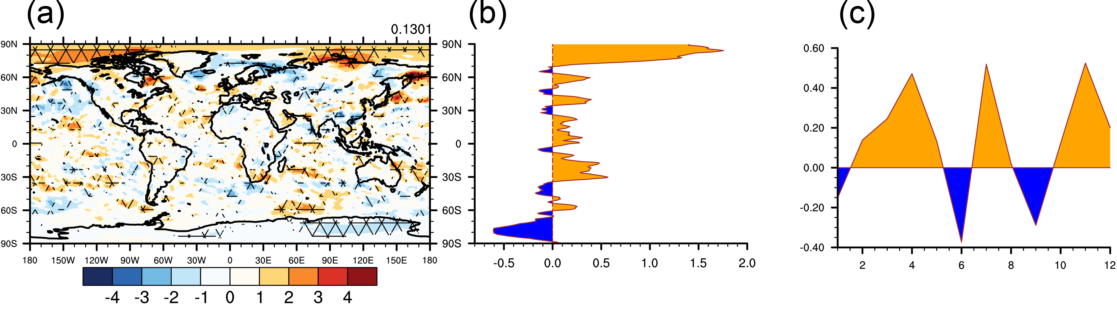
New Model Improves Tracking of Wildfire Aerosol Distribution and Their Radiative Effects
Objectives
To replace the prescribed vertical profiles of biomass burning aerosol emissions with satellite data that reveals height of aerosol distribution.
Approach
In this study, we incorporate an interactive fire plume-rise model that is developed by Freitas et al. (2007, ACP) and fire diurnal cycle assumption in E3SMv1 model. The model results on biomass burning aerosol emission profiles and mass concentration profiles are evaluated against NASA MISR plume height product and NOAA WE-CAN flight in-situ observations.
The difference in radiative effect ΔF at TOA (unit: W m⁻²) between E3SMv1 with plume-rise model and fire diurnal cycle coupled and the default one. The results are averaged over 10 ensemble members with mesh grids indicating signals that pass 95% significant test. (b) zonal averaged ΔF at TOA and (c) time series of monthly mean ΔF at TOA
Impacts
Compared to the remote sensing and flight in-situ observations, we found that the performance by E3SMv1 with new features is considerable improved.
We also find that E3SMv1 with new features produces a larger carbonaceous aerosol burden, leading to 0.13 W m⁻² warming at the top of atmosphere compared to the default E3SMv1. This warming effect is mainly caused by aerosol semi-direct effect and residual effect.
Modeling results also indicate a no-linear nature in the BBA-induced radiative effect.
Lu, Z., Liu, X., Ke, Z., Zhang, K., Ma, P.-L., & Fan, J. (2024). Incorporating an interactive fire plume-rise model in the DOE's energy exascale earth system model version 1 (E3SMv1) and examining aerosol radiative effect. Journal of Advances in Modeling Earth Systems, 16, e2023MS003818. https://doi.org/10.1029/2023MS003818

