Slide 1
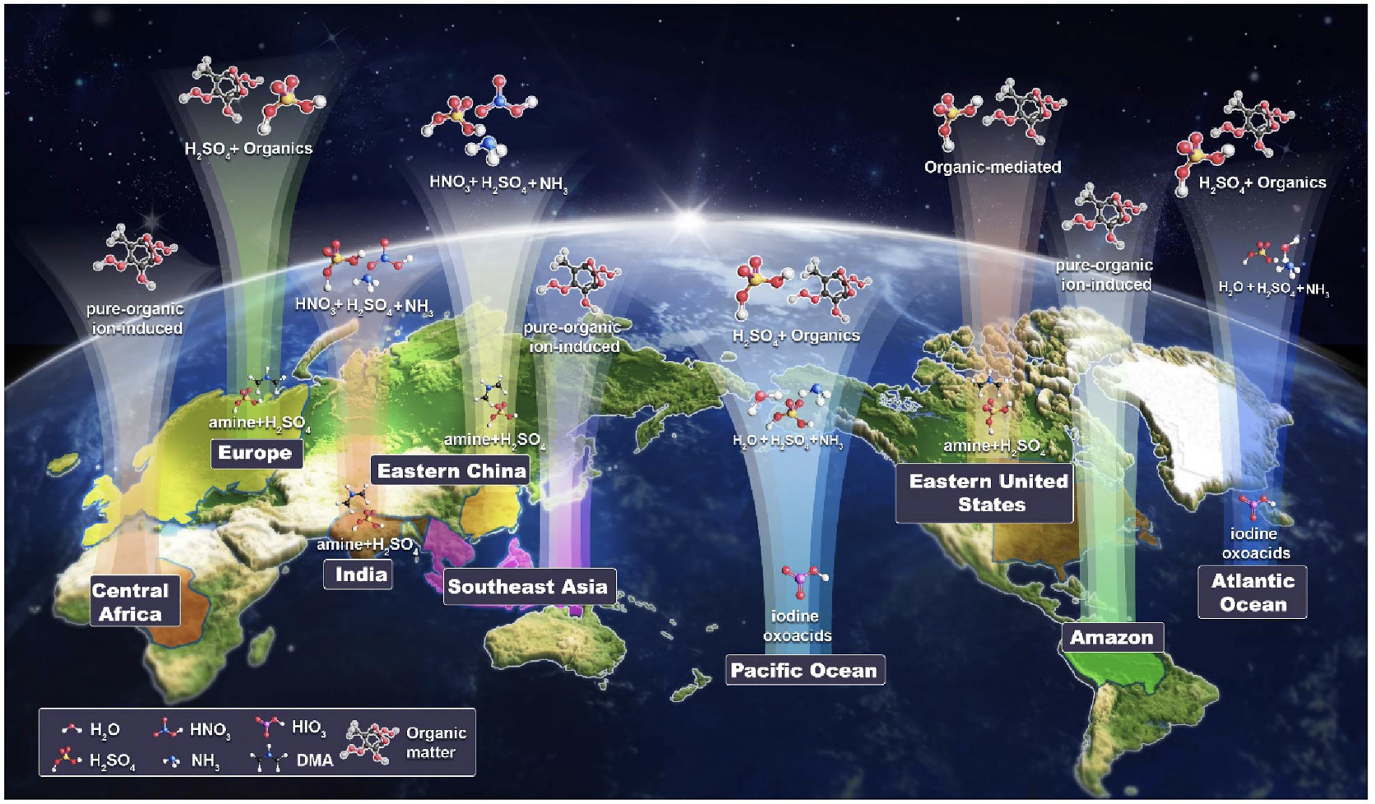
New model explains missing aerosol and cloud condensation nuclei
Objectives
Develop new model representations of new particle formation (NPF) and the chemical transformation of precursor gases in the Energy Exascale Earth System Model (E3SM)
Quantify the contribution of each NPF mechanism to aerosol and cloud condensation nuclei (CCN) around the world
Approach
Synthesize molecular-level laboratory experiments to develop model representations of 11 NPF mechanisms
Use E3SM with the new NPF mechanisms for global atmospheric simulations of aerosol, cloud, and the climate.
Impact
Previously neglected or underrepresented mechanisms dominate NPF in most regions with high concentrations of aerosols or large aerosol radiative forcing.
NPF accounts for 10–80% of the nuclei on which cloud forms at 0.5% supersaturation over various regions in the lower troposphere.
The comprehensive simulation of global NPF mechanisms can help improve estimation and source attribution of the climate effects of aerosols.
Schematic displaying the leading NPF mechanisms in the boundary layer and upper troposphere. (Image courtesy of Zhao et al (2024))
Zhao, B., Donahue, N. M., Zhang, K., Mao, L., Shrivastava, M., Ma, P.-L., Shen, J., Wang, S., Sun, J., Gordon, H., Tang, S., Fast, J., Wang, M., Gao, Y., Yan, C., Singh, B., Li, Z., Huang, L., Lou, S., Lin, G., Wang, H., Jiang, J., Ding, A., Nie, W., Qi, X., Chi, X., and Wang, L.,, “Global variability in atmospheric new particle formation mechanisms.” Nature 631, 98–105 (2024). [DOI: 10.1038/s41586-024-07547-1]

