Slide 1
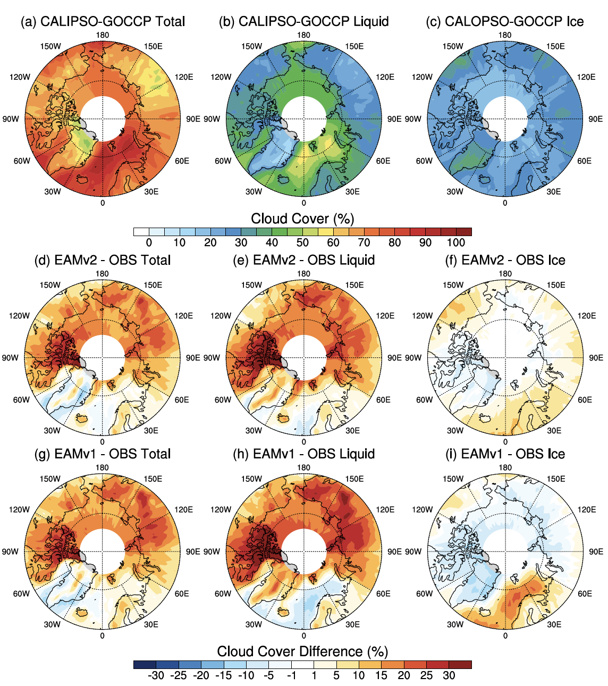
Evaluation of Simulated Cloud Phase in EAMv2 at High Latitude
Objective
Evaluate the cloud phase simulation at high latitudes in the version 2 of the Energy Exascale Earth System Model (E3SM) atmosphere model (EAMv2) and understand the model behavior changes from EAMv1.
Approach
Utilize the Cloud-Aerosol Lidar and Infrared Pathfinder Satellite Observation (CALIPSO) simulator to consistently compare the model clouds with the GCM-Oriented CALIPSO Cloud Product (CALIPSO-GOCCP) observations.
Perform model sensitivity experiments to understand the role of individual new physics features in EAMv2 in the model behavior changes from EAMv1 to EAMv2.
Impact
EAMv2 simulated total cloud cover is overestimated compared to CALIPSO-GOCCP data over the Arctic region, like EAMv1, which is caused by the overestimated low-level supercooled liquid clouds.
The underestimation of cloud ice in high-latitude mixed-phase clouds in EAMv1 has been reduced in EAMv2, due to the modification of Wegner-Bergeron-Findeisen (WBF) and the new convective trigger in EAMv2.
However, the overestimation of supercooled liquid clouds near the surface in both hemispheres and the underestimation of ice clouds over Antarctica, persist in EAMv2.
Arctic map of annual mean observed cloud cover in (a) total, (b) liquid phase, (c) ice phase from CALIPSO-GOCCP. Differences between EAMv2 and observations (d, e, f) and between EAMv1 and observations (g, h, l). EAMv2 improves the cloud ice phase (f, l), while biases in liquid phase shown in EAMv1 remain (e, h).
Zhang, M., Xie, S., Liu, X., Lin, W., Zheng, X., Golaz, J.-C., & Zhang, Y. (2022). Cloud phase simulation at high latitudes in EAMv2: Evaluation using CALIPSO observations and comparison with EAMv1. Journal of Geophysical Research: Atmospheres, 127, e2022JD037100. https://doi.org/10.1029/2022JD037100
Balaguru, K., Xu, W., Chang, C.-C., Leung, L. R., Judi, D. R., Hagos, S. M., Wehner, M. F., Kossin, J. P., Ting, M. “Increased US coastal hurricane risk under climate change,” Science Advances, 9 (14) (2023). DOI: 10.1126/sciadv.adf0259.

