Slide 1
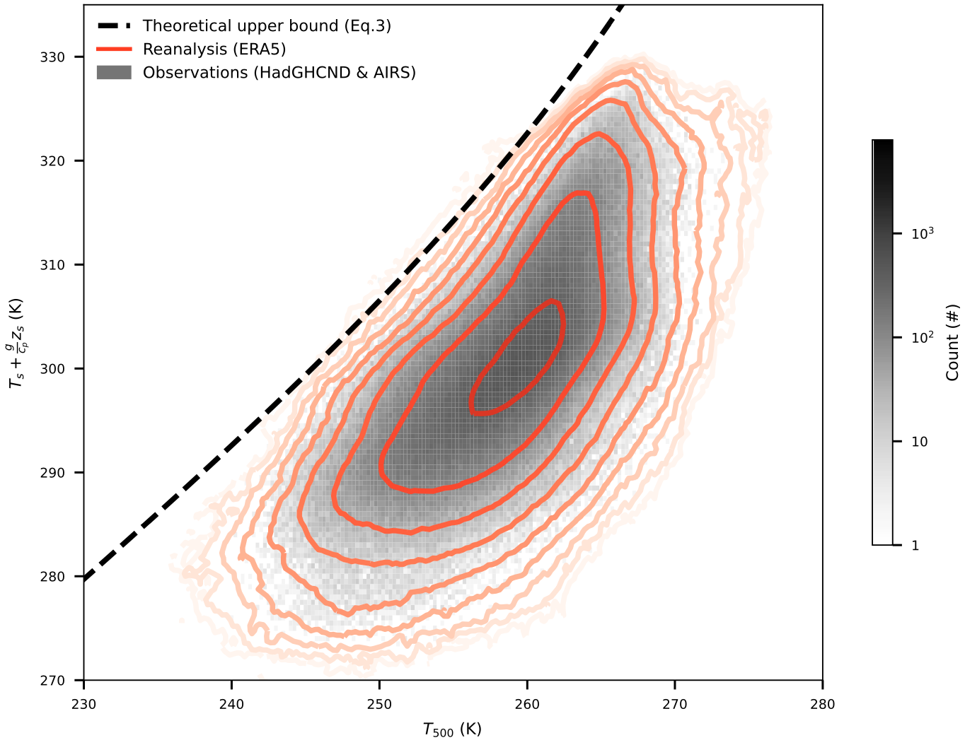
An upper bound for extreme temperatures over midlatitude land
Scientific Challenge
Heatwaves damage societies and are intensifying with global warming, but the maximum possible surface air temperature that can be achieved in heatwaves remained unknown.
Approach and Findings
Researchers showed that maximum surface air temperatures over midlatitude land are limited by the physics of convective cloud formation; this provides an upper bound for surface air temperature, which is shown to be consistent with observations.
Figure
Significance and Impact
Peak midlatitude surface air temperatures are found to increase about twice as fast as global mean surface air temperature.
This work provides evidence from multiple observational sources supporting a quantitative limit on how hot air can get over midlatitude land and how fast that limit will rise as Earth warms.
Theoretical upper bound of surface air temperature (Ts; black dashed line) and histogram of daily-maximum Ts and daily-mean 500-hPa temperatures (T500) over midlatitude land from reanalysis (red contours) and observations (gray shading).
Zhang, Y. and Boos, W.R., 2023. An upper bound for extreme temperatures over midlatitude land. Proceedings of the National Academy of Sciences, 120, p.e2215278120
Department of Energy • Office of Science • Biological and Environmental Research
Notes:
Word highlight text here.

