Slide 1
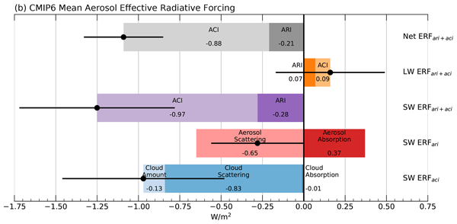
Comparison of methods to estimate aerosol effective radiative forcings
Science Question
How does the present-day aerosol effective radiative forcing (ERF) vary among climate models, and what are the various components contributing to it?
How are the different methods of estimating aerosol ERF related?
Key Accomplishments
The team identified biases in previous estimates of aerosol ERF in climate models, produced corrected estimates, and provided code for the community to also compute them. In addition, the team made explicit the quantitative links between several methods of quantifying aerosol radiative forcing.
Impact
Accurate quantification of aerosol radiative forcing and its sub-components is crucial for understanding the past and future simulated climate.
The team found that the direct radiative forcing from absorbing aerosols averaged across CMIP6 is more than 40% larger than previously estimated.
Model-to-model differences in aerosol ERF are particularly large and come from both direct and indirect components, each of which has competing contributions from changes in scattering and absorption of SW radiation.
Global mean aerosol ERF values averaged across CMIP6 models, separated into direct (ARI) and indirect (ACI) effects for LW, SW, and net radiation. The direct effect is further separated into its scattering and absorption components. The indirect effect is further separated into its amount, scattering, and absorption components. The sum of terms in each row is indicated by the black dot, with the inter-model standard deviation of each sum indicated by the horizontal error bar.
Zelinka, M. D., Smith, C. J., Qin, Y., and Taylor, K. E., 2023: Comparison of methods to estimate aerosol effective radiative forcings in climate models, Atmos. Chem. Phys., 23, 8879–8898, doi:10.5194/acp-23-8879-2023.
Notes:
The Science
PCMDI Scientists and colleagues at University of Leeds have identified biases in previously published estimates of aerosol radiative forcing in climate models, produced corrected estimates across a suite of climate models, and provided code for the scientific community to also compute them. In addition, the team made explicit the quantitative links between several methods of quantifying aerosol radiative forcing.
The Impact
The primary uncertainty in how strongly Earth's climate has been perturbed by human activities comes from the unknown radiative impact of aerosol changes. Accurately quantifying these forcings is important, and the team discovered errors in previous calculations. Most notably, the direct radiative forcing from absorbing aerosols averaged across CMIP6 models is more than 40% larger than previously estimated. Model-to-model differences in aerosol radiative forcing are particularly large and come from both aerosol direct and indirect components, each of which has competing contributions from changes in scattering and absorption of SW radiation.
Summary
Uncertainty in the effective radiative forcing (ERF) of climate primarily arises from the unknown contribution of aerosols, which impact radiative fluxes directly and through modifying cloud properties. Climate model simulations with fixed sea surface temperatures but perturbed atmospheric aerosol loadings allow for an estimate of how strongly the planet's radiative energy budget has been perturbed by the increase in aerosols since pre-industrial times. The approximate partial radiative perturbation (APRP) technique further decomposes the contributions to the direct forcing due to aerosol scattering and absorption and to the indirect forcing due to aerosol-induced changes in cloud scattering, amount, and absorption, as well as the effects of aerosols on surface albedo. Here we evaluate previously published APRP-derived estimates of aerosol effective radiative forcings from these simulations conducted in the sixth phase of the Coupled Model Intercomparison Project (CMIP6) and find that they are biased as a result of two large coding errors that – in most cases – fortuitously compensate. The most notable exception is the direct radiative forcing from absorbing aerosols, which is more than 40 % larger averaged across CMIP6 models in the present study. Correcting these biases eliminates the residuals and leads to better agreement with benchmark estimates derived from double calls to the radiation code. The APRP method – when properly implemented – remains a highly accurate and efficient technique for diagnosing aerosol ERF in cases where double radiation calls are not available, and in all cases it provides quantification of the individual contributors to the ERF that are highly useful but not otherwise available.

