Slide 1
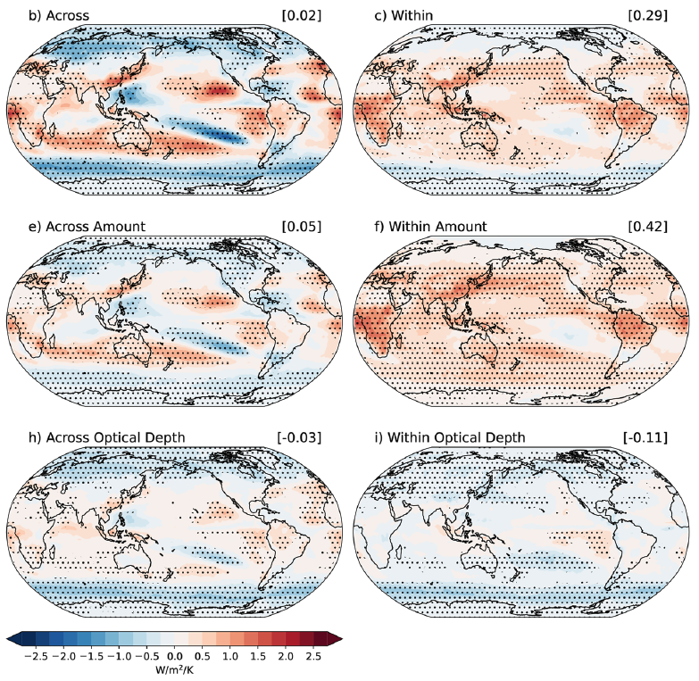
Detailing cloud property feedbacks with a regime‑ based decomposition
Scientific Achievement LLNL scientists have have brought together for the first time two independent techniques for diagnosing and partitioning cloud feedbacks, leading to novel insights. One technique details the cloud feedback arising from changes in cloud amount, altitude, and optical depth, while the other distinguishes cloud feedbacks occurring within specific weather regimes from those that occur due to changes in the frequency of occurrence of various weather regimes.
Significance & Impact
The marriage of these two techniques highlights the complementary roles of within-regime and across-regime feedback components. The spatial pattern of the cloud feedback is largely set by changes in the occurrence of the various cloud regimes, but it makes little global mean contribution. In contrast, the component due to changes in cloud properties within existing regimes is highly uniform in space, across models, and across regimes, leading to very consistent positive SW cloud amount and negative SW cloud optical depth feedback components.
Multi-model mean across- and within-regime SW cloud feedback components, and their cloud amount and optical depth sub-components. The across-regime component sets the spatial structure but contributes little to the global mean value. The within-regime component is highly uniform in sign and is the dominant contributor to the global mean feedback.
Research Details The team detailed the steps necessary to perform this merger of techniques, and then demonstrated the various insights that it yields for the shortwave cloud feedback in ten global climate models performing uniform warming experiments. Code to perform the analysis was made available to the community.
Zelinka, M. D., I. Tan, L. Oreopoulos, G. Tselioudis, 2022: Detailing Cloud Property Feedbacks with a Regime-Based Decomposition, Clim Dyn., doi:10.1007/s00382-022-06488-7.
Notes:
The Science
Lawrence Livermore National Laboratory scientists have brought together for the first time two independent techniques for diagnosing and partitioning cloud feedbacks, leading to novel insights. One technique details the cloud feedback arising from changes in cloud amount, altitude, and optical depth, while the other distinguishes cloud feedbacks occurring within specific weather regimes from those that occur due to changes in the frequency of occurrence of various weather regimes. The authors detail the steps necessary to perform this merger of techniques, and then demonstrate some insights that it yields for the shortwave cloud feedback in ten global climate models performing uniform warming experiments.
The Impact The marriage of these two techniques highlights the important and complementary roles of within-regime and across-regime feedback components. The spatial pattern of the cloud feedback is largely set by changes in the relative frequency of occurrence of the various cloud regimes. Specifically, shifts from thinner, less extensive cloud cover regimes toward thicker, more extensive cloud types causes negative amount and optical depth feedbacks outside of the tropics, with the opposite responses at lower latitudes. Averaged over models and globally, however, this feedback is near zero. In contrast, the within-regime component – that due to changes in cloud properties within existing regimes – is highly uniform in space, across models, and across regimes. Specifically, cloud amount decreases with warming and optical depth increases with warming at nearly every location, in nearly every model, and in nearly every regime, leading to very consistent positive SW cloud amount and negative SW cloud optical depth feedback components. This within-regime component makes the dominant contribution to the global mean feedback averaged across models.
Summary Diagnosing the root causes of cloud feedback in climate models and reasons for inter-model disagreement is a necessary first step in understanding their wide variation in climate sensitivities. Here we bring together two analysis techniques that illuminate complementary aspects of cloud feedback. The first quantifies feedbacks from changes in cloud amount, altitude, and optical depth, while the second separates feedbacks due to cloud property changes within specific cloud regimes from those due to regime occurrence frequency changes. We find that in the global mean, shortwave cloud feedback averaged across ten models comes solely from a positive within-regime cloud amount feedback countered slightly by a negative within-regime optical depth feedback. These within-regime feedbacks are highly uniform: In nearly all regimes, locations, and models, cloud amount decreases and cloud albedo increases with warming. In contrast, global-mean across-regime components vary widely across models but are very small on average. This component, however, is dominant in setting the geographic structure of the shortwave cloud feedback: Thicker, more extensive cloud types increase at the expense of thinner, less extensive cloud types in the extratropics, and vice versa at low latitudes. The prominent negative extratropical optical depth feedback has contributions from both within- and across-regime components, suggesting that thermodynamic processes affecting cloud properties as well as dynamical processes that favor thicker cloud regimes are important. The feedback breakdown presented herein may provide additional targets for observational constraints by isolating cloud property feedbacks within specific regimes without the obfuscating effects of changing dynamics that may differ across timescales.

