Slide 1
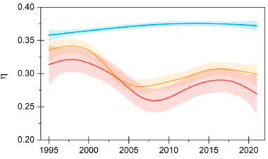



Adaptive Changes of Above & Belowground Biomass over Permafrost Region
Scientific Achievement
Climate warming has led to a 17% increase in the above- to belowground biomass ratio (η) in alpine wetlands, while η decreased by 26% in alpine meadows and 48% in alpine steppes.
Soil temperature emerged as the primary climatic driver influencing η, with different effects across vegetation types, with soil moisture modulating the response direction.
Wetland vegetation
meadow
Significance and Impact
The increase in aboveground biomass in alpine wetlands and the greater allocation of biomass to belowground in alpine meadows and steppes reflect adaptive responses to temperature changes.
These adaptations have implications for carbon storage and emissions, emphasizing the need for refined ecosystem models to better predict future climate scenarios.
steppe
Smoothed changes of above- to belowground biomass ratio (η) at the alpine wetlands (blue; n = 680), alpine meadows (orange; n = 1,214), and alpine steppes (red; n = 1,119)
Research Details
  This study analyzed data from 3,013 plots and 26,337 species-specific measurements across the Tibetan Plateau from 1995 to 2021, focusing on three vegetation types: alpine wetlands, meadows, and steppes.
  Long-term trends and drivers of η were identified through statistical analysis.
Yun, H., Ciais, P., Zhu, Q., Chen, D., Zohner, C.M., Tang, J., Qu, Y., Zhou, H., Schimel, J., Zhu, P. and Shao, M., 2024. Changes in above-versus belowground biomass distribution in permafrost regions in response to climate warming. Proceedings of the National Academy of Sciences, 121(25), p.e2314036121. DOI: 10.1073/pnas.2314036121
Supported by the Reducing Uncertainties in Biogeochemical Interactions through Synthesis and Computation (RUBISCO) Scientific Focus Area Project of the U.S. Department of Energy.

