Slide 1
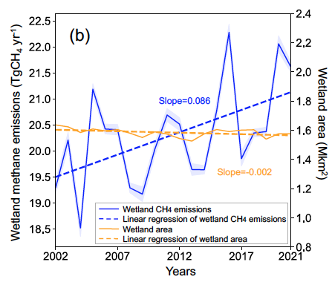





High latitudes wetland methane emission is growing
Scientific Achievement
We find the strong signal of wetland CH₄ emission increases occurred in early summer (June and July) and were mainly driven by warming (52.3%) and ecosystem productivity (40.7%).
2 °C temperature anomaly in 2016 led to the highest recorded annual CH₄ emissions (22.3 Tg CH₄ yr−1) over this region, driven primarily by Western Siberian lowlands.
Significance and Impact
Boreal-Arctic wetlands are vulnerable to climate change. This study analyzed two decades (2002–2021) of methane emissions over this region revealed a 9% increase.
Strong inter-annual variation was observed and peak emission was due to overlapping of arctic warming with wetland hotspots.
Annual Boreal–Arctic wetland CH₄ emissions and and wetland area from 2002 to 2021. Dashed lines indicate the linear regression results for wetland CH₄ emissions (p = 0.017, two-sided t-test) and wetland area (p = 0.064).
Research Details
  This analysis used eddy covariance and chamber observations and highlighted the big impacts of warming and vegetation activity.
  A causality-guided machine learning approach (developed at LBNL) was used to upscale and analyze Boreal-Arctic wetland CH₄ dynamics
Yuan, K.. et al. Boreal-Arctic wetland methane emissions modulated by warming and vegetation activity. Nat. Clim. Chang. (2024).https://doi.org/10.1038/s41558-024-01933-3
Work is performed at LBNL, supported by Reducing Uncertainties in Biogeochemical Interactions through Synthesis and Computation (RUBISCO) Scientific Focus Area Project.

