Slide 1
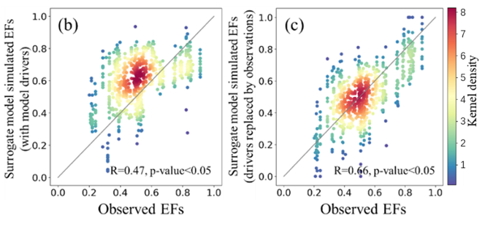


Understanding and reducing the uncertainties of land surface energy flux partitioning within CMIP6 land models
Scientific Challenges
Land surfaces dissipate energy through latent and sensible heat fluxes that modulate atmospheric temperature and humidity
CMIP6 models overestimated the land sensible heat flux fraction
Approach and Results
Surface forcing variables e.g., vapor pressure deficit, dominated the CMIP6 energy fluxes uncertainties
Accounting for forcing biases improved CMIP6 model ensembles
ML-based surrogate model further improved CMIP6 energy fluxes through parameterization
Figure 1. Machine learning and causal inference approaches substantially improved CMIP6 models’ predictions of evaporative fraction (EF). Before (left) and after (right) the uncertainty reduction in the CMIP6 model predictions.
Significance
CMIP6 model structure imperfections remained for evergreen broadleaf forest ecosystems.
This work developed an effective framework to reduce model uncertainties in simulating land surface energy flux partitioning and highlighted the need for model structural improvements
K. Yuan, Q. Zhu, W.J. Riley, F. Li, H. Wu. "Understanding and reducing the uncertainties of land surface energy flux partitioning within CMIP6 land models." Agricultural and Forest Meteorology 319 (2022): 108920, DOI: 10.1016/j.agrformet.2022.108920

