Slide 1
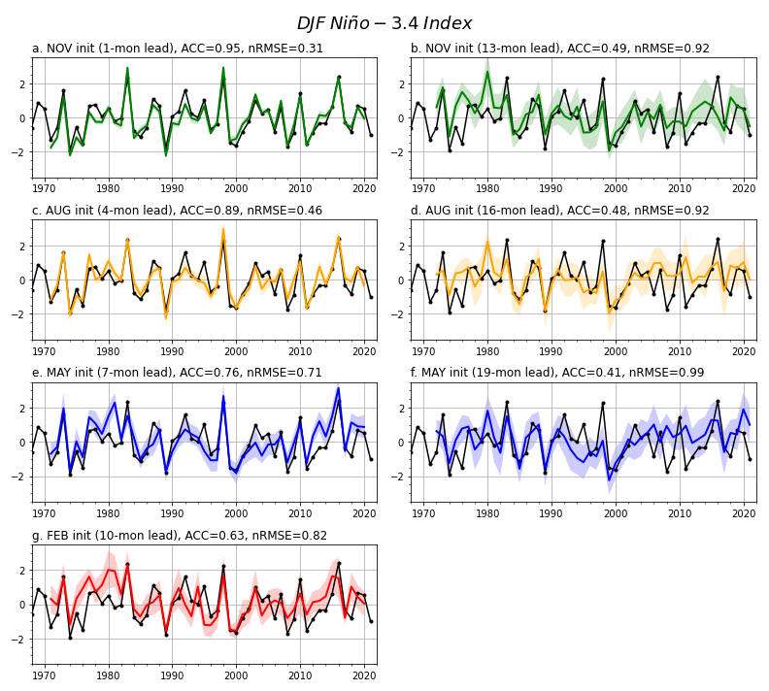
The Seasonal-to-Multiyear Large Ensemble (SMYLE) prediction system using the Community Earth System Model version 2
S. G. Yeager, N. Rosenbloom, A. A. Glanville, X. Wu, I. Simpson, H. Li, M. J. Molina, K. Krumhardt, S. Mogen, K. Lindsay, D. Lombardozzi, W. Wieder, W. M. Kim, J.H. Richter, M. Long, G. Danabasoglu, D. Bailey, M. Holland, N. Lovenduski, W. G. Strand, and T. King (2022): GMD: https://doi.org/10.5194/gmd-15-6451-2022
OBJECTIVE
To explore the potential for seasonal-to-multiyear prediction of Earth system quantities of interest spanning the atmosphere, ocean, land, and sea ice. To document a new community resource for prediction research.
Predictions of DJF Niño-3.4
APPROACH
20-member ensemble hindcasts using CESM2 initialized quarterly between 1970-2019 and integrated for 24 months.
IMPACT
The CESM2 SMYLE prediction system exhibits very competitive seasonal skill (e.g., for ENSO) while permitting a fuller exploration of extended (multiyear) prediction performance for Earth system fields (including ocean biogeochemistry) than is possible in other systems. SMYLE data and experimental infrastructure is freely available, and so this overview paper is expected to have significant broader impact within the geoscience community as a template and toolkit supporting future climate prediction research.
Observed
Predicted

