Slide 1
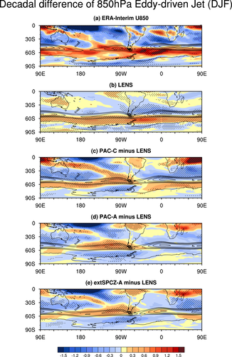
The role of coupled feedbacks in the decadal variability
of the Southern Hemisphere eddy-driven jet
Reanalysis
Objective: Identify the role of coupled ocean-atmosphere processes in the influence of tropical Pacific sea surface temperatures on SH high latitudes
Human-induced
Research:
--Yang et al (2020) identified the importance of tropical Pacific sea surface temperatures in the poleward shift of the SH mid-latitude jet (red shading) over the satellite era
--The mechanism was explored by designing experiments with CAM5 to mimic the CESM1 tropical Pacific pacemaker experiments but with coupling to the ocean turned off
--The CAM5 experiments captured the observed jet shift in the Pacific basin but not the Atlantic or Indian
Impact:
--Results indicate the importance of air-sea coupling in driving the teleconnections between the tropical Pacific and South Atlantic-Indian jet variations
Tropical Pacific - coupled
Tropical Pacific – uncoupled
Southern Hemisphere summertime wind shift between
1979-1998 and 1999-2013. Climatological winds are shown in black contours
--This highlights the importance of considering internal variability such as the Interdecadal Pacific Oscillation in future predictions of SH winds and their impacts on the ocean and cryosphere
Yang D., J.M. Arblaster, G.A. Meehl, M.H. England, 2021, The role of coupled feedbacks in the decadal variability
of the Southern Hemisphere eddy-driven jet, JGR-Atmospheres, https://doi.org/10.1029/2021JD035023

