Slide 1
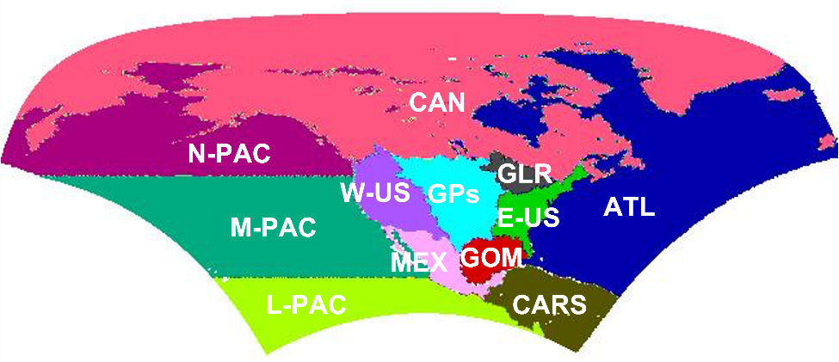
Moisture Sources for Great Lakes Region Precipitation: Climatology and Recent Changes
Objective
Understand the detailed spatiotemporal variations in moisture contribution from different source regions to the Great Lakes region (GLR).
Approach
Use the Dynamic Recycling Model (DRM) to quantify moisture sources of the GLR precipitation.
Employ various reanalysis/analysis products for intercomparison, including the North America Regional Reanalysis (NARR), ECMWF Reanalysis v5 (ERA-5), Modern-Era Retrospective analysis for Research and Applications, Version 2 (MERRA-2), and NCEP Final (FNL) Operational Global Analysis.
Subdivide the studied domain into 12 source regions and evaluate their respective contributions to the GLR precipitation on a daily scale.
Impact
Identified the major sources of moisture for precipitation in the GLR, which are the Great Plains (GPs) and the GLR.
Revealed that moisture evapotranspired from the GPs is more important for stronger precipitation in the GLR.
Highlighted a significant increasing trend in moisture contribution from the Mid-Pacific to springtime Great Lakes precipitation.
.3
.3
.3
Delineation of 12 moisture source regions (top) for the GLR. Moisture contribution from top three moisture source regions according to MERRA-2 and ERA-5. The GPs and GLR are the dominant moisture sources across the reanalysis products.
Yang, Z., Qian, Y., Xue, P., Wang, J., Chakraborty, T. C., Pringle, W. J., et al. “Moisture sources of precipitation in the Great Lakes Region: Climatology and recent changes,” Geophysical Research Letters, 50, e2022GL100682, (2023). [DOI: 10.1029/2022GL100682]
Notes:
12 Source regions:
northeastern Pacific (N-PAC), eastern mid-Pacific (M-PAC), tropical Pacific (T-PAC), Canada and Alaska (CAN), western United States (W-US), the Great Plains (GPs), eastern United States (E-US), Mexico (MEX), Gulf of Mexico (GOM), Caribbean Region (CARS), and the GLR itself
Reanalysis:
NARR for 1979–2019 (Mesinger et al. 2006); ERA-5 for 1979–2019 (Hersbach et al. 2020); MERRA-2 for 1981–2019 (GMAO 2015); and NCEP final analysis (FNL) for 2016–2018 (NCEP/NOAA/NWS/DOC 2000).

