Slide 1
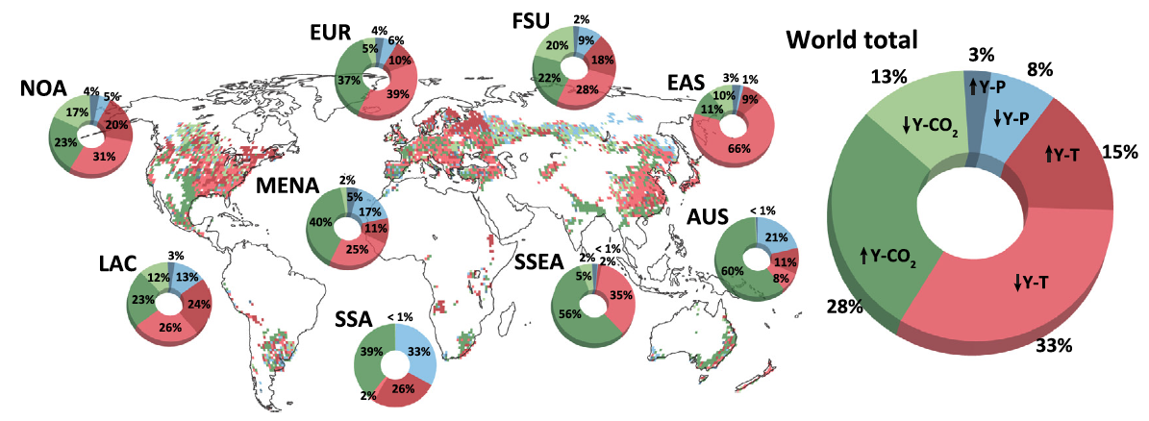
Site-specific field management is needed to feed the world in the 21st century
Scientific Challenges
Crop yields are controlled by a wide range of interacting factors, driving the need for mechanistic models to explore food production
Climate change and growing population threaten global food security
Approach and Results
Analyzed wheat yield responses to climate change and field management adaptation using ecosys, a mechanistic crop model, evaluated against observed yields over 13 years at 3749 sites
Considered early planting, increased irrigation, and increased fertilizer application
Figure. Globally, the largest negative effect on wheat yields by year 2100 was from rising temperatures, while the largest positive effect was from increasing CO₂ concentrations. However, these effects varied regionally and drove diverse management needs to improve yields.
Significance
Addressing food shortages under climate change is a great challenge facing mankind
Used a mechanistic model, compared to a observational dataset (3749 sites over 13 years), to evaluate management
Early planting with later-maturing varieties provided the most benefit to future yields under climate change
Woo, D. K., W. J. Riley, R. F. Grant, and Y. Wu, (2022) “Site-specific field management adaptation is key to feeding the world in the 21st century”, Agricultural and Forest Meteorology, 327, https://doi.org/10.1016/j.agrformet.2022.109230.

