Slide 1
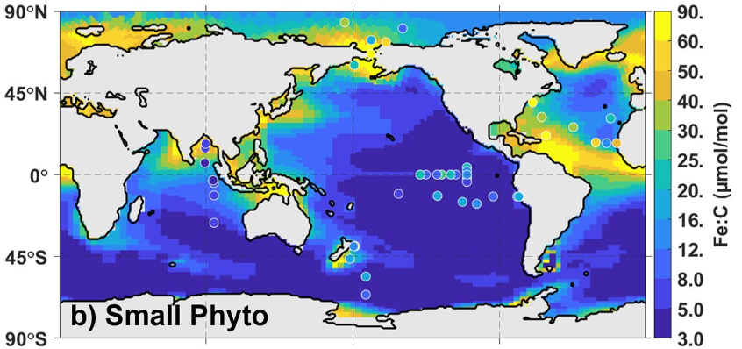
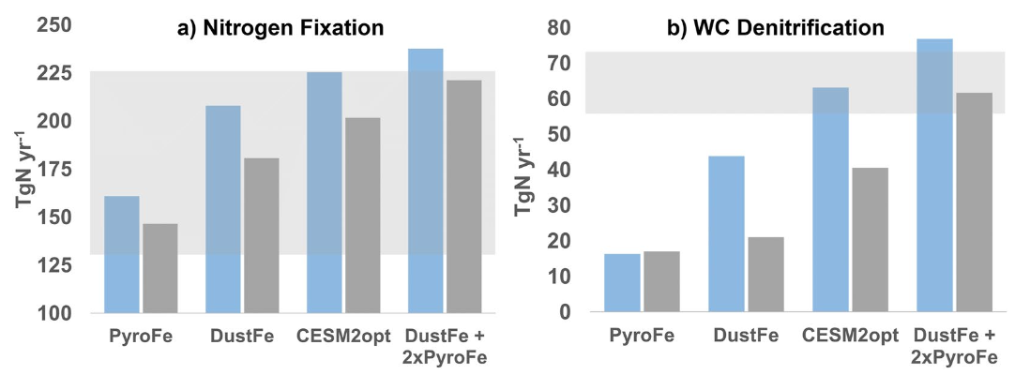
Acclimation of Phytoplankton Fe:C Ratios
Dampens the Biogeochemical Response to Varying
Atmospheric Deposition of Soluble Iron
Objectives:
Develop improved treatment of phytoplankton iron to carbon (Fe:C) ratios in MARBL
Quantify the biogeochemical impacts of dynamic phytoplankton Fe:C ratios
Results/Impacts:
A) Accounting for phytoplankton Fe:C acclimation
dampens impacts on the carbon and nitrogen cycles
from varying levels of atmospheric iron deposition.
B) Predicting how carbon export by the biological pump
will respond to climate change and other forcings,
requires accurately accounting for variability in the
elemental composition of the plankton.
Summary
Iron is the growth-limiting nutrient over > 33% of the oceans
Variable plankton Fe:C ratios link carbon export and the ocean’s biological pump to available iron. Fe:C variations strongly impact important nitrogen cycle fluxes and the response to varying atmospheric iron deposition.
Figure 1. Simulated and observed Fe:C values,
varying by more than an order of magnitude..
Figure 2. Plankton Fe:C modifies key nitrogen cycle fluxes in response to varying atmospheric iron deposition.
Wiseman, N. A., Moore, J. K., Twining, B. S., Hamilton, D. S., & Mahowald, N. M. (2023). Acclimation of phytoplankton Fe:C ratios dampens the biogeochemical response to varying atmospheric deposition of soluble iron. Global Biogeochemical Cycles, 37, e2022GB007491. https://doi. org/10.1029/2022GB007491.
ESMD
Notes:
This research funded by BER-ESMP grant (DE-SC0022177 to J.K.M.) and the RGMA RUBISCO-SFA (DE-SC0016539 to J.K.M.).

