Slide 1
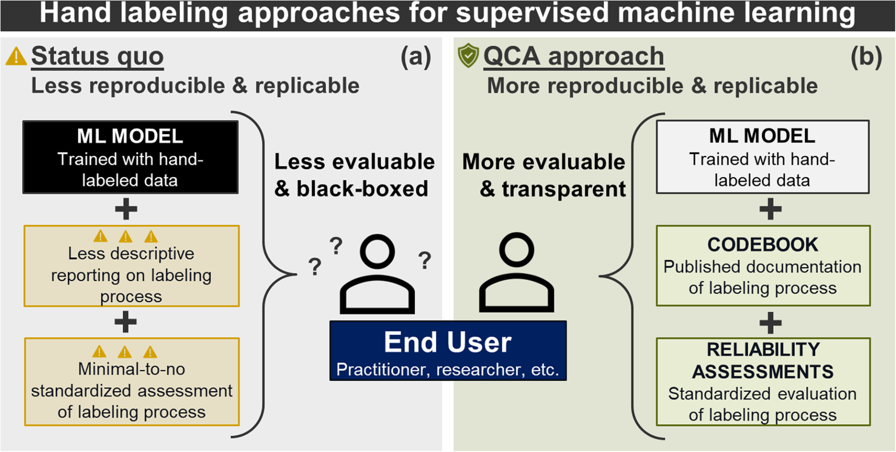
Increasing the Reproducibility and Replicability of Supervised AI/ML in the Earth Systems Science by Leveraging Social Science Methods
OBJECTIVE
Provide an introduction to Quantitative Content Analysis (QCA) to improve reproducibility and replicability of hand labeling for supervised machine learning applications in Earth System Science.
APPROACH
We introduce and demonstrate a social science method to the Earth System Sciences to help improve the reproducibility and replicability of hand labeling data for supervised machine learning tasks. Quantitative Content Analysis (QCA) requires the documentation (a codebook) of the decision making process used to classify samples along with a reliability assessment to evaluate the consistency among labelers using the codebook. This iterative, thorough process results in more methodologically transparent machine learning applications.
IMPACT
This work demonstrates how supervised machine learning applications in the Earth System Sciences can leverage social science methods such as QCA to improve the reproducibility and replicability of hand labeling tasks (e.g. labeling atmospheric rivers or fronts). As machine learning continues to grow in popularity and is applied to a variety of different data sets (e.g. observations, CESM, and E3SM), it is important to use these tools to ensure results can be reproduced and replicated.
Figure 1:
Conceptual diagram of how QCA addresses weaknesses of the hand labeling status quo (a) and can help make supervised ML more reproducible and replicable (b).
Wirz, C. D., Sutter, C., Demuth, J. L., Mayer, K. J., Chapman, W. E., Cains, M.G., et al. (2024). Increasing the reproducibility and replicability of supervised AI/ML in the Earth systems science by leveraging social science methods. Earth and Space Science, 11, e2023EA003364. https://doi.org/10.1029/2023EA003364

