Slide 1
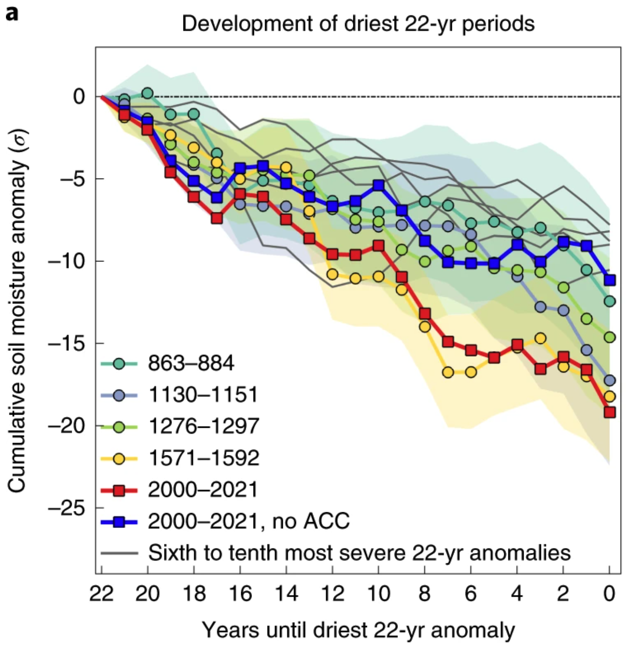
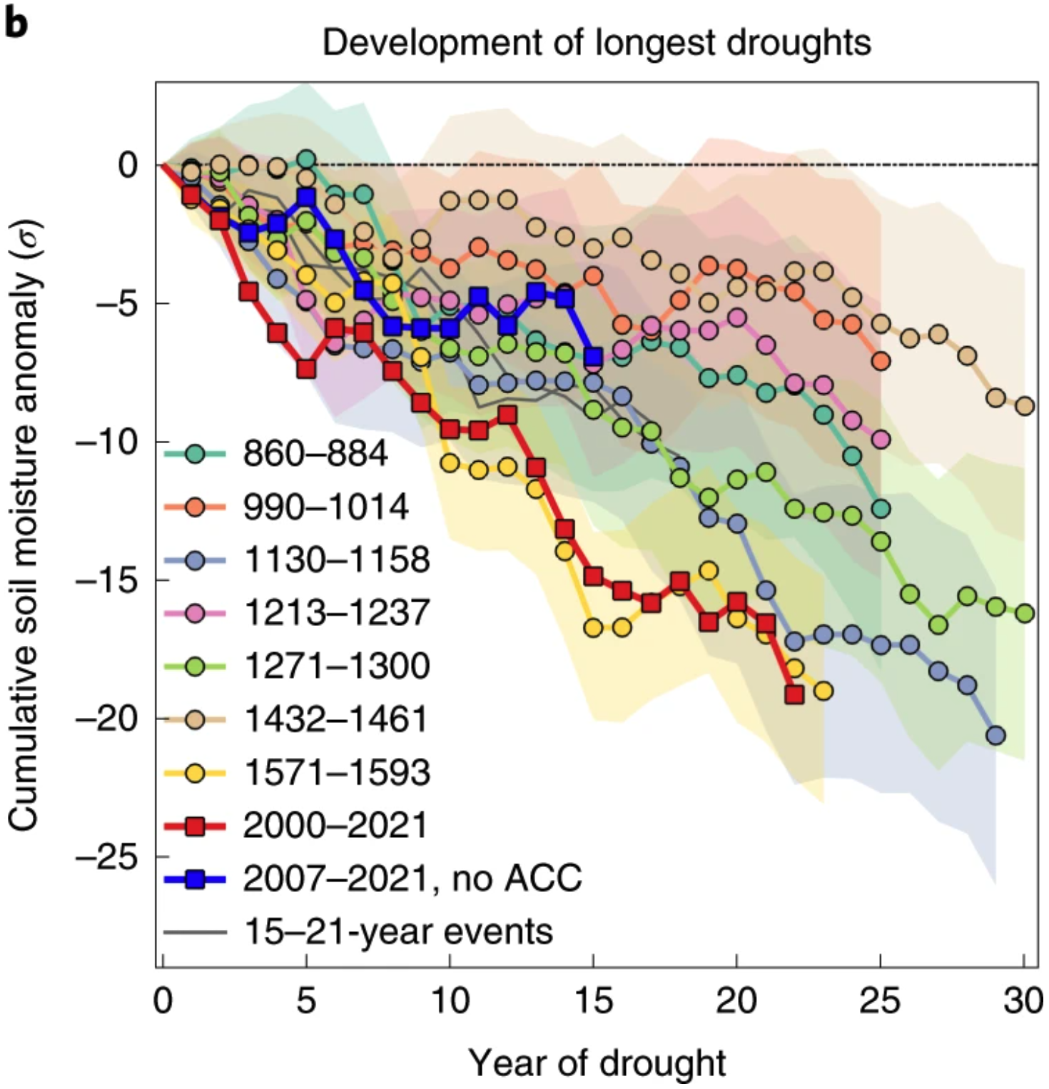
Rapid intensification of the emerging southwestern North American megadrought in 2020–2021
Williams, A.P., Cook, B.I. and Smerdon, J.E., 2022, Nature Climate Change,12, 232-234. doi:10.1038/s41558-022-01290-z
Objective
Since the year 2000, southwestern North America has been unusually dry due to low precipitation totals and heat, punctuated most recently by exceptional drought in 2021. From 2000 to 2021, October–September SWNA precipitation was 8.3% below the 1950–1999 average and temperature was 0.91 °C above average. The objective of this research was to quantify how abnormal those conditions have been in the context of the last millennium and whether human impacts on the climate contributed to the severe drought conditions.
Approach
We used tree rings in the western US to reconstruct soil moisture conditions back to 800 CE. These reconstructions allowed us to estimate that the 2000-21 period was the dries 22-yr period since at least 800 CE. We also used climate models to estimate that 42% of the cumulative soil moisture deficit can be attributed to human-induced warming.
Figure. Time series of cumulative SWNA soil moisture anomalies during the development of the most negative 22-yr mean soil moisture anomalies since 800 CE (a) and from the beginning of all drought events ≥15 years (b). In b, each drought period ends in its final year (based on our definition of an extended drought event, the longest megadroughts lasted 30 years). “no anthropogenic climate change (ACC)” represents the drought events after removing the human component of temperature change (dark blue lines).
Impact
Our results have been reported in every major news medium, and have been widely covered in the international press as well. As the drought continues, our results continue to be referenced as an important context for the historical severity of the ongoing drought in the southwestern US and impact that human-caused climate change has had on the conditions.

