Slide 1
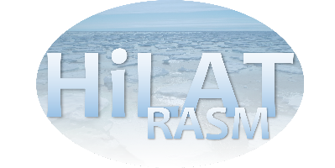
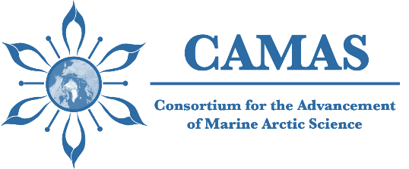
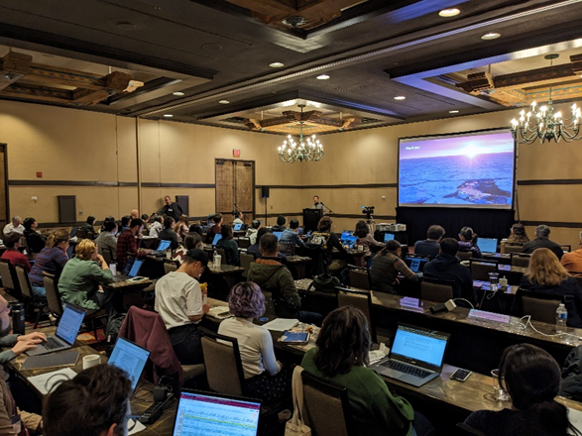
Advancing Marine Arctic Science through Facilitating International Collaborations
Objective
Advance the understanding and model representation of key marine Arctic processes that contribute to the rapid changes in the Arctic, by facilitating and enhancing international collaboration on marine Arctic science.
Research
The Consortium for the Advancement of Marine Arctic Science (CAMAS) held its inaugural workshop and early-career school in Santa Fe, NM.
The gathering of Arctic marine scientists discussed current state of knowledge and develop ideas for collaborative projects.
Nine research projects have been proposed and research teams are being formed to execute these projects.
The inaugural workshop and early-career school of the Consortium for the Advancement of Marine Arctic Science (CAMAS) was held in Santa Fe, NM, February 13-16, 2024.
Impact
The workshop was attended by 80 marine Arctic scientists from around the world.
The early-career school was attended by 35 postdocs and students who enjoyed lectures from experts in the field.
The next CAMAS Workshop will be held in Seattle, WA, April 14-18, 2025.
Weijer, W., Veneziani, M., Clement Kinney, J., Maslowski, W., Zhang, J., & Steele, M. (2024). Advancing Marine Arctic Science Through Facilitating International Collaborations. Bulletin of the American Meteorological Society, E1762–E1767. Doi: 10.1175/BAMS-D-24-0175.1.

