Slide 1
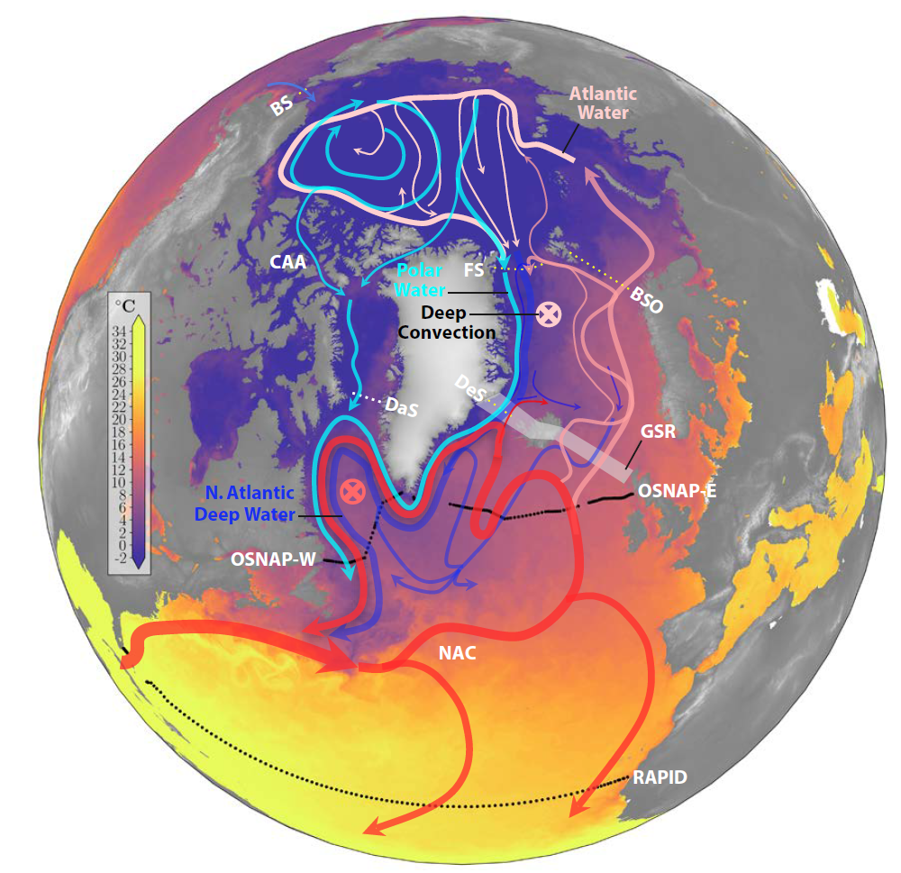
On the interactions between the Arctic Mediterranean and the Atlantic Meridional Overturning Circulation
Objective
Summarize recent progress in our understanding of the two-way interactions between the Arctic climate system and the Atlantic Meridional Overturning Circulation.
Research
The Atlantic Meridional Overturning Circulation (AMOC) is tightly coupled to the Arctic Ocean.
Recent advances in monitoring (e.g., OSNAP, Argo) and modeling (e.g., E3SM-Arctic) capabilities have significantly increased our understanding of these connections.
The AMOC impacts the Arctic mostly through its (partial) control on poleward heat transport.
The Arctic impacts the AMOC primarily through changes in its freshwater budget and the impact on surface salinity.
Impact
Both the AMOC and Arctic are projected to change dramatically in a warming climate.
Understanding the mutual interactions between these important elements of the climate system is critical for our ability to project the future of our Earth system.
Schematic of the horizontal circulation in the North Atlantic and Arctic Oceans, overlain on Sea Surface Temperature. Polar Water (cyan) lies at the surface, North Atlantic Deep Water (blue) lies at depth, and Atlantic Water from the North Atlantic Current lies at the surface in the Atlantic and Nordic Seas and at intermediate depth in the Arctic Ocean (red and pink).
Weĳer, W., T. W. N. Haine, A. H. Siddiqui, W. Cheng, M. Veneziani, and P. Kurtakoti. 2022. Interactions between the Arctic Mediterranean and the Atlantic Meridional Overturning Circulation: A review. Oceanography, https://doi.org/10.5670/oceanog.2022.130.

