Slide 1
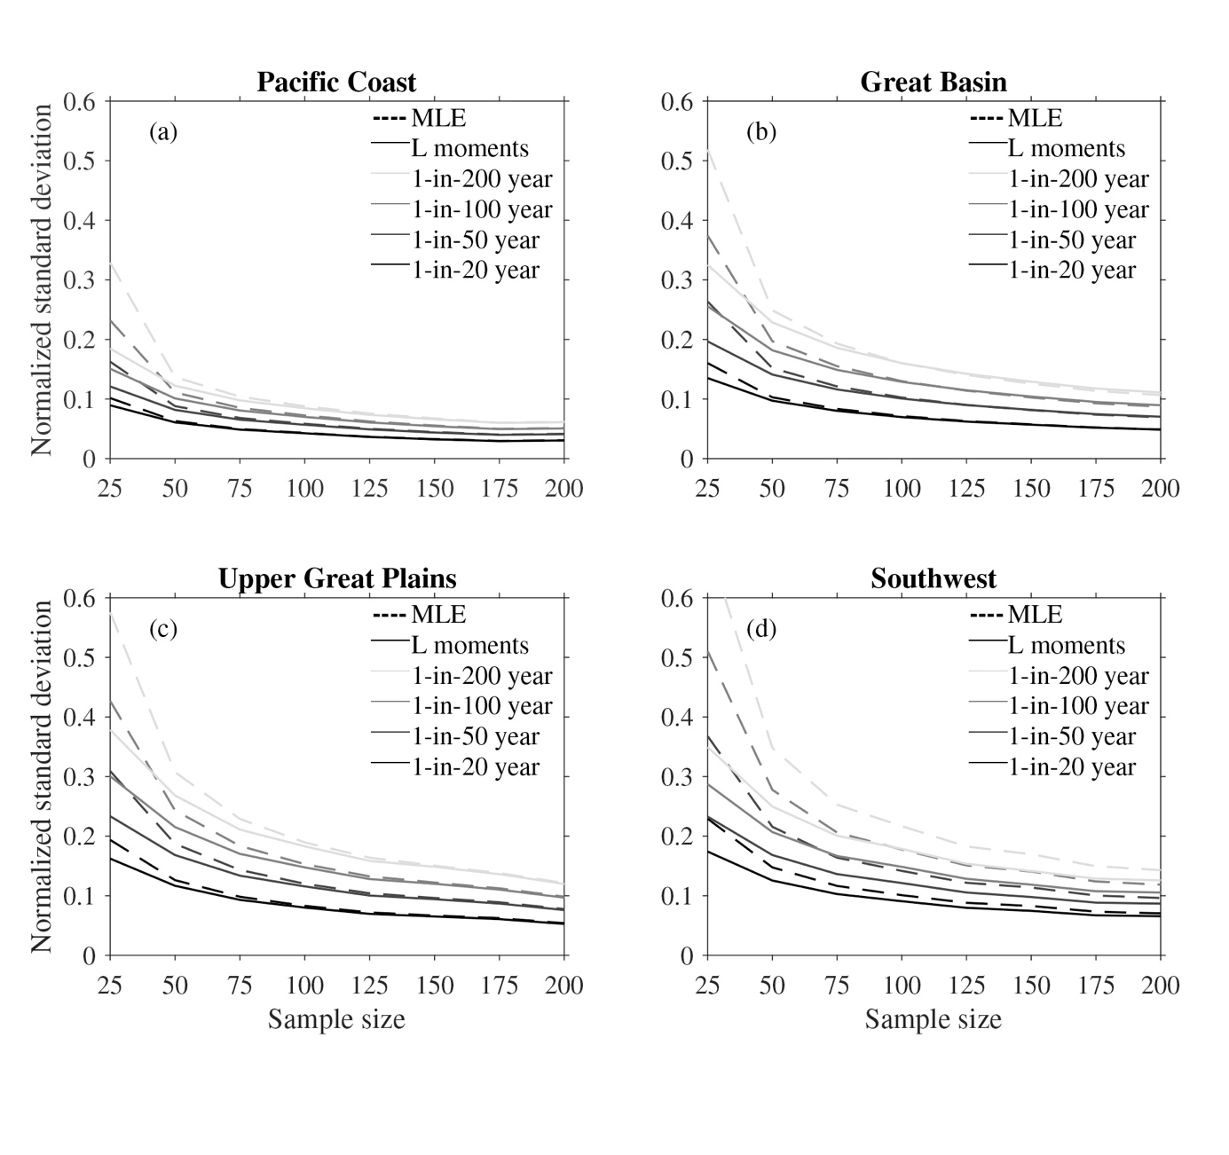
On the uncertainty of long-period return values of extreme daily precipitation.
Methods for calculating return values of extreme precipitation and their uncertainty are compared using daily precipitation rates over the Western U.S. and Southwestern Canada from a large ensemble of climate model simulations. The roles of return-value estimation procedures and sample size in uncertainty are evaluated for various return periods. We compare 2 different generalized extreme value (GEV) parameter estimation techniques, the L-moments and maximum likelihood (MLE), against empirical methods.
Even for very large datasets, confidence intervals calculated using GEV techniques are narrower than those calculated using empirical methods. The more efficient L-moments parameter estimation techniques result in narrower confidence intervals than MLE parameter estimation techniques at small sample sizes, but similar best estimates.
This study provides several recommendations to climate data analysts about statistical analyses of extreme precipitation and temperature. The primary contributions of this paper are to compare uncertainty in estimated precipitation return values between various methods of estimating return values; to compare uncertainty in estimated precipitation return values across various sample sizes; to compare practical ways of quantifying uncertainty when the sample size is limited; and to evaluate whether uncertainty approaches zero at increasing sample size.
Normalized regional average uncertainty associated with GEV estimate of extreme precipitation return values for various sample sizes ranging from 20 to 200 years. MLE (dashed) and L-moments (solid).
Wehner MF, Duffy ML, Risser M, Paciorek CJ, Stone DA and Pall P (2024) On the uncertainty of long-period return values of extreme daily precipitation. Frontiers in Climate. 6:1343072. doi: 10.3389/fclim.2024.1343072

