Slide 1
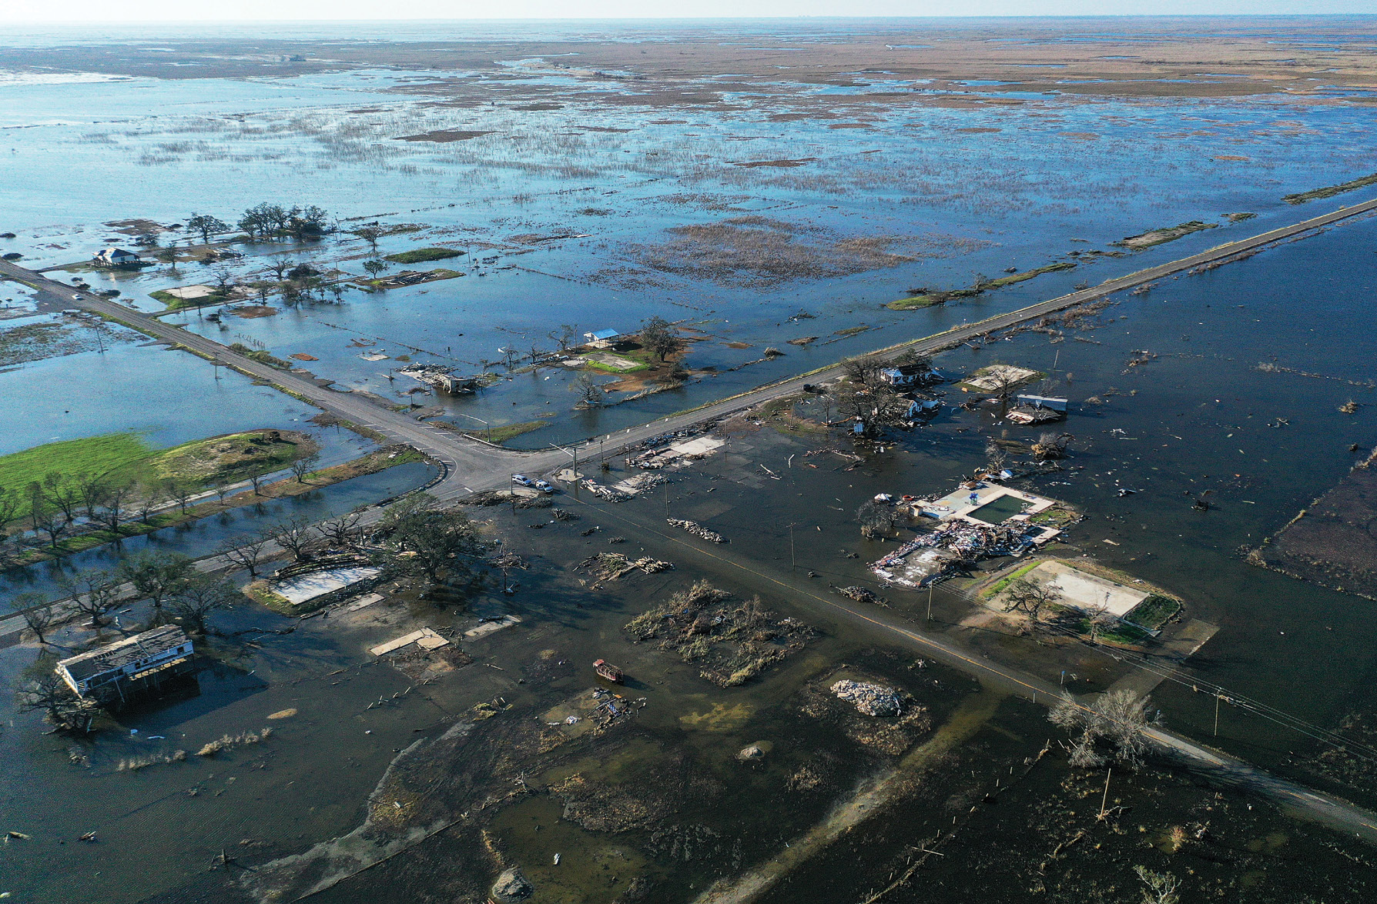
Connecting extreme weather events to climate change 
Developments in attribution science over the past two decades have extended attribution statements about observed long term climate change to robust statements about the human influence on many types of actual individual extreme weather events, including heat waves, heavy precipitation events and floods. Extension of attribution science to socio-economic damages and inequalities is now underway with the potential for legal consequences. This review article, intended for a general scientific audience, highlights recent developments in quantifying the human influence on extreme weather events and their impacts.
This review uses examples from the RGMA funded projects to illustrate what extreme event attribution is and its relative strengths and weaknesses. In addition to discussing the human influence on individual extreme weather events, it also discusses the rapidly developing area of quantifying the impacts and costs of these events. A special box discussing how causal inference techniques are fundamental to attribution is included to help clarify this often confusing and sometimes philosophical topic.
Hurricane Harvey flood. Background picture for the review article.
According the 6th Assessment Report of the Intergovernmental Panel on Climate Change: “Human-induced climate change is already affecting many weather and climate extremes in every region across the globe.” Indeed, this summer of 2023 has been particularly extreme in the US and elsewhere. Event attribution both aids in our understanding of how humans are affecting this aspect of the climate and helps communicate the risks of extreme weather in a changing climate to the general public
Michael Wehner; Connecting extreme weather events to climate change. Physics Today 1 September 2023; 76 (9): 40–46. https://doi.org/10.1063/PT.3.5309

