Slide 1
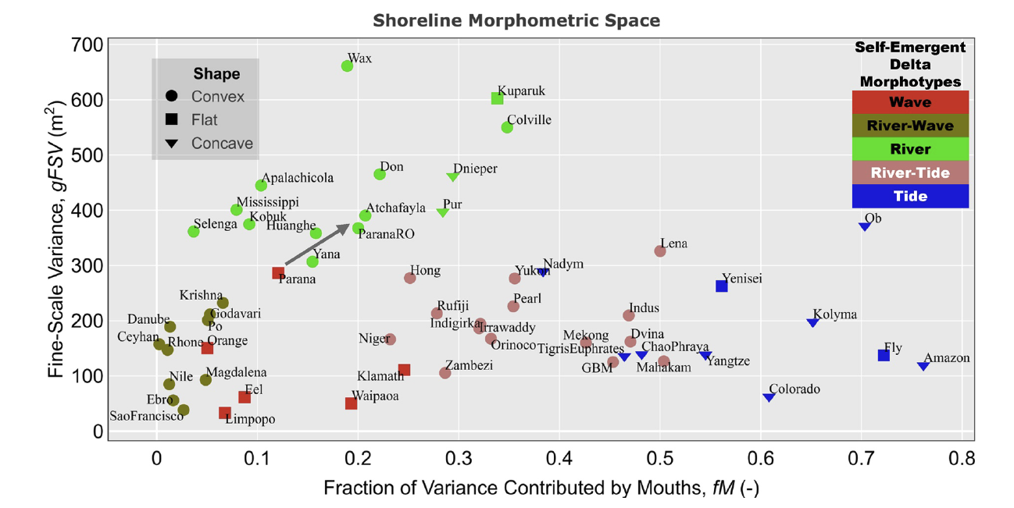
Delta shoreline metrics link form to process
Scientific Challenge
Identifying the relative balance of rivers, waves, and tides on river delta morphology has been a longstanding challenge in earth surface research.
Approach and Findings
We used three process-informed, geometric, and spectral metrics to characterize multiscale shoreline features. Our unsupervised clustering of delta shoreline metrics revealed five distinct delta morphotypes which correspond to distinct forcings.
Significance and Impact
By linking form to process, our method allows for evaluating dominant controls on delta based on easily measurable metrics even for river systems where process-based data is scarce.
The Shoreline Morphometric Space (SMS). Deltas shorelines are positioned in the three-dimensional space constructed by the macroscale shape, fM, and gFSV metrics. Unsupervised clustering of the SMS using k-prototypes reveals five self-emergent delta morphotypes, that is, classes of morphologically similar systems.
Vulis, L., Tejedor, A., Ma, H., Nienhuis, J. H., Broaddus, C. M., Brown, J., et al. (2023). River delta morphotypes emerge from multiscale characterization of shorelines. Geophysical Research Letters, 50, e2022GL102684. https://doi. org/10.1029/2022GL102684
Department of Energy • Office of Science • Biological and Environmental Research
Notes:
Word highlight text here.

