Slide 1
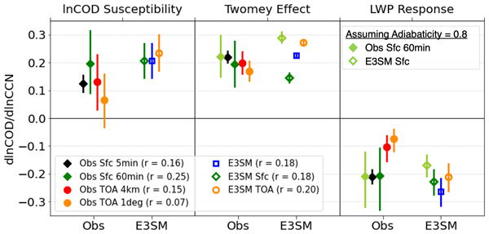
Cloud response to aerosol confounded by its effectiveness to hold water
Objectives
Develop metrics to evaluate E3SMv1’s representation of cloud albedo response to changes in aerosols using several different observational retrievals and assess possible reasons for dataset discrepancies in support of model improvement.
Approach
ARM Eastern North Atlantic surface and satellite measurements are used with E3SMv1 output and simulated measurements to produce several complementary datasets for evaluating variables and relationships affecting liquid cloud susceptibility to aerosols.
Impacts
The simulated cloud brightness increase with aerosols (Twomey effect) is suppressed by clouds in E3SMv1 that hold much less water than observed relative to the holding capacity of the clouds (lesser “adiabaticity”).
Removing adiabaticity differences produces a greater Twomey effect than observed related to a greater response of drop number (N_{d}) to aerosols in E3SMv1.
Overly subadiabatic E3SMv1 clouds are related to more frequent rain and weaker cloud top stability that increases cloud depth and potential mixing with dry air.
Aerosol-N_{d} relationships change as the method for retrieving N_{d} changes, highlighting the importance of multiple observational and model estimates when performing model evaluation.
Cloud albedo (COD) response to aerosols (CCN) with Twomey Effect and liquid water path (LWP) response contributions for each observational (Obs) and E3SM dataset including how surface retrieval values with variable adiabaticity (green) change when assuming a constant cloud adiabaticity (0.8, light green) consistent with satellite (TOA) retrievals (orange).
Varble, A.C., et al.: Evaluation of liquid cloud albedo susceptibility in E3SM using coupled eastern North Atlantic surface and satellite retrievals, ACP, 2023, DOI:10.5194/acp-23-13523-2023.

