Slide 1
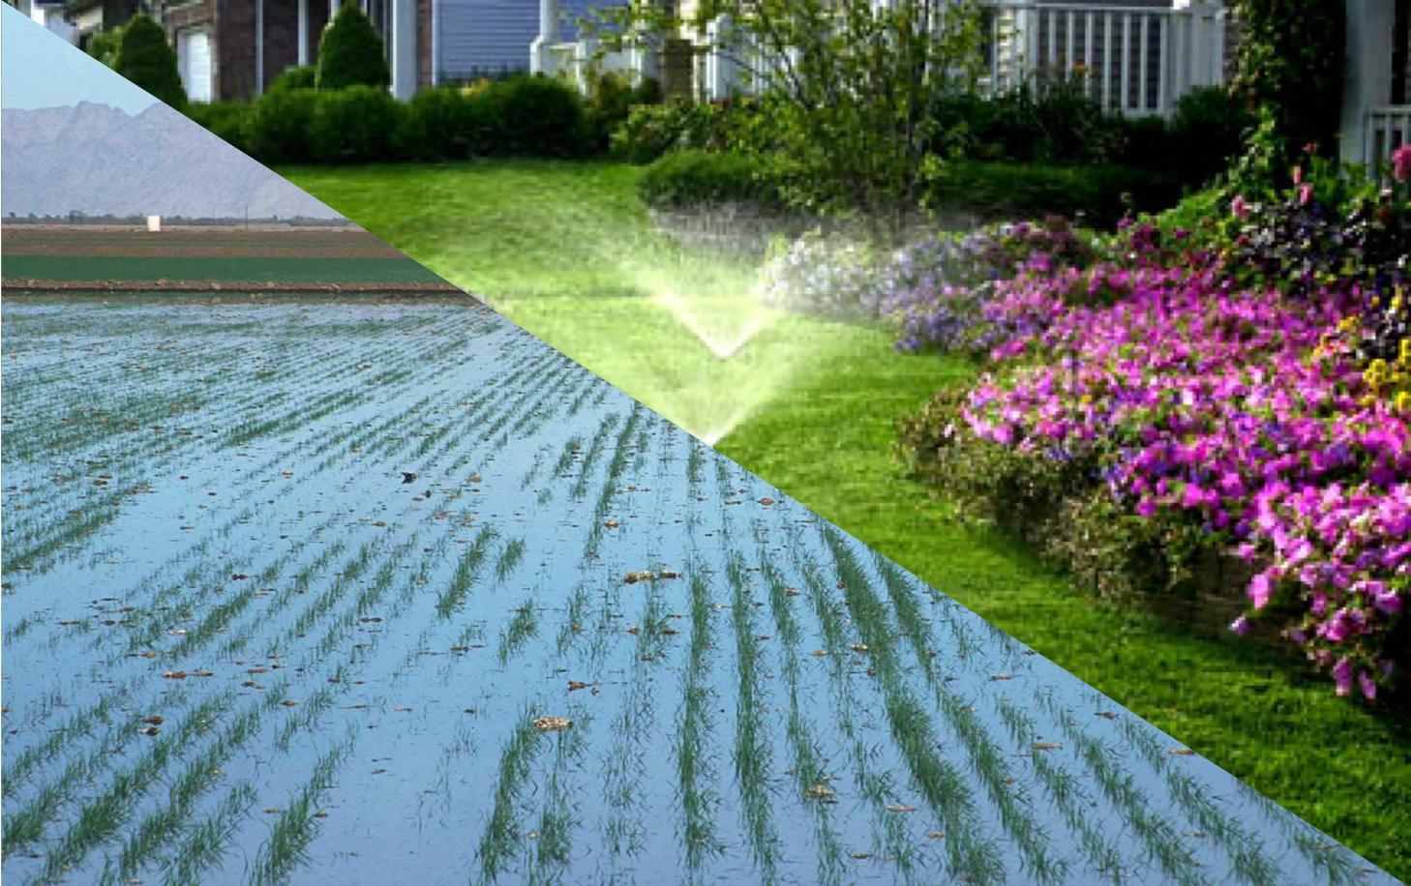
FUTURE OF IRRIGATION WATER DEMAND UNDER A CHANGING CLIMATE
Scientific Challenges
Climate modeling studies and observations do not fully agree on the implications of climate change-induced warming of the atmosphere for evapotranspiration (ET), a primary driver of irrigation water demand.
Approach and Results
We find that the vegetation response to the warming and drying atmospheric conditions, via regulation of stomata resistance, can offset the expected increase in evapotranspiration rates and irrigation water demands that would otherwise result from abiotic processes.
Significance
Increasing atmospheric temperature and vapor pressure deficit have minimal implications for nonwater limited evapotranspiration (ET) and irrigation water demand.
Anthropogenic warming of the atmosphere has minimal implications for mean relative humidity and the surface available energy, which are critical drivers of ET.
Vahmani, P., Jones, A. D., & Li, D. (2022). Will anthropogenic warming increase evapotranspiration? Examining irrigation water demand implications of climate change in California. Earth’s Future, 10, e2021EF002221. DOI: 10.1029/2021EF002221

