Slide 1
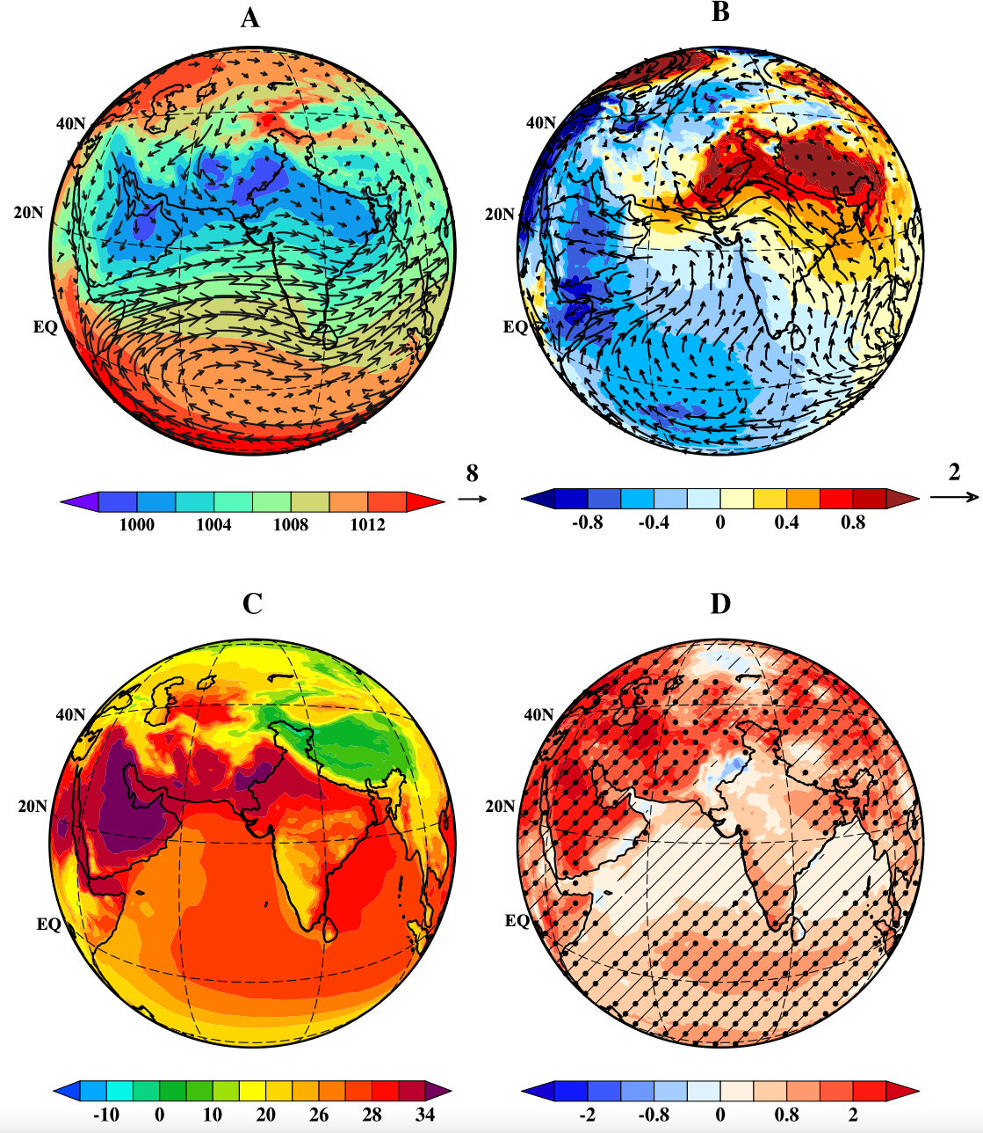
Attributing the recent weakening of the South Asian sub-tropical westerlies in summer
Upadhyaya, P., S. Mishra, J. T. Fasullo, I.-S. Kang, 2024, npj Climate and Atmospheric Science, doi: 10.1038/s41612-024-00777-0.
OBJECTIVE
In recent decades, the changes in the southwesterly monsoon circulation have been documented in conjunction with regional changes in temperature. Changes in subtropical westerlies have received less attention and the roles of external forcing and individual anthropogenic contributions relative to internal variability have not been addressed.
APPROACH
Here we use multiple CESM2 simulation ensembles including the large ensemble and multi-model ensembles from the Detection and Attribution Model Intercomparison Project to evaluate the potential role of anthropogenic forcing and explore the relative roles of individual climate forcings.
IMPACT
Trends in a range of climate model simulations suggest that the weakening is driven by a multiple anthropogenic forcings including anthropogenic aerosols, greenhouse gases (GHGs), and changes in land-use and land cover (LULC). Over the same period, sea-level pressure has increased by 0.6-1.0 hPa over South Asia's north-western regions, induced by cooling due to aerosol emission and LULC changes, and has decreased over the Arabian Peninsula (AP) mainly due to warming by GHGs. These changes in temperature and pressure act to weaken the regional pressure gradient, deflecting the sub-tropical westerlies from South Asia towards the AP and weakening the winds in the monsoon trough and its adjacent regions.
Climatology and trends of SLP, winds at 850hPa, and TS.
(A) Climatology and (B) the trends of SLP (underlying shading) during the Indian Summer Monsoon months (June-September) over 41 years (1980-2020). The overlaid wind vectors in (A) represent the climatological mean winds. The climatology shown in (A) is the mean of three data sets (ERA5, NCEP-NCAR, and MERRA2). The overlaid vectors and shaded background in (B) are the trends of winds and SLP, respectively, in ERA5. (C) Same as SLP in (A) but for near-surface temperature. The shaded background in (D) is the trend of near-surface temperature in ERA5; the stippling represents the regions where the trends exceed a 99% statistically significant level, and the hatching represents the regions where the sign of the trend agrees in all three datasets.

Slide 2
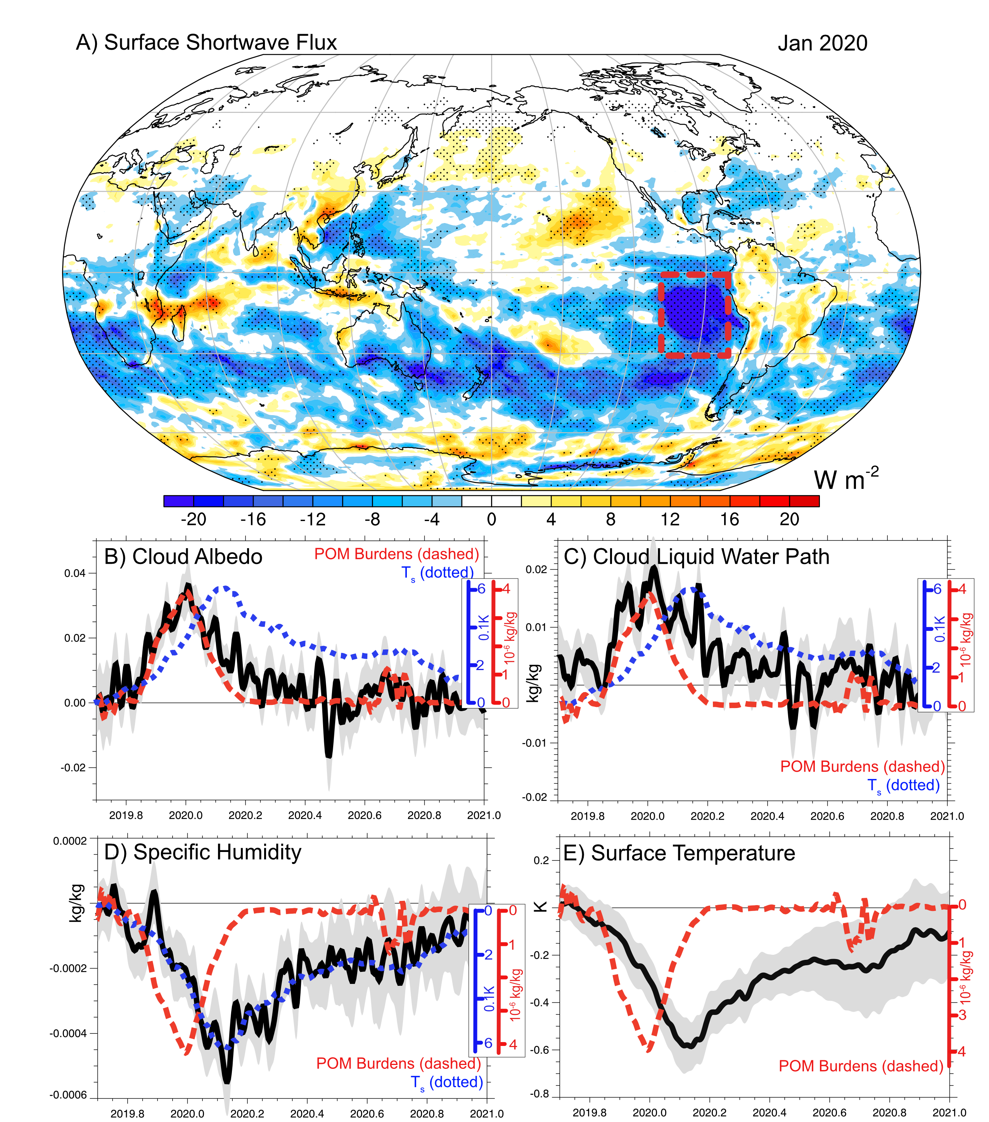
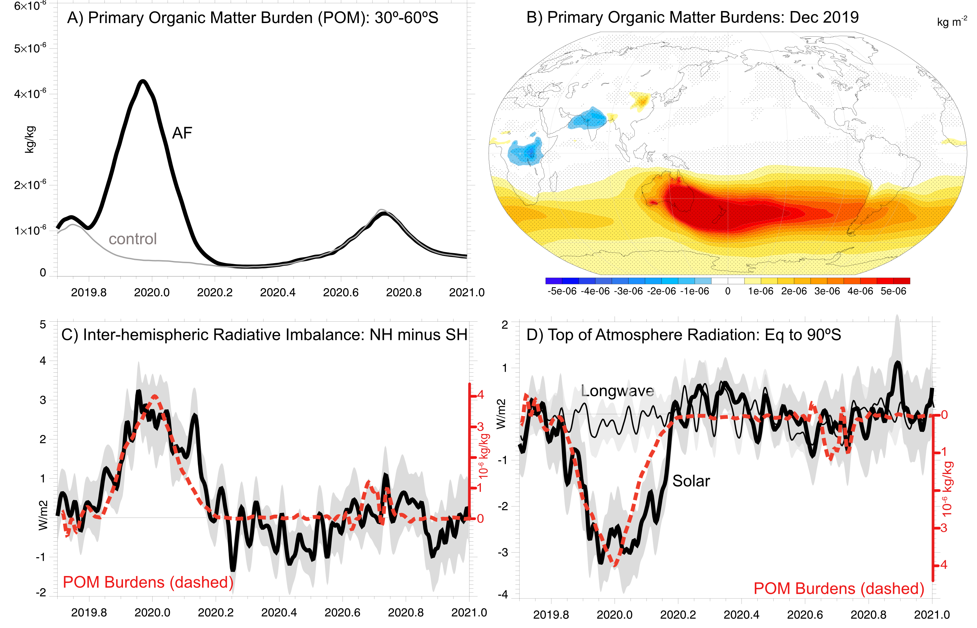
Large-Scale Responses
Eastern Pacific Responses

Slide 3
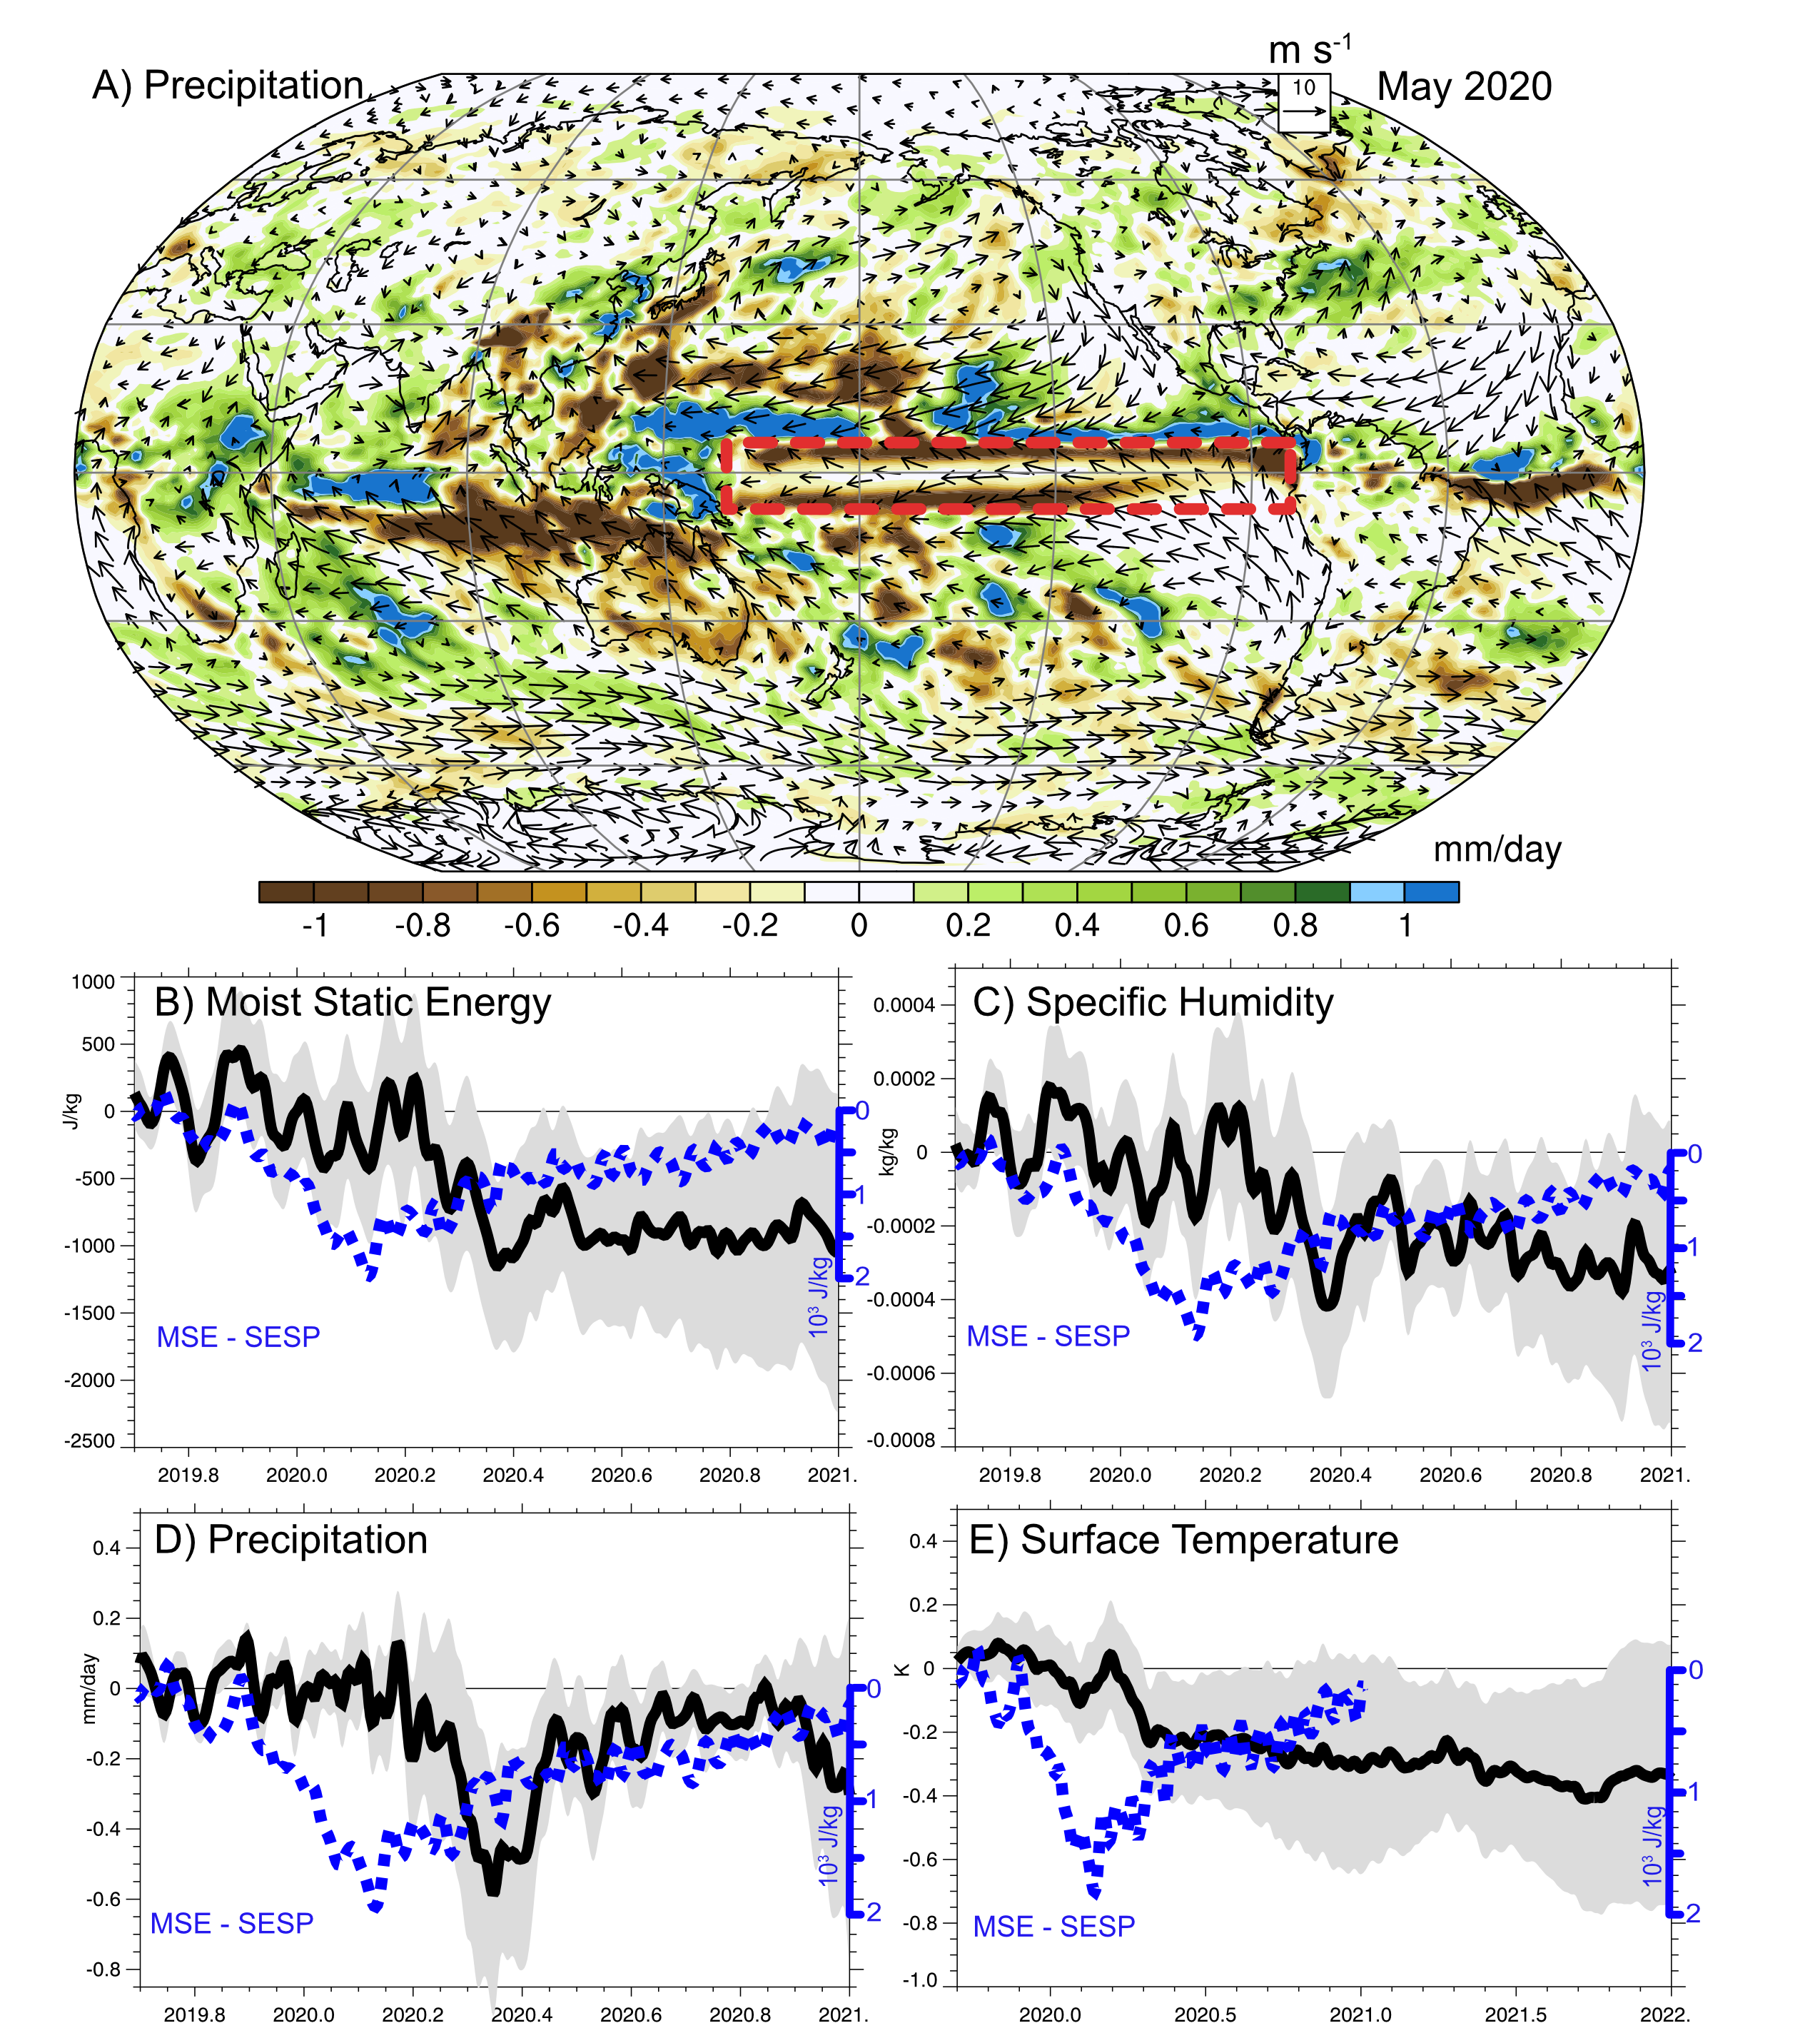
Equatorial Pacific Responses

