Slide 1
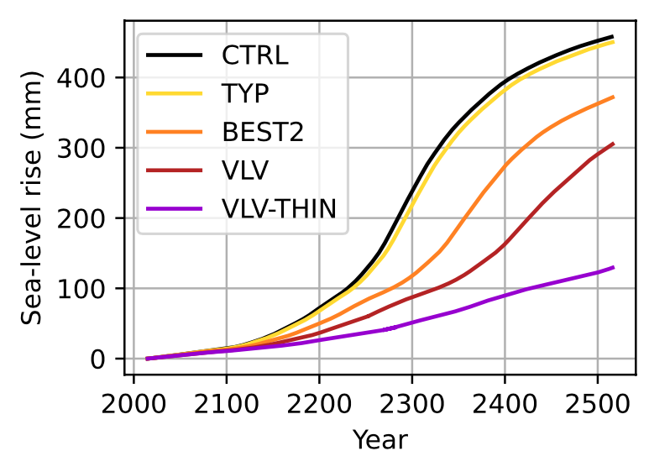
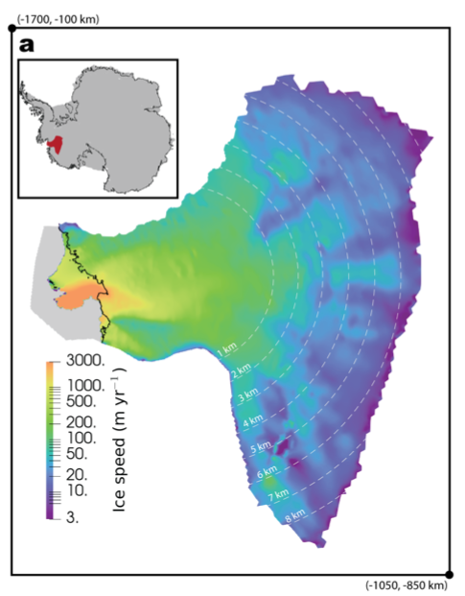
Bedrock uplift to reduce Thwaites Glacier retreat by 20% or more
Objective
Thwaites Glacier is subject to marine ice-sheet instability and could raise sea level by up to 1.5 meters.
However, it overlies a region of anomalously low mantle viscosity and thin lithoshpere.
Our goal is to investigate the effects of glacial isostatic adjustment on glacier mass loss here.
Research
Ran 500-year simulations of a coupled higher-order ice-sheet, MALI, and planar glacial isostatic adjustment model, giapy.
Considered solid-earth rheologies including typical-Earth and likely and extreme values for the region. Compared the results with different rheologies to a control excluding bedrock uplift.
Most likely rheology reduces glacier mass loss by >20% beyond about 100 yr. Extreme rheology reduces mass loss by over 70%.
Sea-level rise projections for Thwaites Glacier, Antarctica are reduced by 20% or more (orange line) when including crustal uplift as the glacier thins. Extreme, but possible, solid earth rheology (red and purple lines) reduce ice loss much more.
Impact
Crustal uplift will substantially slow retreat of Thwaites Glacier and should be included in Antarctic projections. More observations are needed to reduce the uncertainty in the strength of this negative feedback.
Reference: Book, Cameron, Matthew J. Hoffman, Samuel B. Kachuck, Trevor R. Hillebrand, Stephen F. Price, Mauro Perego, and Jeremy N. Bassis. 2022. Stabilizing Effect of Bedrock Uplift on Retreat of Thwaites Glacier, Antarctica, at Centennial Timescales. Earth and Planetary Science Letters 597:117798. https://doi.org/10.1016/j.epsl.2022.117798.

