Slide 1
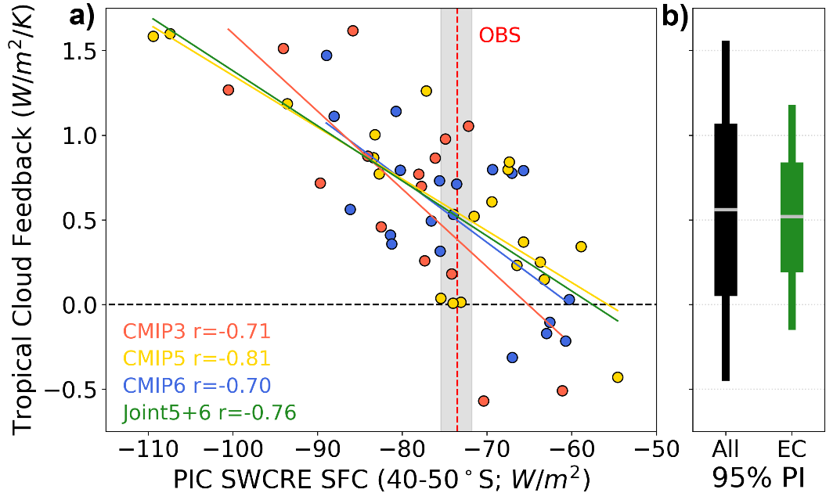
Relationship Between Tropical Cloud Feedback and Climatological Bias in Clouds
Scientific Achievement Scientists at University of California Los Angeles and Lawrence Livermore National Laboratory have proposed a new emergent constraint to reduce uncertainty in climate model estimates of future cloud feedback strength across the Tropics. They show that variability in projected tropical cloud changes is closely tied to historical shortwave cloud radiative properties across the Southern Ocean. They then use this intermodel relationship along with observations to produce a best estimate of tropical cloud feedback. Significance & Impact
Much of the uncertainty in future climate change projections stems from disagreements in how clouds will respond to future warming. It is therefore an important task to provide insight on which changes from the suite of global climate models are to be deemed most realistic. The emergent relationship shown here suggests a tropical cloud feedback value that broadly supports prior community assessments, reduces uncertainty by one-third, and points to negative values as highly unlikely. This linkage also provides modeling centers with a straightforward, observable, mean-state metric to track during model development that is robustly tied to future cloud feedback strength.
Scatterplot of climatological SFC SWCRE averaged over 40–50°S versus TCF where each point represents a different GCM. The vertical dashed red line represents an observed estimate from observations (CERES, ERA5) while gray shading denotes the range in annual mean values, which is used in the derivation of the EC (see Methods). 95% prediction intervals of TCF for the unconstrained CMIP5/6 ensemble (black) and the EC (green) are shown to the right. The horizontal gray dash denotes the central estimates, while the wider portion of the bar shows the 66% prediction interval.
Research Details Using three ensembles of global climate models, the team compared multiple metrics of climatological cloud/radiative properties with future cloud feedback across a variety of latitudinal bands. The most robust linkage was found for shortwave cloud radiative effect across the Southern Hemisphere mid-latitudes. Further work sought to untangle the complex physical mechanisms driving this relationship.
Thackeray, C. W., M. D. Zelinka, J. Norris, A. Hall, and S. Po-Chedley, 2024: Relationship Between Tropical Cloud Feedback and Climatological Bias in Clouds, Geophysical Research Letters, doi:10.1029/2024GL111347.
Notes:
The Science
Scientists at University of California Los Angeles and Lawrence Livermore National Laboratory have proposed a new emergent constraint to reduce uncertainty in climate model estimates of future cloud feedback strength across the Tropics. They show that variability in projected tropical cloud changes is closely tied to historical shortwave cloud radiative properties across the Southern Ocean. They then use this intermodel relationship along with observations to produce a best estimate of tropical cloud feedback.
The Impact Much of the uncertainty in future climate change projections stems from disagreements in how clouds will respond to future warming. It is therefore an important task to provide insight on which changes from the suite of global climate models are to be deemed most realistic. The emergent relationship shown here suggests a tropical cloud feedback value that broadly supports prior community assessments, reduces uncertainty by one-third, and points to negative values as highly unlikely. This linkage also provides modeling centers with a straightforward, observable, mean-state metric to track during model development that is robustly tied to future cloud feedback strength.
Summary Global climate model (GCM) projections of future climate are uncertain largely due to a persistent spread in cloud feedback. This is despite efforts to reduce this model uncertainty through a variety of emergent constraints (ECs); with several studies suggesting an important role for present-day biases in clouds. Here, we use three generations of GCMs to assess the value of climatological cloud metrics for constraining uncertainty in cloud feedback. We find that shortwave cloud radiative properties across the Southern Hemisphere extratropics are most robustly correlated with tropical cloud feedback (TCF). Using this relationship in conjunction with observations, we produce an EC that yields a TCF value of 0.52 ± 0.34 W/m²/K, which equates to a 34% reduction in uncertainty. Thus, we show that climatological cloud properties can be used to reduce uncertainty in how clouds will respond to future warming.

