Slide 1
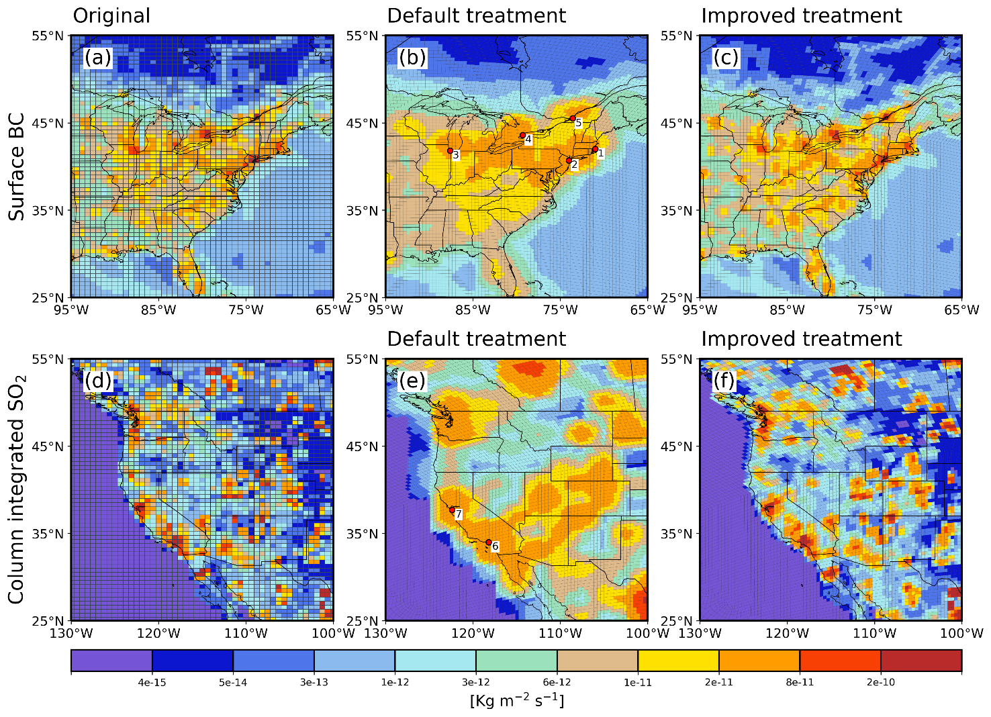
More Accurate Aerosol Emission Needed for High-Resolution Earth System Models
Objectives
Improve anthropogenic aerosol emission representations in E3SM and assess the impact on the simulated aerosol concentrations, optical properties, and anthropogenic aerosol forcing estimate.
Approach
Use high-resolution emission inventory to remap the emission data conservatively to model native grid offline and directly read/apply the emissions in simulation. Online interpolation is no longer needed.
Conduct nudged simulations with the original and revised emission treatment and assess the errors.
Evaluate the impact on aerosol simulations in both globally uniform, standard-resolution simulations and regionally refined high-resolution simulations.
Impacts
The revised emission treatment better represents the spatial heterogeneity and mass conservation of anthropogenic aerosol emissions in E3SM .
It is especially useful for variable-resolution model applications to investigate the anthropogenic aerosol effect at convection-permitting scales.
Spatial distribution of the present-day surface BC (top) and SO₂ emissions from (a, d) the original high-resolution data, (b, e) the default emission treatment, and (c, f) the revised emission treatment. Red markers indicate major cities with large anthropogenic emissions from (1) Boston, (2) New York, (3) Chicago, (4) Toronto, (5) Montreal, (6) Los Angeles, and (7) San Francisco respectively.
Hassan, T., Zhang, K., Li, J., Singh, B., Zhang, S., Wang, H., and Ma, P.-L.: Impacts of spatial heterogeneity of anthropogenic aerosol emissions in a regionally refined global aerosol–climate model, Geosci. Model Dev., 17, 3507–3532, https://doi.org/10.5194/gmd-17-3507-2024, 2024.

