Slide 1
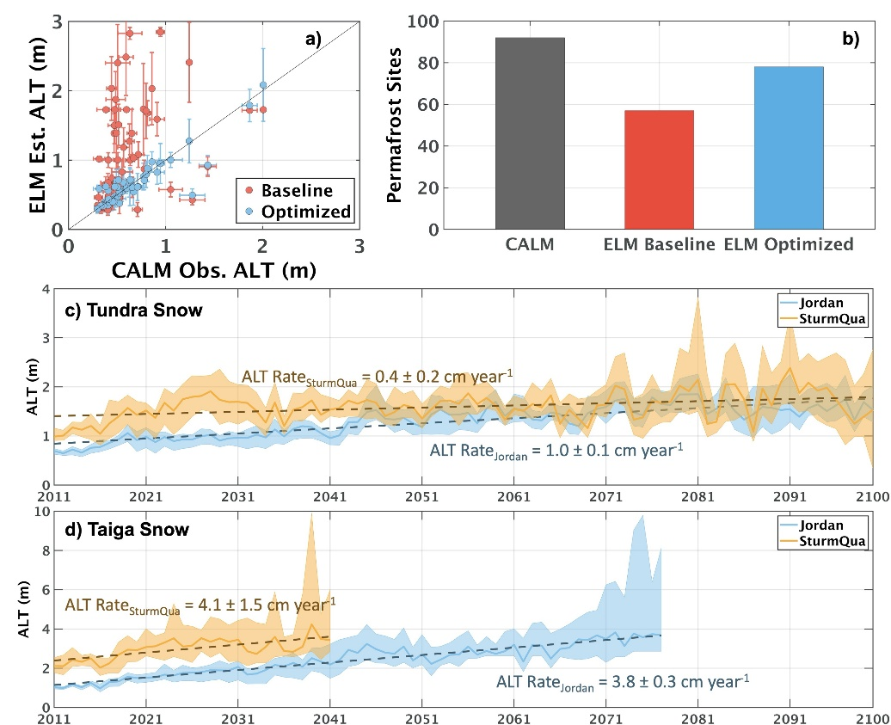
Peat Soils and Snow Schemes Mutually Impact Permafrost Simulations
Scientific Achievement
Improved E3SM land model (ELM) simulations of soil temperature and Active Layer Thickness (ALT) at >100 permafrost sites across the pan-Arctic domain by optimizing peat soil- and snow-related schemes.
Significance and Impact
Yielded a comprehensive assessment of the impacts of peat soils and snow schemes on predicted permafrost conditions. Highlighted the importance of accurately representing both snow processes and peat soil profiles in models to enhance permafrost simulations.
Research Details
Conducted site-level simulations at CALM permafrost sites across the pan-Arctic; Improved ELM-simulated ALT using a knowledge-based hierarchical optimization procedure; Examined the impacts of peat soil organic matter profile, precipitation-phase partitioning methods, snow compaction, and snow thermal conductivity schemes on simulated ALT under current and future climates.
Optimized ELM significantly improved simulations of (a) ALT and (b) permafrost conditions. The quadratic Sturm snow scheme predicted deeper ALTs for both (c) Tundra and (d) Taiga sites, showing a 36-year earlier transition to permafrost-free for taiga sites.
Tao, Jing, William J. Riley, and Qing Zhu. "Evaluating the impact of peat soils and snow schemes on simulated active layer thickness at pan-Arctic permafrost sites." Environmental Research Letters 19, no. 5 (2024): 054027. doi: 10.1088/1748-9326/ad38ce.
Work was performed at LBNL and supported by NGEE-Arctic and RUBISCO.
Notes:
Permafrost stability is significantly influenced by the thermal buffering effects of snow and active-layer peat soils. In the warm season, peat soils act as a barrier to downward heat transfer due to their low thermal conductivity. In the cold season, the snowpack serves as a thermal insulator, retarding the release of heat from the soil to the atmosphere. Currently, many global land models overestimate permafrost soil temperature and active layer thickness (ALT), partially due to inaccurate representations of soil organic matter (SOM) density profiles and snow thermal insulation. In this study, we evaluated the impacts of SOM and snow schemes on ALT simulations at pan-Arctic permafrost sites using the Energy Exascale Earth System Model (E3SM) land model (ELM). We conducted simulations at the Circumpolar Active Layer Monitoring (CALM) sites across the pan-Arctic domain. We improved ELM-simulated site-level ALT using a knowledge-based hierarchical optimization procedure and examined the effects of precipitation-phase partitioning methods (PPMs), snow compaction schemes, and snow thermal conductivity schemes on simulated snow depth, soil temperature, ALT, and CO2 fluxes. Results showed that the optimized ELM significantly improved agreement with observed ALT (e.g., RMSE decreased from 0.83 m to 0.15 m). Our sensitivity analysis revealed that snow-related schemes significantly impact simulated snow thermal insulation levels, soil temperature, and ALT. For example, one of the commonly used snow thermal conductivity schemes (quadratic Sturm or SturmQua) generally produced warmer soil temperatures and larger ALT compared to the other two tested schemes. The SturmQua scheme also amplified the model's sensitivity to PPMs and predicted deeper ALTs than the other two snow schemes under both current and future climates. The study highlights the importance of accurately representing snow-related processes and soil thermal properties in land models to enhance permafrost dynamics simulations.
Researchers: Jing Tao, William (Bill) J. Riley, and Qing Zhu are all from LBNL.
Acknowledgement from paper: This research was supported by the Reducing Uncertainties in Biogeochemical Interactions through Synthesis and Computation (RUBISCO) Scientific Focus Area of the Regional and Global Modeling Analysis (RGMA) program and the Next-Generation Ecosystem Experiments in the Arctic (NGEE-Arctic) project in the Climate and Environmental Sciences Division (CESD) of the Biological and Environmental Research (BER) Program in the U.S. Department of Energy Office of Science under contract DE-AC02-05CH11231.
Full highlight:

